Slide 1



Few-body Physics in a Many-body World
Nikolaj Thomas Zinner
Aarhus University

Slide 2
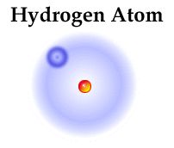
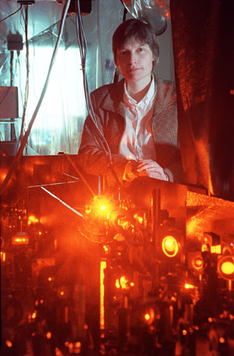
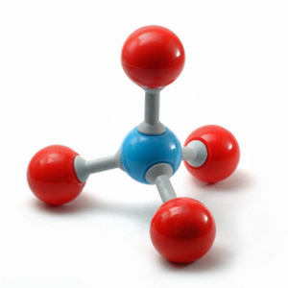
Quantum bound states
The dawn of modern quantum mechanics
Stopping light
Methane Molecule

Slide 3
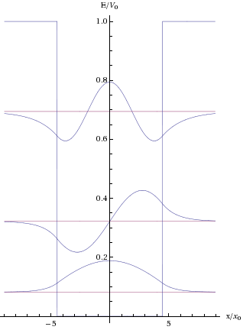
When do bound states form?
When do bound states form?
Consider 1D finite square well potential
Ground state solution for ANY strength
Excited state solution REQUIRES finite strength
Attractive potential of ANY strength produces bound state in 1D. Finite strength required in 3D
1D and 3D are very similar
2D is very different! More later

Slide 4



Low-energy and universality
Consider bound states that have very low energy
This means a very extended state
The wave function is mostly in the classically forbidden region
A two-body example in 3D:
Relative wave function:
The scattering length, a, can be very different from r₀

Slide 5



Scattering length
Asymptotic scattering
Low energy bound state
Low energy bound states and low energy scattering dynamics are intimately connected

Slide 6
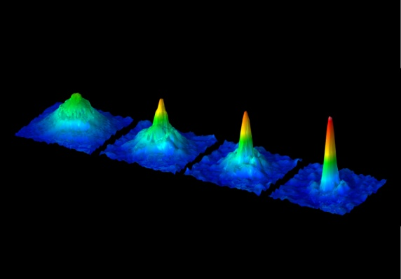
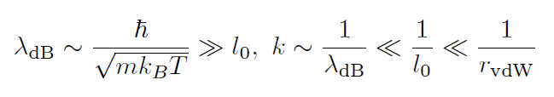
Low-energy and universality
Cold atomic gases
Extremely cold, T~10-100nK
Extremely dilute, n~10¹²⁻¹⁵ cm⁻³
⁸⁷Rb Rempe group, MPQ
Low-energy (elastic) scattering dominates, controlled by a!
Expect that physics is independent of short-range details – it should be universal

Slide 7
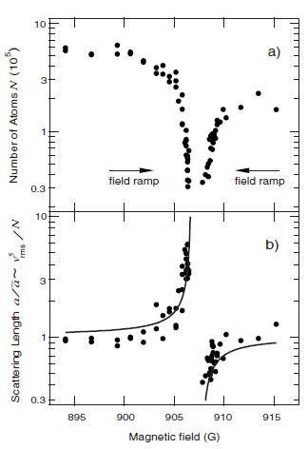
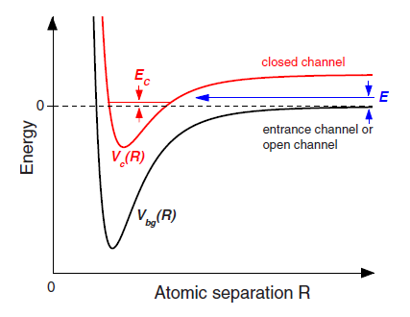
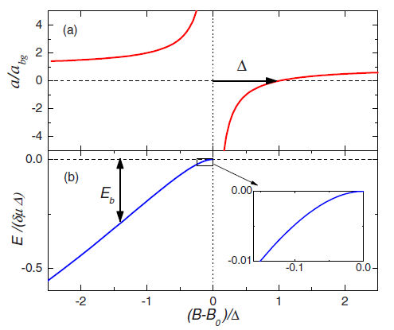
A neat feature
S. Inouye et al., Nature 392, 151 (1998)
Interactions are tunable!
Feshbach resonance
C. Chin et al., RMP 82, 1225 (2010)

Slide 8
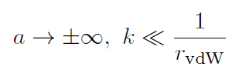

Universality
Tune onto the resonance itself where scattering length diverges but collision energy is still low
Anything I calculate in this limit cannot depend on scattering length!
An example is a Fermi gas
The regime of diverging a is called the universal regime
We can study strongly-interacting systems!

Slide 9
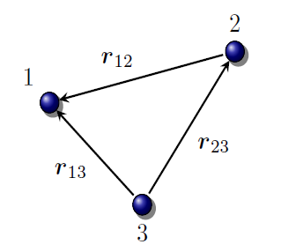
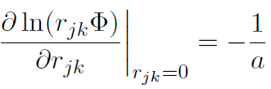



Universal three-body states
Zero-range model
Exact radial solution when a diverges
Log-periodic behavior! This is the Efimov effect!
M. Thøgersen, arXiv:0908.0852v1

Slide 10
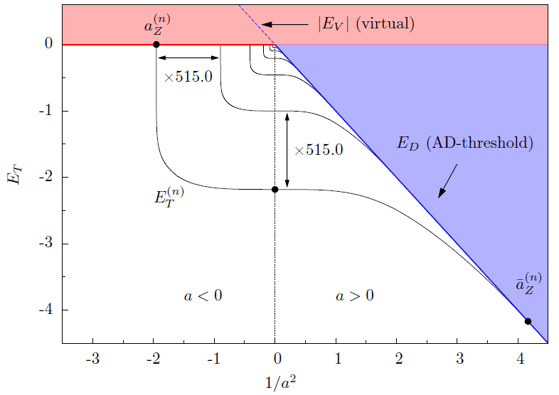
Universal three-body states
M. Thøgersen, arXiv:0908.0852v1

Slide 11
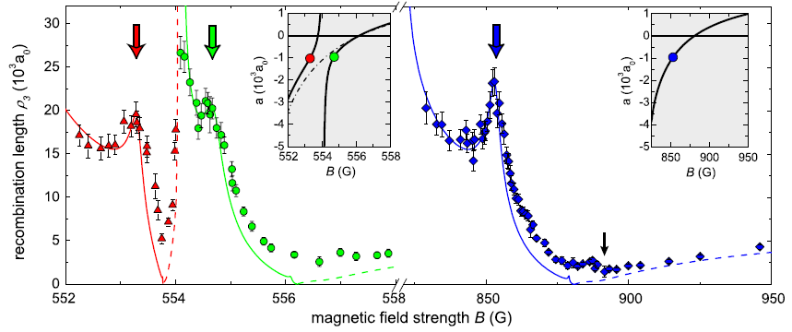
Universal three-body physics
Observations of a₋ in ¹³³Cs at different resonances
M. Berninger et al., PRL 107, 120401 (2011)

Slide 12
Bound states and background
Bound states are rarely alone in the world when we probe them
Separation of scales usually comes to the rescue
Cold atomic three-body results are largely consistent with no background effect
HOWEVER: Background density has energy scale that is slightly smaller than binding energy. Effects should be addressable in current experiments!
Important lesson: Cooper pair problem
No bound states in vacuum, but bound states with Fermi sea background!
How do we generalize the Cooper problem to three-body states?
N.G. Nygaard and N.T. Zinner, arXiv:1110:5854

Slide 13
Background Effects?
External confinement
Non-universality
Finite temperature
Quantum degeneracy
Condensed Bose or degenerate Fermi systems

Slide 14
Reductionism
Consider a single Fermi sea and two other particles
Pauli principle is simpler to handle in momentum space
Turns out the two-body physics is the same as for the Cooper pair problem
Born-Oppenheimer limit and analytics – MacNeill and Zhou PRL 106, 145301 (2011).
N.G. Nygaard and N.T. Zinner, arXiv:1110:5854

Slide 15
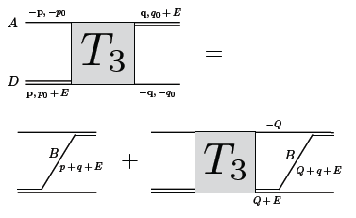

Three-body problem
Momentum-space three-body equations
Skornyakov and Ter-Martirosian, Zh.Eksp. Teor. Fiz. 31, 775 (1956).
Bound states:
Needs regularization! Use method of Danilov, Zh.Eksp. Teor. Fiz. 40, 498 (1961). Nice recent discuss by Pricoupenko, Phys. Rev. A 82, 043633 (2010)

Slide 16


Implementing many-body
A top-down scheme
Use momentum-space equations and dress the propagators in a hierarchical manner
Dimer propagator
Vacuum
D(q,E)
Include single Fermi sea:
N.G. Nygaard and N.T. Zinner, arXiv:1110:5854

Slide 17
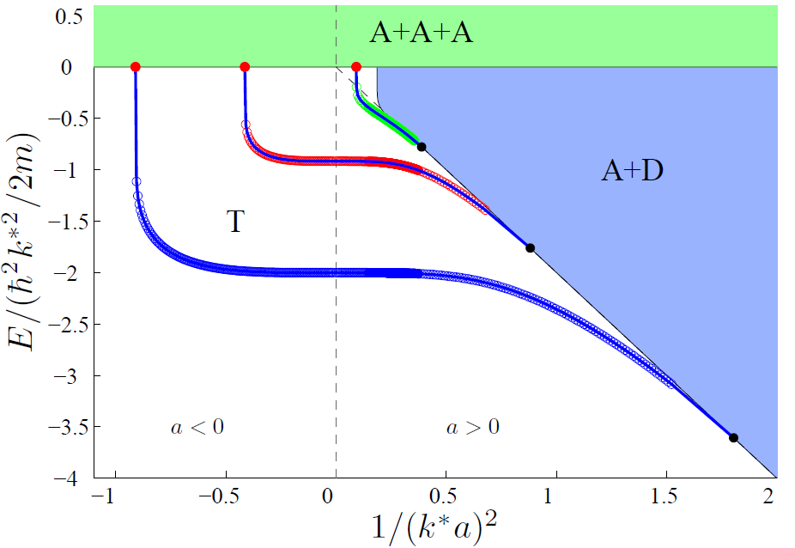
Increasing k_{F}
N.G. Nygaard and N.T. Zinner, arXiv:1110:5854

Slide 18
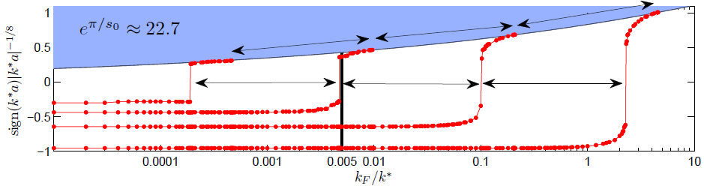
Scaling in a background
We find many-body Efimov scaling!
Efimov scaling
N.G. Nygaard and N.T. Zinner, arXiv:1110:5854

Slide 19
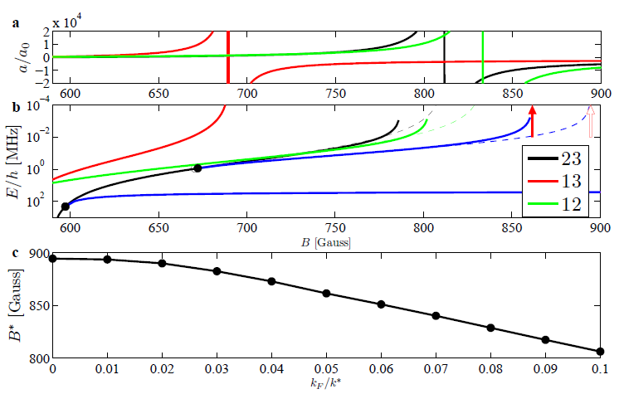
Real three fermion systems
Experimentally realized three-component Fermi gas with three-body states. T. Lompe et al. Science 330, 940 (2010)
N.G. Nygaard and N.T. Zinner, arXiv:1110:5854

Slide 20
Outlook
More Fermi seas will not change the results qualitatively
Niemann and Hammer Phys. Rev. A 86, 013628 (2012).
Fluctuations are an important outstanding question!
Scattering states and recombination in a Fermi sea
Mixed systems of bosonic and fermionic atoms
Can many-body effects provide a three-body parameter? Can it be universal?

Slide 21
Observability?
Densities have been too small or measurements have not been around the second trimer threshold point.
Trimer moves outside threshold regime D’Incao et al. PRL 93, 123201 (2004).
Perhaps not a problem Wang and Esry New. J. Phys. 13, 035025 (2011).
Dimer regime is harder since lowest Efimov state has large binding energy.

Slide 22

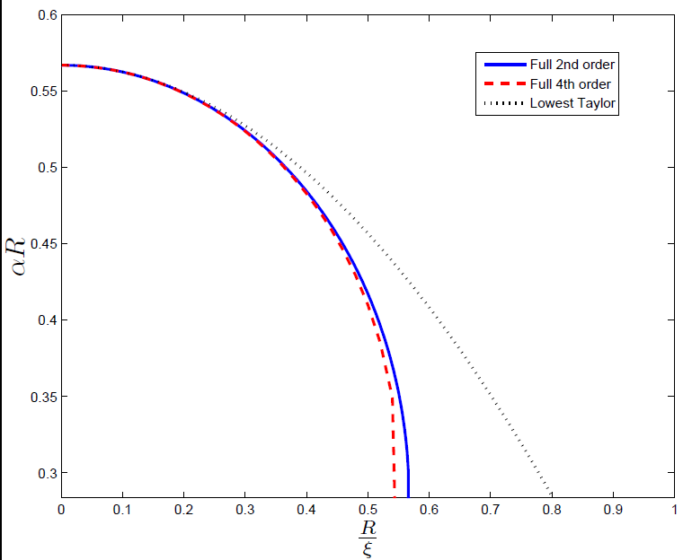

Trimers in Condensates
Impurities
Born-Oppenheimer potential with no condensate
R
BEC
Two impurities in BEC of light bosons – BEC is weakly interacting – ξ is large
Born-Oppenheimer result is strongly modified by presence of condensate
NTZ,
NTZ, EPL 101 (2013) 60009

Slide 23
Three angles of approach
Characterize low-energy bound states in different geometries, dimensionalities, and with both short- and long-range interactions.
Apply many-body effects in either a top-down or a bottom-up fashion.
Merge findings to improve formalism that accounts for both many- and few-body correlations in a general setting.

Slide 24
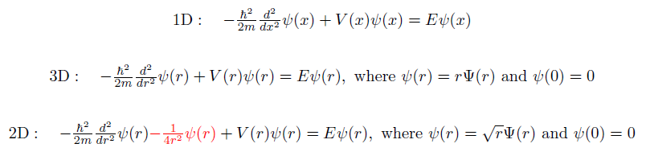
Characterization
Peculiarities of 2D systems
Schrödinger equation(s)
Fall to the center - L. H. Thomas, Phys. Rev. 47, 903 (1935).
Infinitesimal attraction binds the system!

Slide 25
Messing with 2D quantum gases
2D quantum gases typically always hold a two-body bound state which is important for many-body physics
Study the system by a maximal disturbance
Get rid of the two-body bound state!
Hard to achieve with normal non-polar atoms but possible with polar molecules!

Slide 26
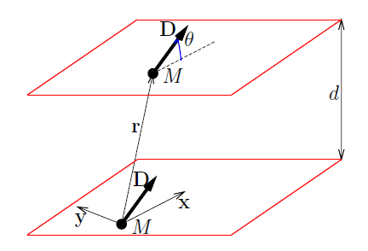

Polar molecules in 2D layers
Interaction is long-range and anisotropic for general ϑ
External electric field aligns the molecules
Peculiar property of the potential:
Two-body bound state exists for any dipole moment!
J.R. Armstrong et al., EPL 91, 16001 (2010)
A.G. Volosniev et al., PRL 106, 250401 (2011)
A.G. Volosniev et al., J. Phys. B 44, 125301 (2011)

Slide 27
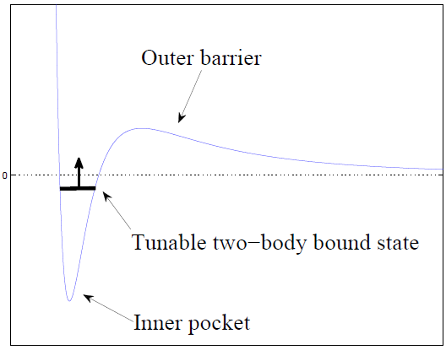
External field manipulation
Use external DC and AC fields to tune dipole-dipole potential
S.-J. Huang et al., PRA 85, 055601 (2012)

Slide 28

New ground state of 2D gas
Assume no two-body bound state
For three bosonic polar molecules there will be a bound three-body state
A Borromean system!
Two-component fermionic molecules are more complicated due to the Pauli principle
The many-body physics should be controlled by the three-body bound state. A trion quantum gas!
H. Lee, A.G. Volosniev et al.

Slide 29
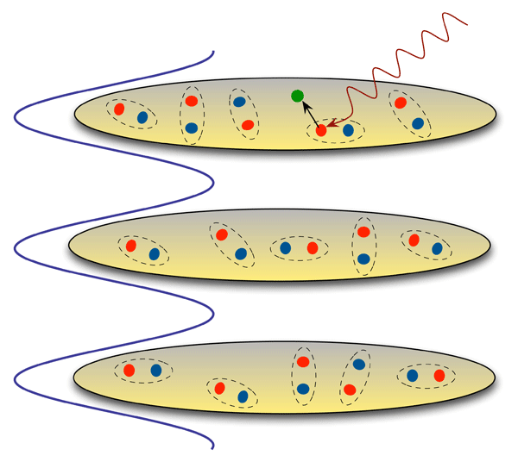
Dimensional crossover
2D length scale; µm
3D interaction scale; nm
2D kinematics but 3D correlations???
Typical experimental setup in Cambridge, JILA, MIT, Paris etc.
What about three-body?

Slide 30
Condensed-matter applications
Multi-band superconductors
Surfaces and wires – low-dimensional bound state problems
Excitons and polarons
Trion states – carbon nanotubes
Surface states on non-trivial insulators

Slide 31
Collaborators
AU
Aksel Jensen
Dmitri Fedorov
Peder Sørensen*
Artem Volosniev*
Oleksandr Marchukov*
Jeremy Armstrong
Georg Bruun
Jens Kusk*
Jan Arlt
Jakob Sherson
Taiwan
Daw-Wei Wang
Sheng-Jie Huang*
Hao Lee*
Caltech
David Pekker
Chalmers
Christian Forssén
Jimmy Rotureau
Harvard
Eugene Demler
Bernard Wunsch
Ville Pietila
Thank you for your attention
Notes:
Consider putting Erez Berg, Cem Özen, Lars Fritz, Matthias Rosenkranz, Antionio Garcia-Garcia or others

