Slide 1



The 22nd European Conference on Few-Body Problems in Physics.
Multiquark systems from a quark model perspective
J. Vijande

Slide 2

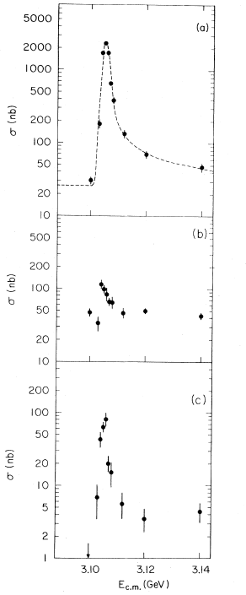
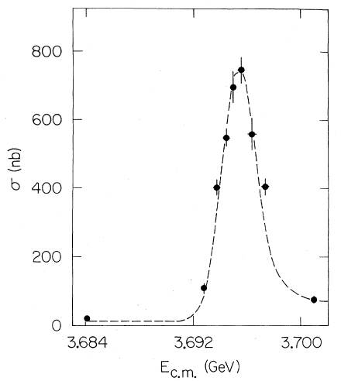
The november revolution: 1974
M = 3.105 GeV
Γ < 1.3 MeV
BNL
SLAC
M = 3.695 GeV
Γ = 2.7 MeV
M = 3.1 GeV
Γ ∼ 0 MeV
SLAC

Slide 3
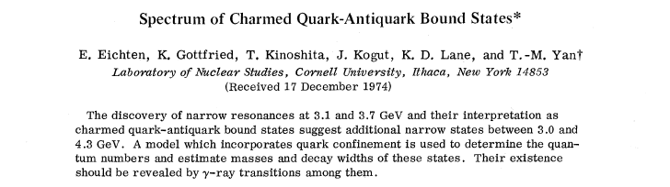
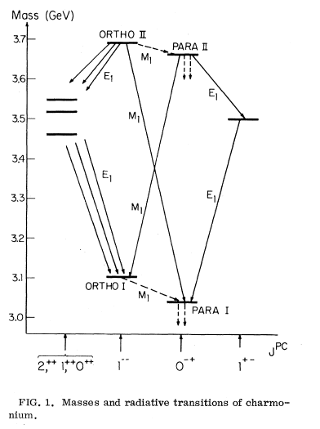
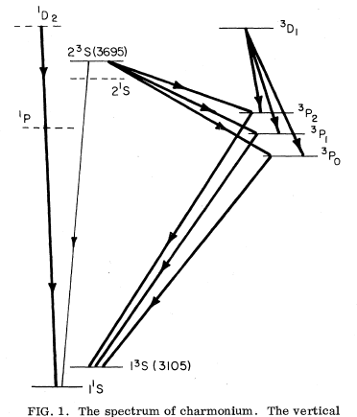

Slide 4
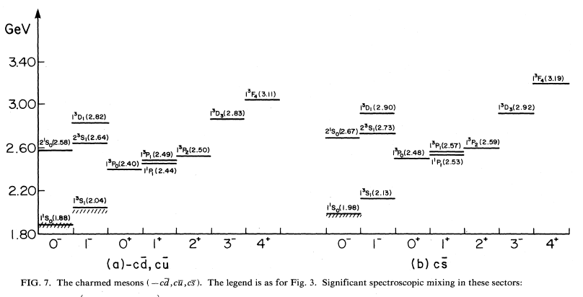
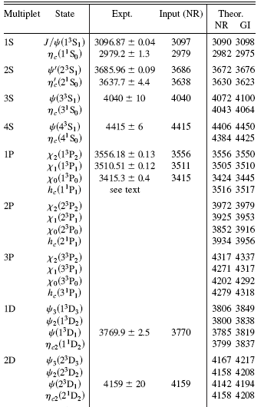
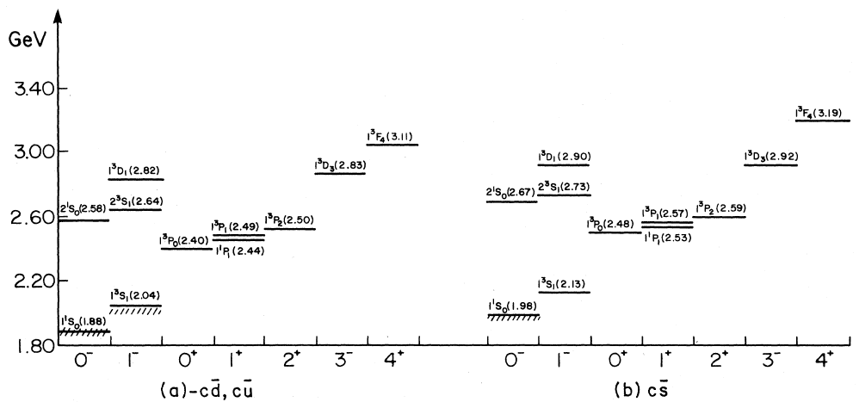
A quiet period: 1974-2003
T. Barnes et al., Phys. Rev. D72, 054026 (2005)
S. Godfrey and N. Isgur,
Phys. Rev. D32, 189 (1985)

Slide 5
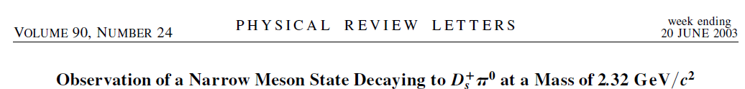
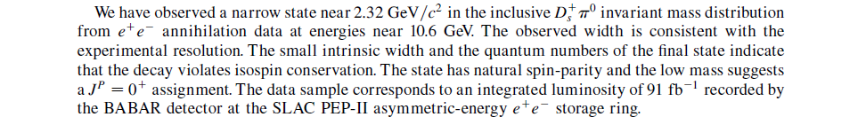
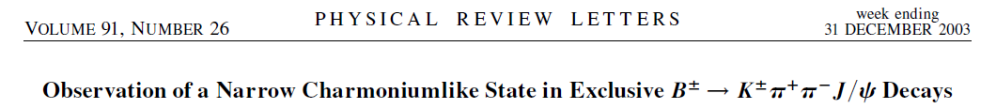
The beginning of a new era: 2003
X(3872)
Γ<2.3 MeV
D_{s0}*(2317), J^{P}=0⁺, Γ<3.8 MeV
D_{s1}(2460), J^{P}=1⁺, Γ < 3.5 MeV

Slide 6
Y(4660)
X(3940)
D₀(2308)
Y(3940)
X(4260)
Z(3930)
D_{sJ}(2317)
D_{sJ}(2460)
X(3872)
X(4160)
Z(4430)
D_{sJ}(2860)
D_{sJ}(2700)
D_{sJ}(3040)
Z₁(4040)
Y(4350)
Z₂(4240)
X(4008)
Etc...
May you live in interesting times
How to proceed?

Slide 7
Naive Quark Model

Slide 8
Solving the Schrödinger equation for a 4q system: VM and HH
ccnn
3
cncn
3
1
1
η₁
η₃
η₁
η₃
η₂
–
–
η₂
4
4
2
L=0 S=1 I=0 ccnn
2
1,2 → c
3,4 → n
1,2 → c
3,4 → n
HH
VM
E
RMS
E
RMS
3860.6
0.367
3861.4
0.363
Hyperspherical Harmonics: Radial part is expanded into HH functions, hyperangular part, (up to a K_{max} value) and a sum of Laguerre functions, hyperradial part.
Variational method: Radial part is expanded into generalized gaussians. Each generalized gaussian contains an infinite number of relative angular momentum, L=0 and positive parity
Pauli principle must be imposed.
Phys. Rev. D 79, 074010 (2009).
C-parity is a good symmetry.

Slide 9
System: ccnn. Model: BCN
4q energies
Energías del sistema 4q
M₁M₂ threshold
There are no non-exotic deeply four-quark bound states (compact)
J.V., et al., Phys. Rev. D76, 094022 (2007)

Slide 10
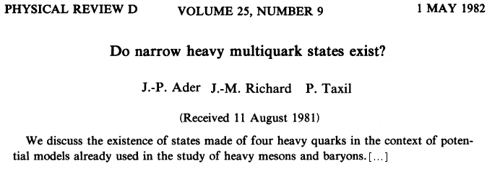
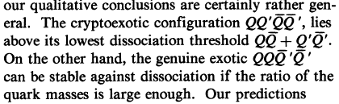
The gift from nature to hadronic physicists
!!
These states cannot camouflage themselves in the mesonic jungle

Slide 11
System: cncn. Model: CQC
4600
4q energies
M₁M₂ threshold
4500
4400
)
4300
One compact state in the ccnn system (J^{P}=1⁺)
V
e
M
4200
(
J.V., A.V., N.B., Phys. Rev. D79, 074010 (2009)
E
4100
4000
3900
3800
0
1
2
−
−
−
−
−
−
+
+
+
0
1
2
0
1
2
0
1
2
+
+
+
(
2
8
)
(
2
4
)
(
3
0
)
(
2
1
)
(
2
1
)
(
2
1
)
(
2
8
)
(
2
4
)
(
3
0
)
(
2
1
)
(
2
1
)
(
2
1
)
I
=
0
I
=
1

Slide 12
ccnn
3
1
x
y
z
4
2
1,2 → c
3,4 → n
Unbound.
Bound.

Slide 13
No compact bound states in the ccnn and bbnn sectors.
One compact bound state in the ccnn sector and four/three in the bbnn sector.

Slide 14
What about the existence of slighty bound states very close to the threshold?

Slide 15
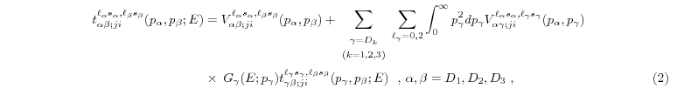
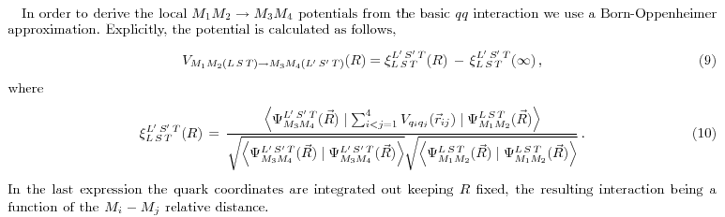
Molecular states, how to look for them?
We solved the scattering of two-meson systems in a coupled-channel approach by means of the Lippmann-Schwinger equation, looking for attractive channels.
(I)
(II)
The meson-meson interacting potential is obtained from the same quark-quark interaction used in the HH and VM methods, by means of the adiabatic approximation.
D
D
D
D
We study the consequences of allowing for the reordering of quarks (I) or not (II).
n
c
n
c
DD ↔ D*D*

Slide 16
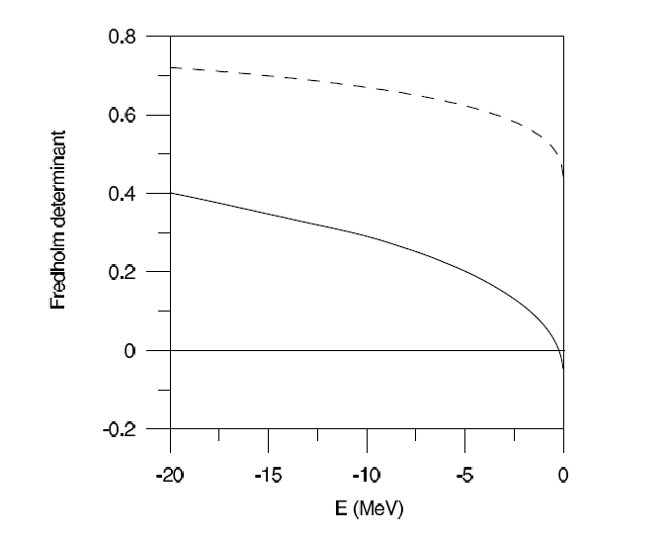
Hidden flavor sector: Charmonium
(I) DD*
(II) DD* – J/Ψ ω
T. F.-C., A.V., J.V., Phys. Rev. Lett. 103, 222001 (2009)
J^{PC}(I)=1⁺⁺(0)
X(3872)
There are no charged partners of the X(3872) [diquark-antidiquark]

Slide 17
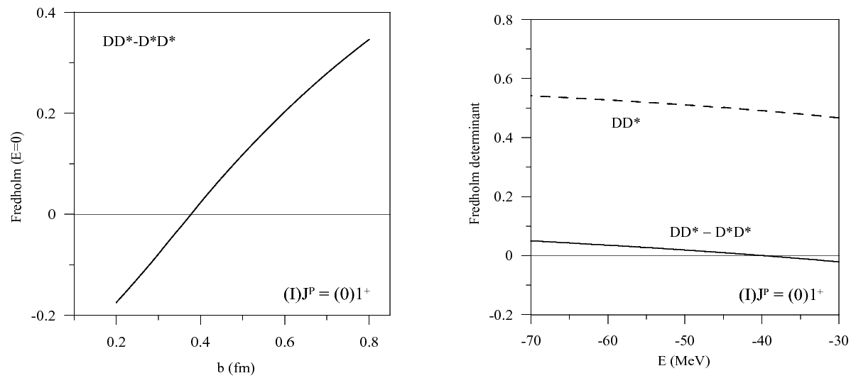
T. F. Caramés et al., Phys. Lett. B. 699, 291 (2011)
(I) J^{P} = (0) 1⁺
Four-quark states
II
I
Meson-Meson
P_{DD}
P_{DD*}
P_{D*D*}
Formalisms based on meson-meson and four-quark configurations are fully compatible if they incorporate all the relevants basis vectors (channels)!

Slide 18
There should not be a partner of the X(3872) in the bottom sector
Hidden flavor
T.F.C., A.V., J.V., Phys. Lett. B 709, 358 (2012)
There should be a J^{P}=1⁺ bound state in the exotic bottom sector
Explicit flavor
Charm
Bottom

Slide 19
Implementing confinement
Mesons: Including the flux tube.
Baryons: two-body Vs. Many-body
a
x
a
x
x
J
a

Slide 20
Tetraquarks: One step further.
1
3
2
4
k
l
Notes:
Numerar

Slide 21
The Steiner piece is negligible, less than 1 % contribution, as compared to the Flip – Flop interaction
The ground state energy of a system containing identical quarks and antiquarks is found below threshold.
For Flavor-exotic binding increases with the mass ratio.
For non-exotic states the effect is opposite.
more stable than
becomes unstable for

Slide 22
The Steiner piece is negligible, less than 1 % contribution, as compared to the Flip – Flop interaction
The ground state energy of a system containing identical quarks and antiquarks is found below threshold.
For Flavor-exotic binding increases with the
mass ratio.
For non-exotic states the effect is opposite.
Improvements
The effect of statistics is neglected → gluon degrees of freedom are integrated out.
Therefore, the color structure is not included.
Long range forces between color singlet are not discussed.
Spin dependent terms are not taken into account.
PRD76, 114013 (2007)

Slide 23
Pentaquarks: increasing difficulties
k
l
m
l
j
k
m

Slide 24
Models based on two-body color-additive interactions offer no bound states.
The Steiner piece is once more negligible.
Systems made of identical quarks and antiquarks, are found to be below the dissociation threshold when many-body configurations are considered.
Systems containing an infinitely massive quark(antiquark) are also bound
Improvements
Completely symmetric S-wave function has been considered. Therefore, no statistics is taken into account.
Realistic heavy quark masses should be analyzed, paying special attention to the charm and bottom sectors, including spin-spin forces.
Doubly-heavy systems should be addressed.
J-M. Richard. PRC81, 015205 (2010)

Slide 25
Hexaquarks: reaching the limit

Slide 27
Improvements
Based on the previous results Steiner-tree diagrams are not considered.
Antisymmetrization and color structure is once more neglected
Annihilation is not considered.
Q³q³ is found to be stable upto values M/m ~ 8 – 10, an intermediate region between the charm and bottom sectors.
For baryonium, the lowest threshold corresponds to a 4q-2q configuration. However, for larger values of M/m no multiquark configuration can compete with the compact Q³ and systems become unstable with respect to the heavy baryon-light antibaryon threshold.
PRD85, 014019 (2012)

Slide 28
Going beyond the adiabatic aproximation.

Slide 29
Beyond the adiabatic limit
PRD87, 034040 (2013)

Slide 30
Summary
  Constituent quark models are an important tool to study heavy hadron spectroscopy, however, like all powerfull tools have to be handled carefully.
  Hidden flavor components, unquenching the quark model beyond the “naive” approximation, seem to be neccessary to tame the bewildering landscape of hadrons, but an amazing folklore is borning around.
  Compact four-quark bound states with non-exotic quantum numbers are hard to justify while “many-body (medium)” effects do not enter the game.
  Exotic many-quark systems should exist if our understanding of the dynamics does not hide some information. I hope experimentalists can answer this question to help in the advance of hadron spectroscopy.
  The role of antisymmetrization and understanding the adiabatic aproximation for confinement is very important to prevent a proliferation of multiquarks.

Slide 31
Acknowledgements
Let me thank the people I collaborated with in the different subjects I covered in this talk
A. Valcarce (Univ. Salamanca, Spain) T. F. Caramés (Univ. Salamanca, Spain) N. Barnea (Hebrew Univ. Jerusalem, Israel) E. Weissman (Hebrew Univ. Jerusalem, Israel) | J.M. Richard (Grenoble, France) F. Fernández (Univ. Salamanca, Spain) H. Garcilazo (IPN, Méjico) B. Silvestre-Brac (Grenoble, France)
Thanks!

