Slide 1
Few-body aspects
of near threshold meson production
Paweł Moskal
Jagiellonian University, Cracow, Poland
EFB22
The 22nd European Conference on Few-Body Problems
in Physics, Cracow, Poland, 9-13 September 2013
Notes:
I guess at least one of the wishes of organizers was to challange You to extend the research
from few nucleon systems to nucleons+meson systems… therefore….

Slide 2
Few-body aspects
of near threshold meson production
Paweł Moskal
Jagiellonian University, Cracow, Poland
EFB22
The 22nd European Conference on Few-Body Problems
in Physics, Cracow, Poland, 9-13 September 2013
Notes:
I guess at least one of the wishes of organizers was to challange You to extend the research
from few nucleon systems to nucleons+meson systems… therefore….

Slide 3
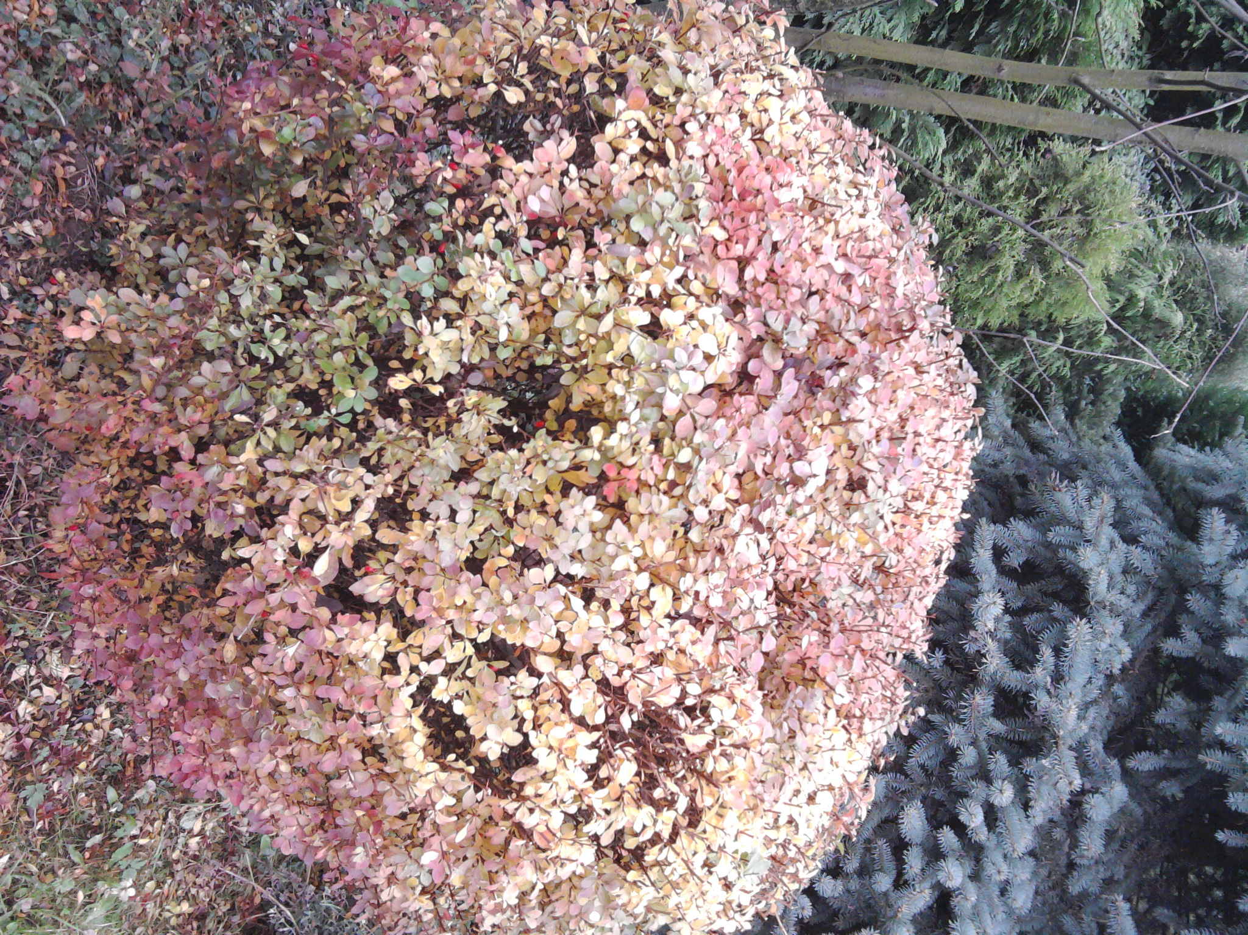

NNM NNNM NNNNM
φ
η
π
p
R. Pohl and others, The size of the proton, Nature 466, 213 (2010)
Transition Form-Factors: J. Zdebik PhD JU (2013); M.Hodana PhD JU (2012)
I thought… the scientific theories were not the digest of observation,
but that they were inventions-conjectures boldly put forward for trial
to be eliminated if they clashed with observation …
David Hume
Notes:
Very nice systematics !!!
Opowiedziec co jest na rysunku
Oprócz implikacji szumnych do badania granic stosowalnosci modelu SM
Możemy się też nauczyć bardzo łatwo uchwytnych i przyjemnych własciwości
Takich na przykład, że proton jest większy od pionu a pion od mezonu eta.
Let me make you familiar with the properties of mesons. Size ☺
Something which is nice to remember, a shape a size….
Rp = 0.84184 ± 0.00067 fm
Rpi=0.74+-0.03 fm [69]
Reta= 0.68+-0.02 fm
< r2φ>1/2= 0.56±0.05 fm
Sprawdzic czy KULKI SA W DOBREJ SKALI…
Also in the case of a proton, the recently obtained result by Pohl et al. [71],
< r2P >1/2= 0.84184 ± 0.00067 fm
[71] R. Pohl and others, The size of the proton, Nature 466, 213 (2010)
[69]A. Liesenfeld and others, A measurement of the axial form-factor of
the nucleon by the p(e,e’ pi+)n reaction at W = 1125-MeV, Phys.
Lett. B468, 20 (1999)

Slide 4
production of mesons at threshold
experimental aspects
production dynamics
hadronic interaction
mesic-nuclei ?
Borromean-states?
Homework
Notes:
contributing to the study of the muon
anomalous magnetic moment
Jakos to poskladac do kupy … dlaczego eta SM etc…
Polaczyc z nastepna strona i nawiazac podobnie as two years ago I will repeat since …than to Falsify the theory !!!
With Wasa at COSY we study both production and decays of the eta-meson but Today I will concentrate
of decays which is also a primordial aim of the experiment
In general we search for the phenomena which cannot be describe by the Standard Model…

Slide 5
EXPERIMENTAL FACILITIES
IUCF
SATURNE
CELSIUS
COSY
MAMI
ELSA
J-PARC
JINR
Notes:
So there is no chance to talk about all the research conducted …. I will naturally talk completely arbirarily
At most on the example of COSY …..and…
JINR / LPI gammy z electron synchrotron

Slide 6
threshold as a spin filter
in the laboratory
P
3 GeV/c
η
P
before reaction:
after reaction:
in the centre of mass system
1 GeV/c
P
η
P
1 GeV/c
L = 1, S = 1
L = 0, l=0
⇒ Reaction parameter b ∼ 0.2 fm
³P₀→¹S₀s
Notes:
Pauli principle and small energy => Ss
etc
Parity of eta = -1 … => L=1….,
Experiment: So in the laboratory they fligh in small cone….small experiments … full 4pi
Threshold: With small relative velocities … large effect expected from interaction….

Slide 7
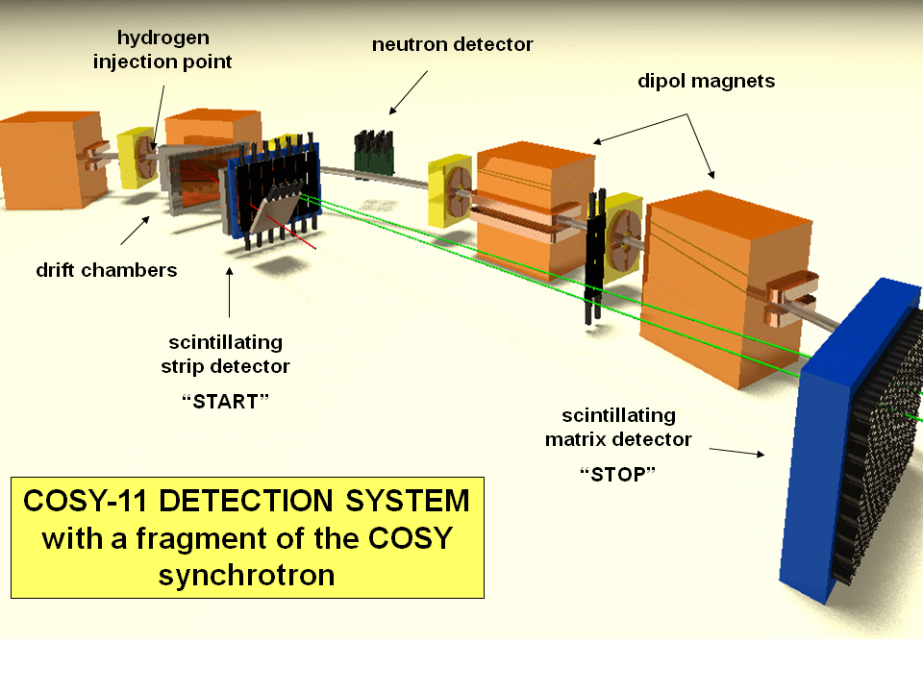
experimental advantages
Notes:
Small detectors cover 4pi…

Slide 8
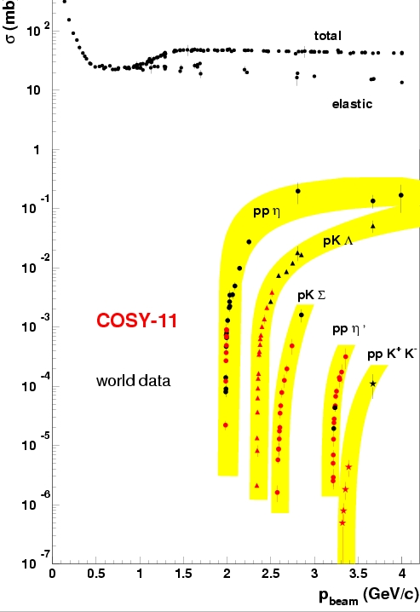
experimental challange !
Notes:
The challange is that the cross sections grows rapidly at threshold (phase spase opens…)
by many orders of magnitudes at few MeV (few tens of MeV)….

Slide 9
OBSERVABLES
Close-to-threshold excitation function:
σ (Q)
dσ ,
dσ , ...
Differential distributions:
dm_{pp}
dΩ
σ = dV_{ps} |M|²
Isospin dependence
Spin observables: A_{Y}
NN →NNM
|M|² ~ |M₀|² |M_{FSI}|²
interaction
dynamics → |M₀|²
interaction → σ (Q)
dynamics
structure
Notes:
Zmienność M0 w zakresie paru MeV jest mała… Duzy transfer pędu, żeby wyprodukowac mezon – 1GeV i zmieniamy go o kilka MeV !!!, stą mamy głownie jedną wartość ….
ale FSI powoduje zmiany…
ZMIENIC KOLORY ETC….

Slide 10
production of mesons at threshold
experimental aspects
production dynamics
hadronic interaction
mesic-nuclei ?
Borromean-states?
Homework

Slide 11
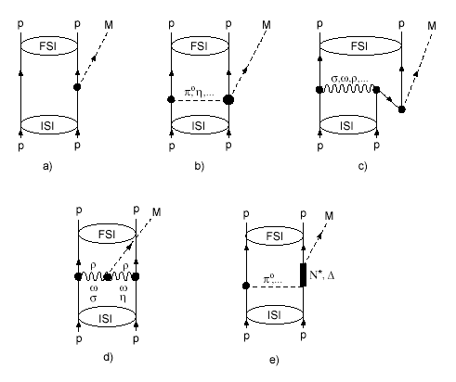
production dynamics e.g. meson η
dynamics → |M₀|²
What would the first experimental physicists tell us?
Salviati. But if, of many computations,
not even two came out in agreement,
what would you think of that?
Simplicio. If that is how the matters stand,
it is truly a serious defect
GALILEO GALILEI
”Dialogue concerning the two chief world systems”
What would the best student
of the Jagellonian University tell us?
He is encouraging us to continue:
For what is determinate
cannot have innumerable explanations
NICOLAUS COPERNICUS
”Minor Works III, Letter against Wagner”
ONE NUMBER and MANY GRAPHS

Slide 12
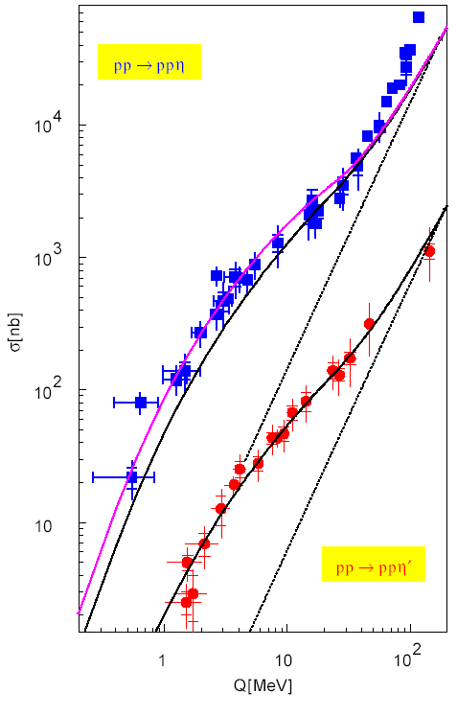
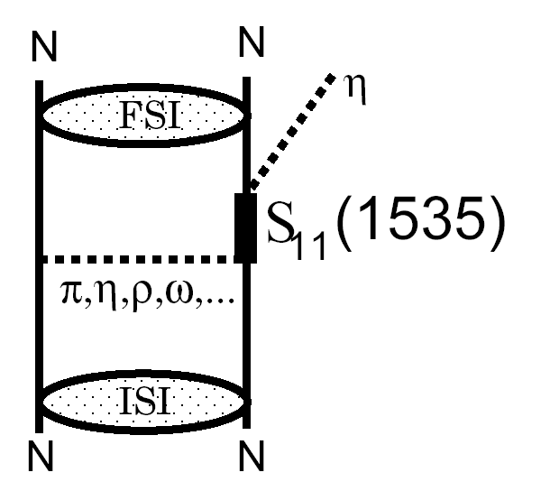
dynamics → |M₀|²
LARGE → RESONANSE
CELSIUS
COSY
SATURNE

Slide 13
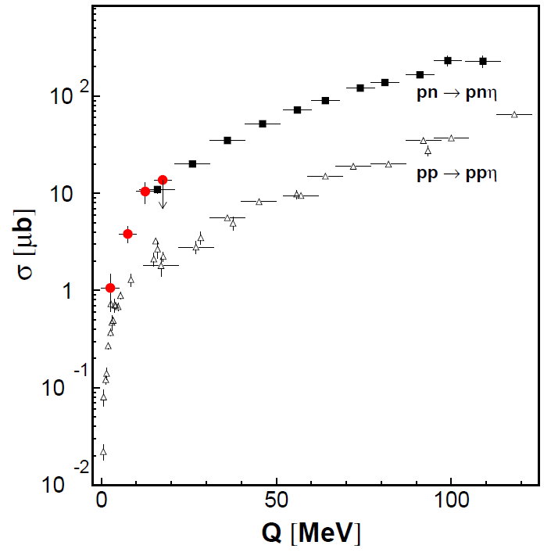
X
X
X
  STRONG ISOSPIN DEPENDENCE
  Eta meson is by factor of 12
  more coupiously produced
  when the total isospin of nucleons
  is equal to 0
  than when it is equal to 1
  Strong evidence of isovector meson
  exchange in production mechanism
CELSIUS
COSY
SATURNE

Slide 14
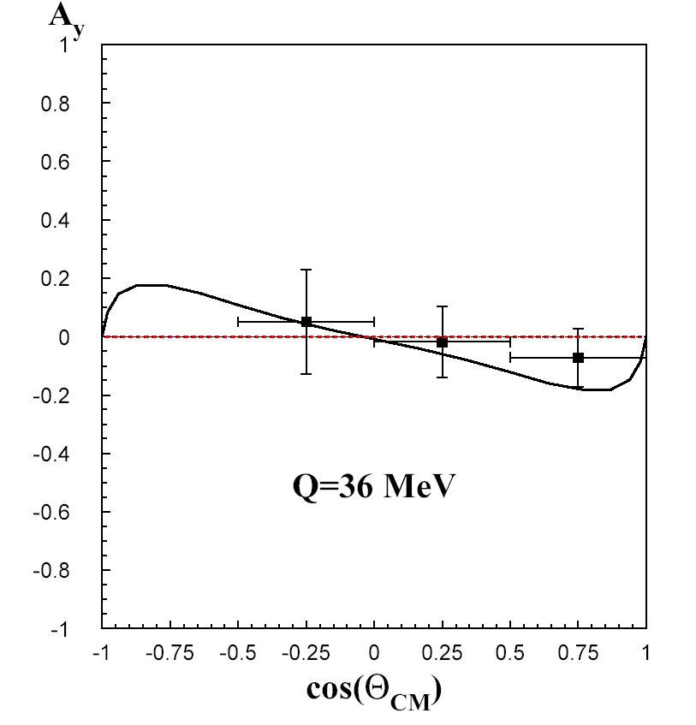
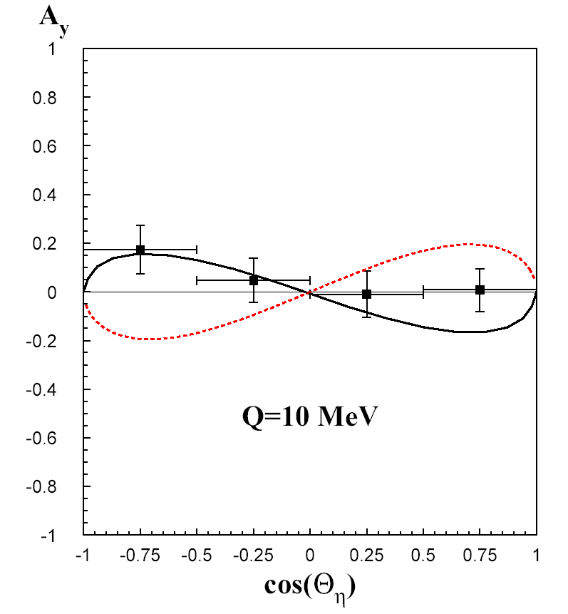
This was PREDICTED already about 2500 years ago
by the very first physicists
Thus, it is suggested that among created beings
there must be some basic agent which will move
things and bring them together
ARISTOTLE
“Metaphysics”
X
X
X
X
π
ρ
COSY-11: R. Czyżykiewicz et al., Phys. Rev. Lett. 98 (2007) 122003
Notes:
ALBO TO TU WSPOMNIEC A WIECEJ PRZY OKAZJI interakcji…
PERSPEKTYWY / WASA / POKAZAC WIDMA POLARYZACJI… !...dla XX %...WYKLAD MH z MAIUS…
ORAZ O FOTOPRODUKCJI
This will be improved by THE WASA-at-COSY collaboartion, I will come to this in few minutes…

Slide 15
production of mesons at threshold
experimental aspects
production dynamics
hadronic interaction
mesic-nuclei ?
Borromean-states?
Homework

Slide 16
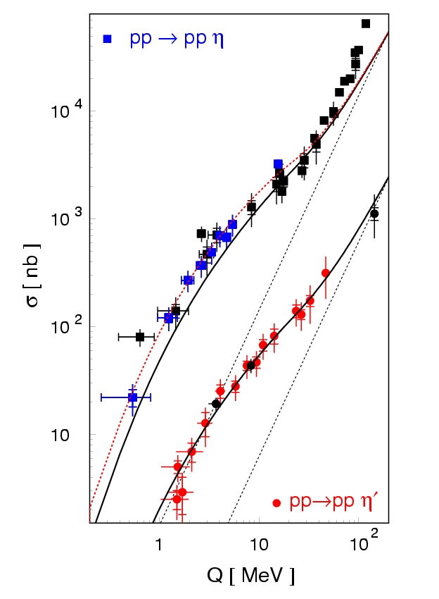
σ = dV_{ps} |M|²
|M|² ~ |M₀|² |M_{FSI}|²
|M_{FSI}|² ~ |M_{pp}|² |M_{p1η}|² |M_{p2η}|²
dynamics → |M₀|²
interaction → σ (Q)
CELSIUS
COSY
SATURNE
Notes:
Please look at this repalsive approximations !!!
This is because you experts on few-body avoid mesons ….
I will come to this later…

Slide 17
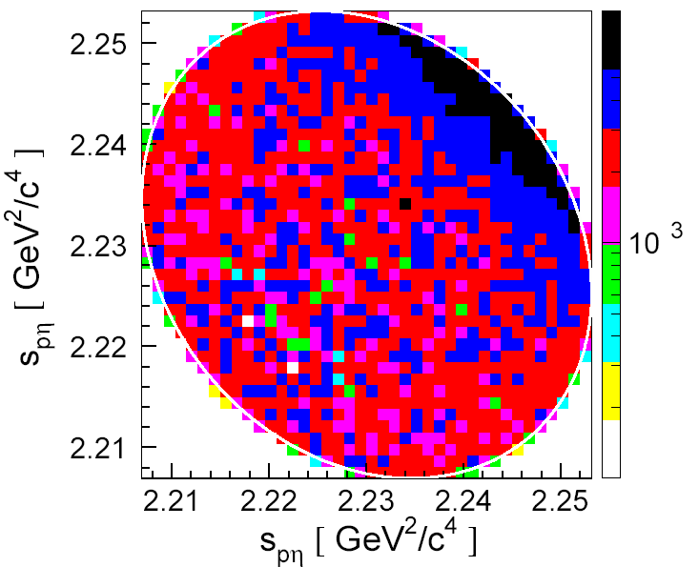
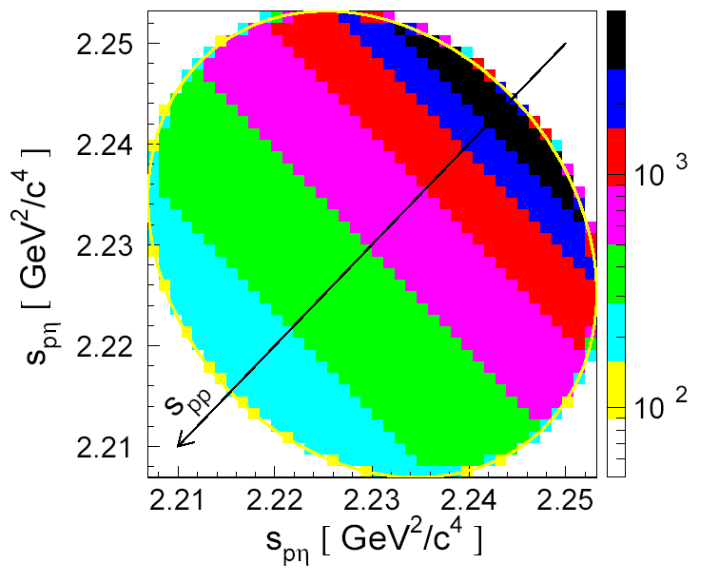
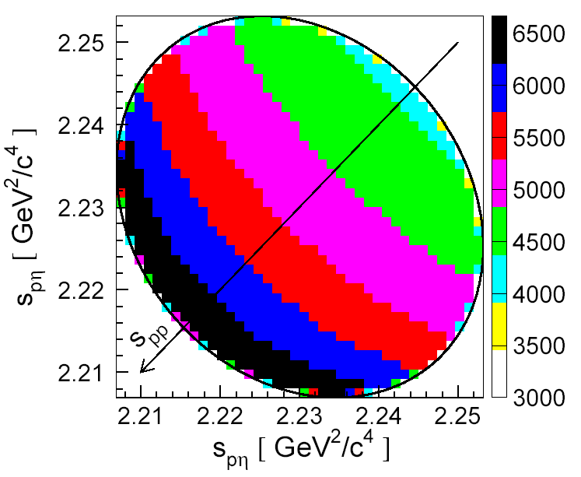
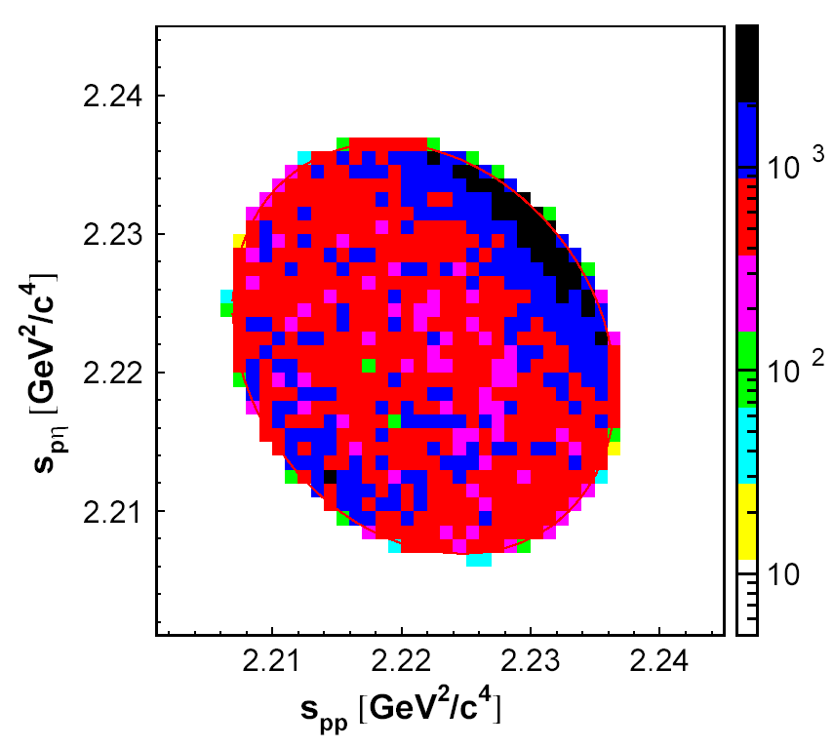
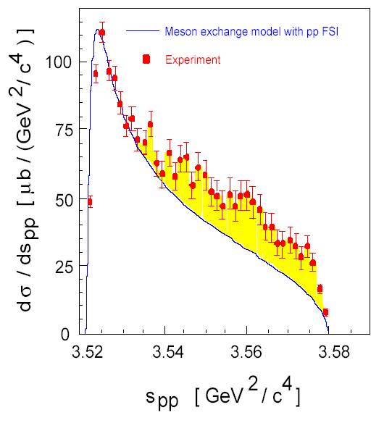
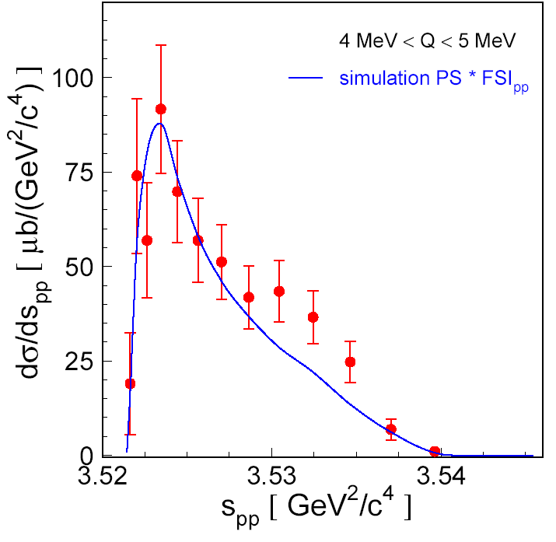
EXPERIMENT Q = 15.5 MeV
SIMULATION
SIMULATION
Phys. Rev. C 69 (2004) 025203
EXPERIMENT Q = 15.5 MeV
EXPERIMENT Q = 10 MeV
EXPERIMENT Q = 4.5 MeV
Notes:
TU DOŁĄCZYC ZE TOF, I NOWY WASA CELSIUS !!!!
ARTYKUŁY KANZO:??
K. Nakayama et al., Phys. Rev. C 68 (2003) 045201 i NOWY….

Slide 18
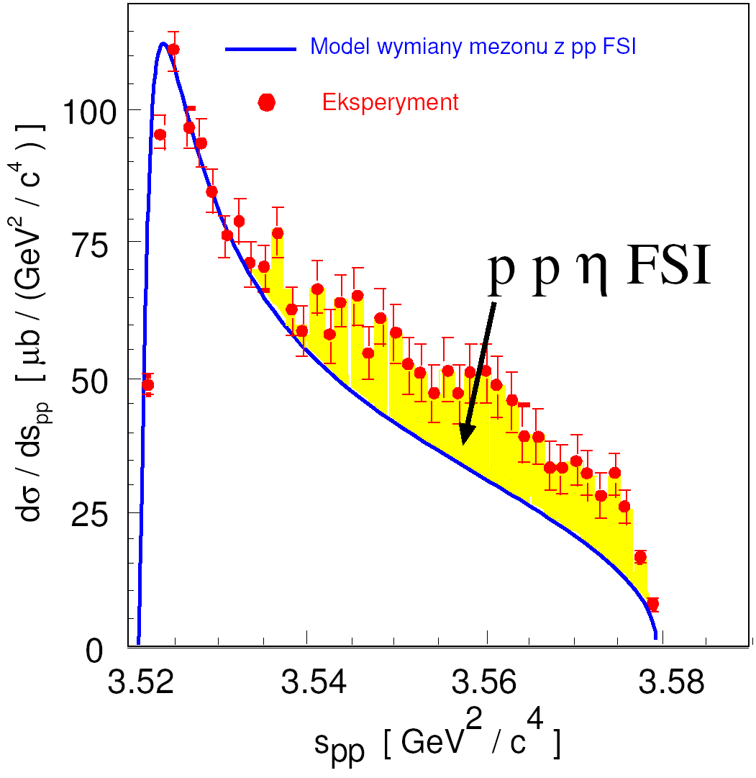
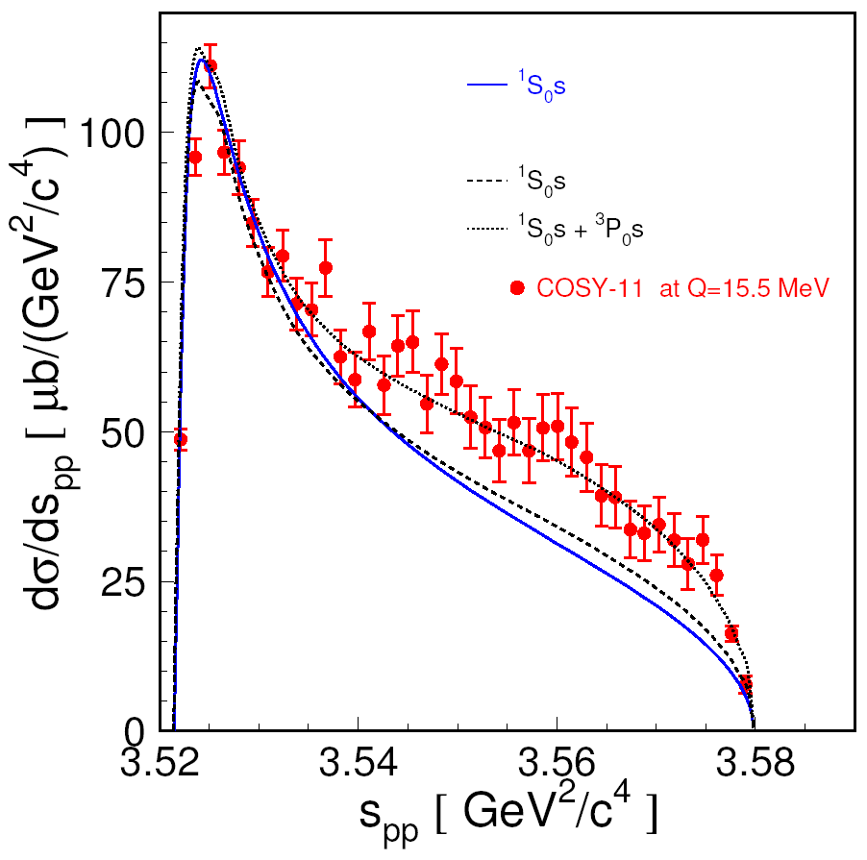
COSY TOF, COSY-11, WASA/CELSIUS
Notes:
FSI or Higher Partial Waves or the M0dependece on spp?

Slide 19
σ = dV_{ps} |M|²
|M|² ~ |M₀|² |M_{FSI}|²
|M_{FSI}|² ~ |M_{pp}|² |M_{p1η}|² |M_{p2η}|²
dynamics → |M₀|²
interaction → σ (Q)
CELSIUS
COSY
SATURNE
Notes:
To popatrzmy jeszcze raz, skoro jest takie wzmocnienie dla ety i tu się nie zgadza, to gdyby to dla ety-prime nie powinno być takiego wzmocnienia ?? Jeśli to oddzialywania??

Slide 20
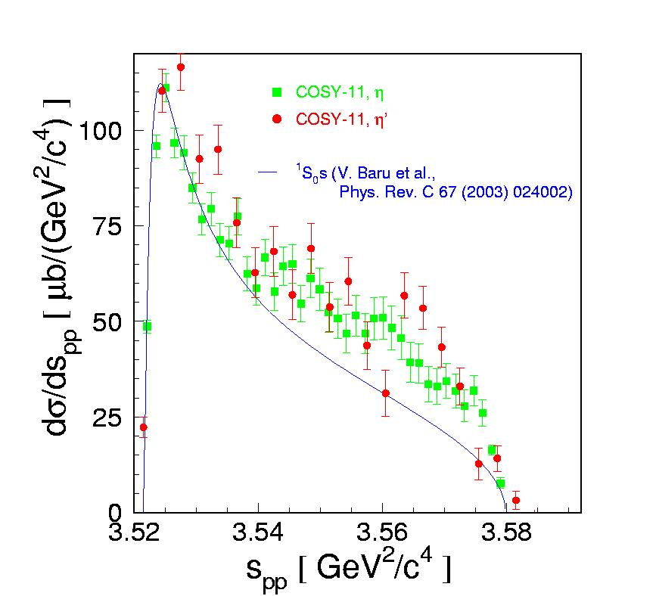
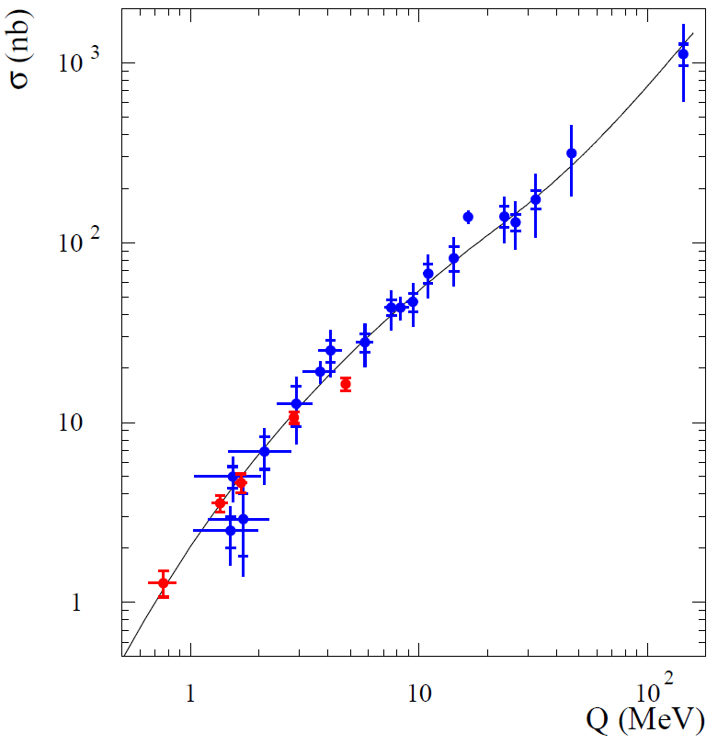
COSY-11 STILL ALIVE
PRELIMINARY
Rysunek 3. Widmo masy niezmienniczej podukładu proton-proton dla układu ppη (zielone punkty) oraz ppη’ (czerwone punkty)
wyznaczone dla energii wzbudzenia wynoszącej 15.5 MeV. W celu umożliwienia porównania kształtu
widm dane dla mezonu η’ zostały unormowane do danych otrzymanych dla mezonu η.
Notes:
To zmierzylismy dla ety-prime gorsza statystyka… ale widac ze się pokrywaja, to w takim razie domierzylismy jeszcze z większa precyzją krzywą wzbudzenia .. Wciąż analizowane ale widac z preliminary
Ze się zgadza….
No to teraz sprawdzamy, czy rzeczywiscie wyzsze fale parcjalne… Do tego potrzebujemy polaryzacje…
WASA-at-COSY is a new world for eta-physics !!!
I REKLAMA WASY 10^9 et i 10^11 mezonów pi0 !!!!

Slide 21
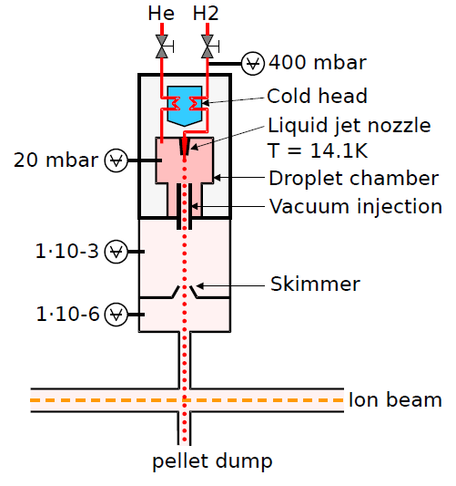
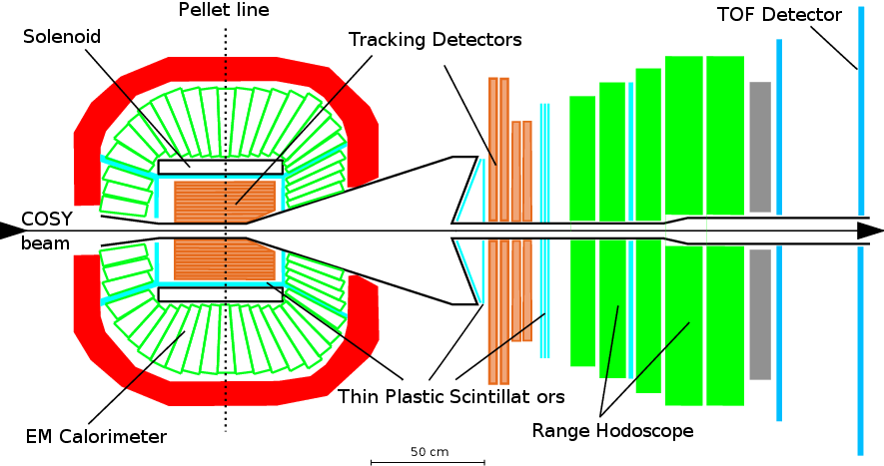
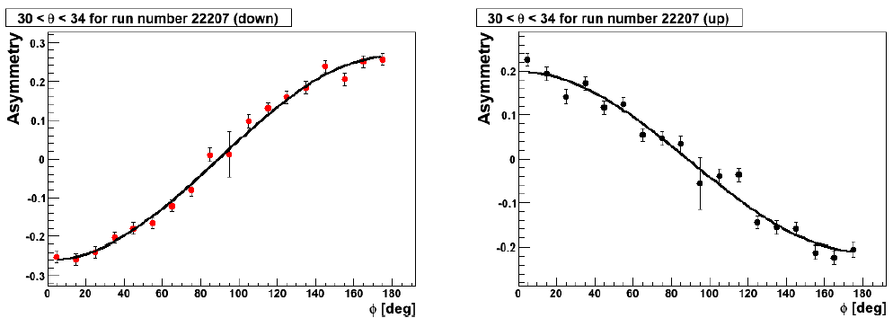
WASA-at-COSY
p p → p p M 10⁹ η and 10¹¹ π⁰ on discs
p p → p p η 10⁶ η mesons on discs
→
Notes:
Tu wpsomniec o Pelletach … ( a może ktos ma szkic albo zdjęcie ..)
TU PRZYDAŁOBY SIĘ WIDMO POKAZUJACE IDENTYFIKACJE …
Magdalena ??
Polaryzacj at Q=15 and at Q=72…

Slide 22
production of mesons at threshold
experimental aspects
production dynamics
hadronic interaction
mesic-nuclei ?
Borromean-states?
Homework

Slide 23
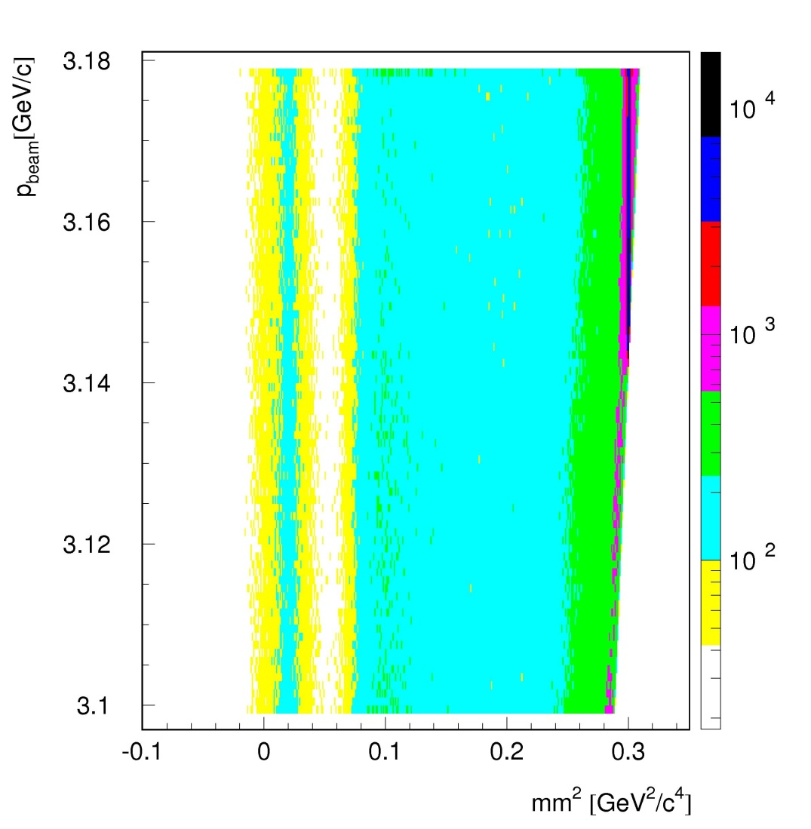
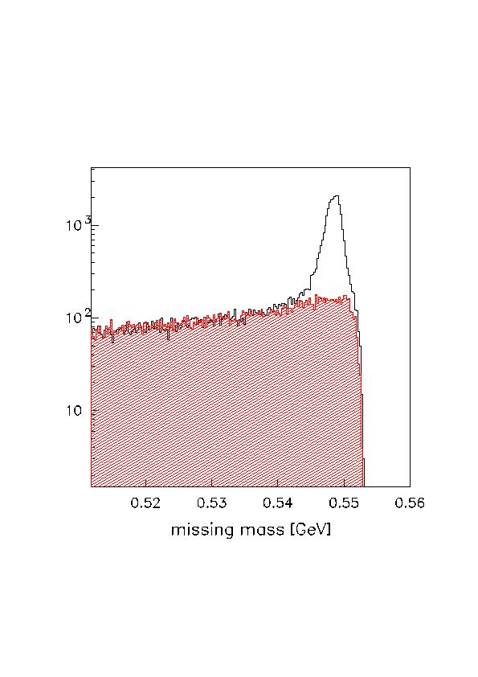
³He η interaction (pd → ³He η)
+
π
η
+
η
Notes:
EG. OF ADVANTAGE OF THE COSY …. BEAM RAMPING …
W TYM OPISIE DOŁOŻYC TAKŻE WIDMA TAKŻE Z FOTOPRODUKCJI …. !!!!!!

Slide 24
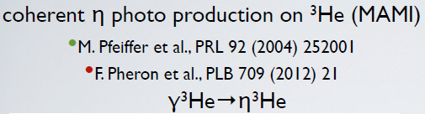
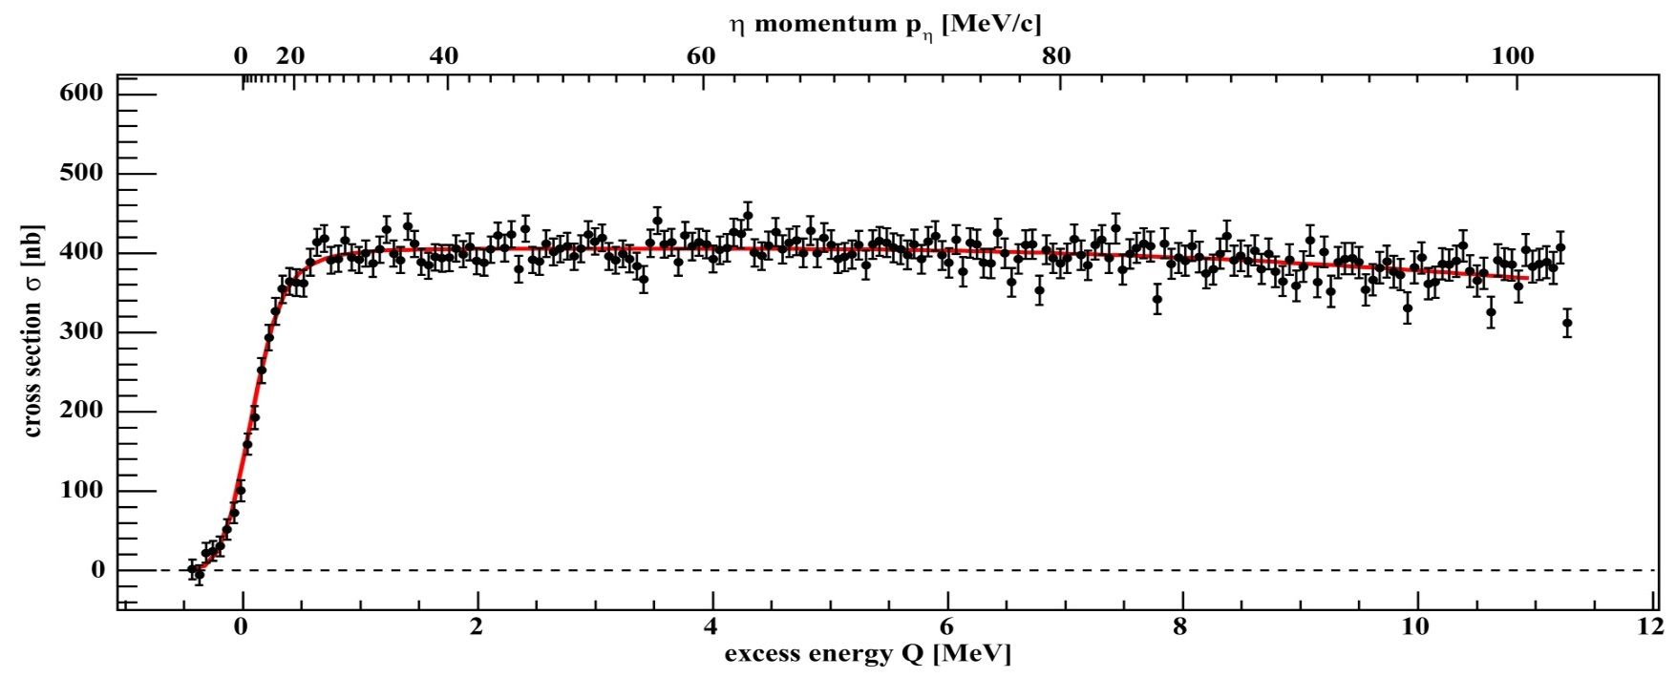
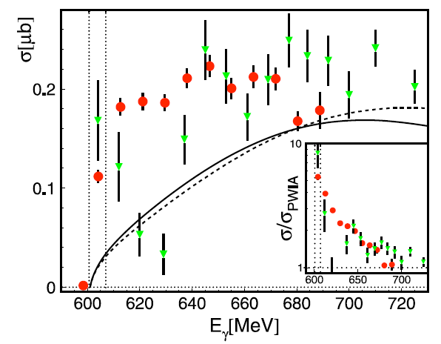
+
η - ³He
+
dp→ ³Heη γ ³He → ³Heη
η
COSY
MAMI
ANKE: T. Mersmann et al., Phys. Rev. Lett. 98 242301 (2007)
T. Mersmann et al., Phys. Rev. Lett. 98, 242301 (2007)
COSY-11: J. Smyrski et al., Phys. Lett B 649 258-262 (2007)
Notes:
SO its connected to the eta-3He system !!!
Is it production or interaction in the final state??? It has rather something to do with hel-eta because…

Slide 25
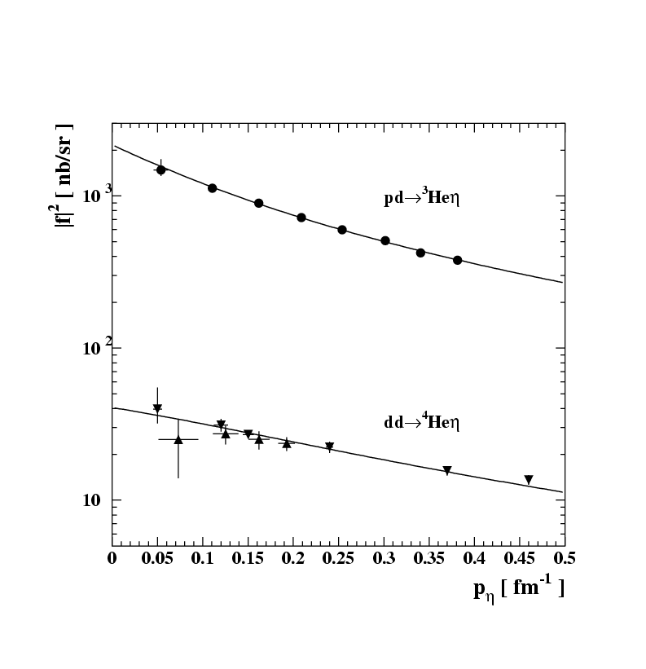
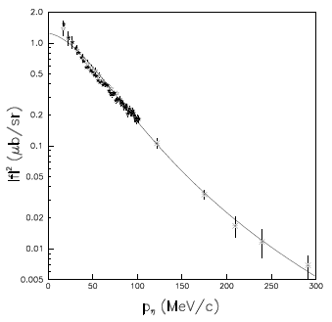
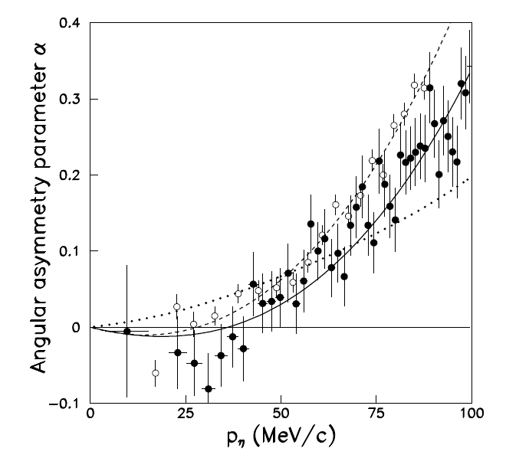
+
η - He
η
+
dp→ ³Heη
C.Wilkin et al., Phys. Lett. B654 (2007) 92‏
|Re(a)| > Im(a)
σ_{tot} = p_{cm}/p^{cm}_{beam} |f_{B}/(1-ip_{cm}a)|²
|Re(a)| = 2.9 ± 0.6 fm
Im(a) = 3.2 ± 0.4 fm
+
η
+
ANKE: T. Mersmann et al., Phys. Rev. Lett. 98 242301 (2007)
COSY-11: J. Smyrski et al., Phys. Lett B 649 258-262 (2007)

Slide 26
production of mesons at threshold
experimental aspects
production dynamics
hadronic interaction
mesic-nuclei ?
Borromean-states?
Homework
Notes:
contributing to the study of the muon
anomalous magnetic moment
Jakos to poskladac do kupy … dlaczego eta SM etc…
Polaczyc z nastepna strona i nawiazac podobnie as two years ago I will repeat since …than to Falsify the theory !!!
With Wasa at COSY we study both production and decays of the eta-meson but Today I will concentrate
of decays which is also a primordial aim of the experiment
In general we search for the phenomena which cannot be describe by the Standard Model…

Slide 27
THE ETA-MESIC NUCLEUS
η meson bound with nucleus via
STRONG INTERACTION
+
+
N*
N*
π
+
N*
η
COSY, J-PARC, MAMI, GSI, LPI/JINR
Talk by Wojciech Krzemień at this conference …
G. A, Sokol et al., arXiv:nucl-ex/0106005
Notes:
Druga HIPOTEZA … PRZEROBIC RYSUNEK, ze rozpada się od razu …. TO TEZ BĘDZIEMY TESTOWAC dd → ⁴He gg

Slide 28
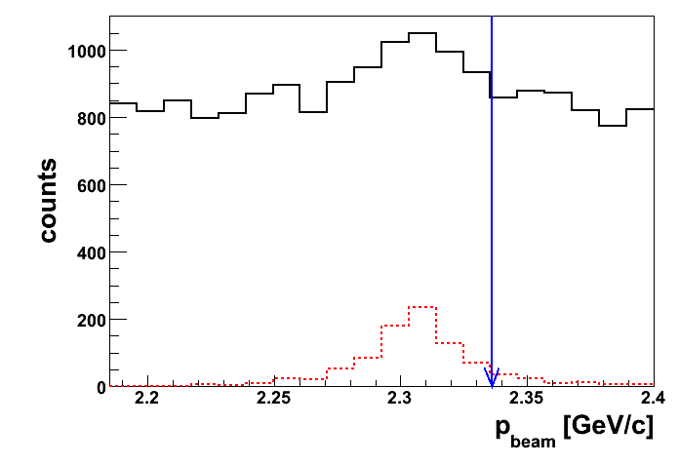
d+d → (⁴He-η)_{bound}→ ³He + p + π⁻
d+d → ³He + p + π⁻
SIMULATIONS
Notes:
Scan… as … you remember COSY has such posibilities….
TU JESZCZE WYPISAC WCZESNIEJ JAKIE SA MOŻLIWE INNE REAKCJIE….
MAMI …. Gamma + X → ….
GSI …….
J-PARC….
COSY ….

Slide 29
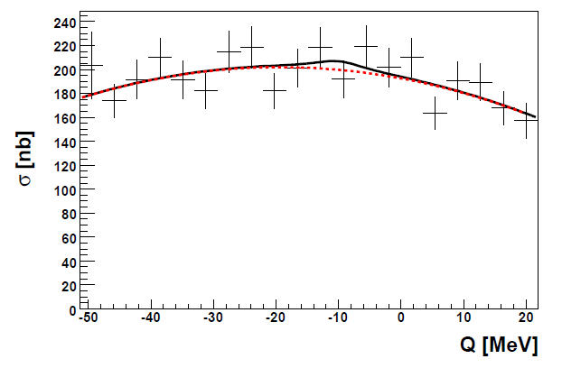
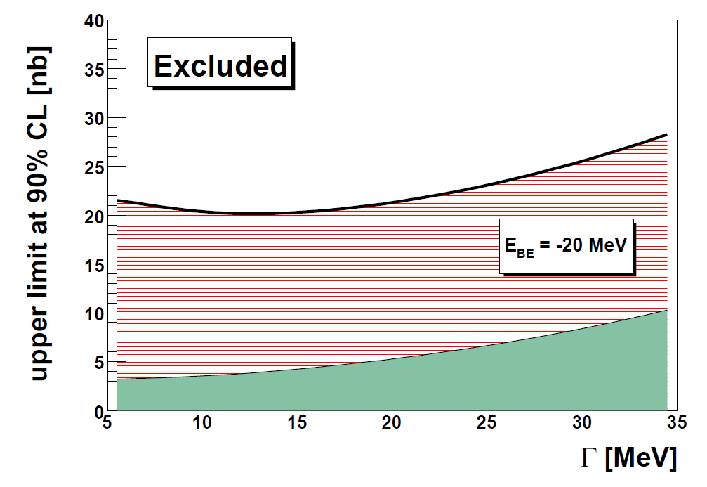
ETA MESIC NUCLEUS, COSY
d+d → ³He + p + π⁻
d+d → (⁴He-η)_{bound}→ ³He + p + π⁻
d+d →(⁴He-η)_{bound}→ ³He + p + π⁻
d+d →(⁴He-η)_{bound}→ ³He + n + π⁰
40 times larger statistics
Notes:
Przerobić na angielski i dopisac PUBLIKACJE WASY….

Slide 30
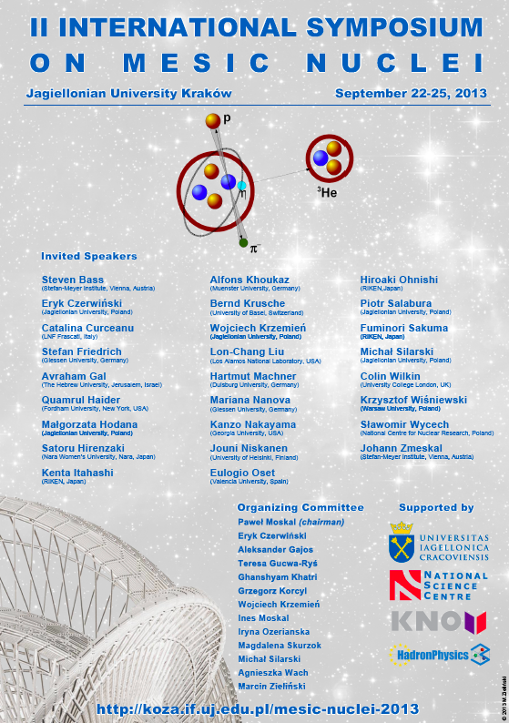
Notes:
contributing to the study of the muon
anomalous magnetic moment
Jakos to poskladac do kupy … dlaczego eta SM etc…
Polaczyc z nastepna strona i nawiazac podobnie as two years ago I will repeat since …than to Falsify the theory !!!
With Wasa at COSY we study both production and decays of the eta-meson but Today I will concentrate
of decays which is also a primordial aim of the experiment
In general we search for the phenomena which cannot be describe by the Standard Model…

Slide 31
production of mesons at threshold
experimental aspects
production dynamics
hadronic interaction
mesic-nuclei ?
Borromean-states?
Homework
Notes:
contributing to the study of the muon
anomalous magnetic moment
Jakos to poskladac do kupy … dlaczego eta SM etc…
Polaczyc z nastepna strona i nawiazac podobnie as two years ago I will repeat since …than to Falsify the theory !!!
With Wasa at COSY we study both production and decays of the eta-meson but Today I will concentrate
of decays which is also a primordial aim of the experiment
In general we search for the phenomena which cannot be describe by the Standard Model…

Slide 32
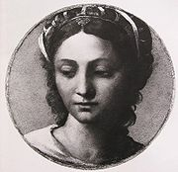
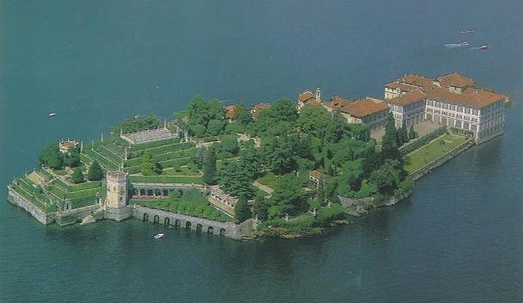
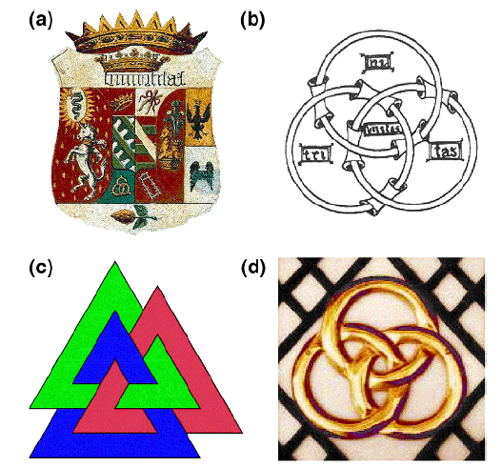
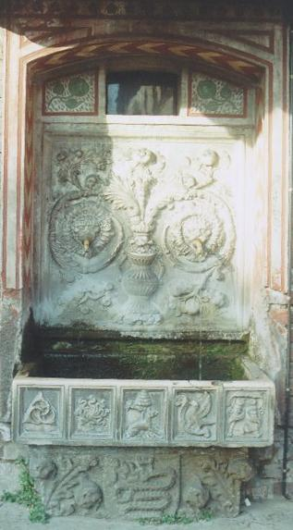
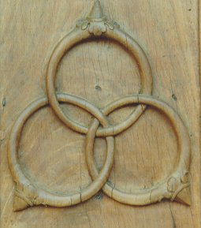
Isola Bella
Baroque Borromeo Palace, Lake Magiorre in Italy
Borromeo, Sforza, Visconti
The most famous of the islands, Isola Bella, is crowned by the princely
Borromeo Palace with its formal Italian-style gardens laid out on ten terraces.
The Baroque palace contains a wealth of artefacts: original furnishings,
gold and silk Flemish tapestries, period weapons, sculptures, paintings
and frescoes from the 16th to the 19th centuries.
Notes:
I am talking about all this because …our queen at the first half of 16th century was …
Bonna Sforza, Sigmundus ~ 1518-1557

Slide 33

Borromean rings from nucleons
⁶He
+
+

Slide 34
σ = dV_{ps} |M|²
|M|² ~ |M₀|² |M_{FSI}|²
|M_{FSI}|² ~ |M_{pp}|² |M_{p1η}|² |M_{p2η}|²
dynamics → |M₀|²
interaction → σ (Q)
CELSIUS, COSY, SATURNE
+
+
η
S. Wycech Acta Phys. Polon. B 27 (1996) 2981
Notes:
CYTAT Z WYCECHA etc… S. Wycech Acta Phys. Polon. B 27, 2981 1996 can be explained with a state of 4fm…
R(k) + 1 = C Y(k)/Y*(k),

Slide 35
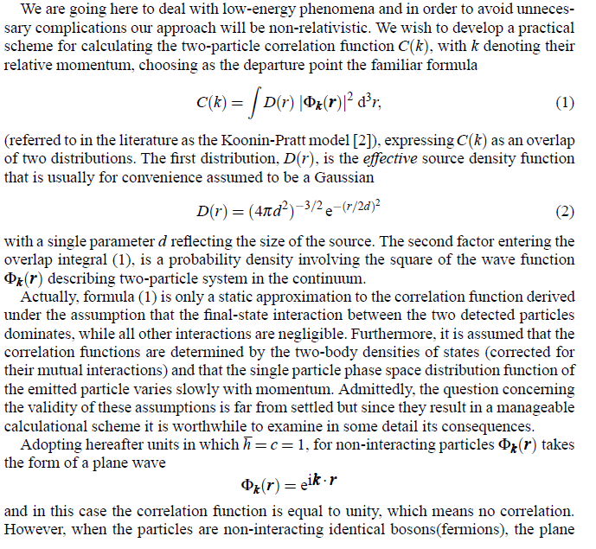
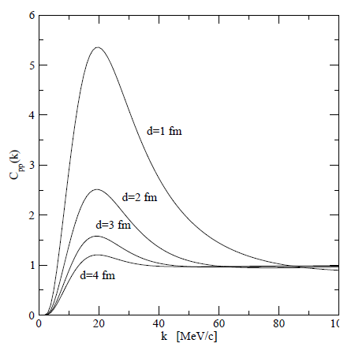
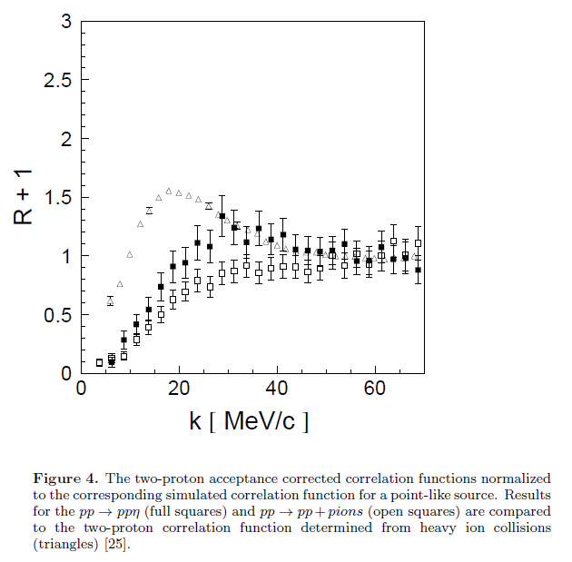


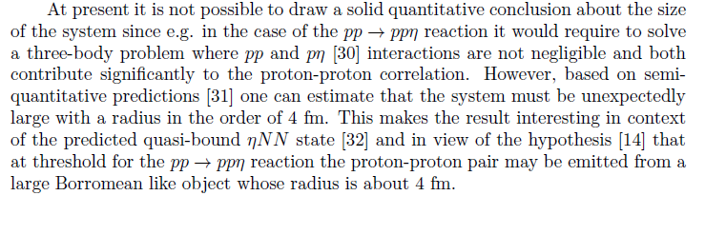
A. Deloff, AIP Conf. Proc. 950 (2207) 150
„At present it is not possible to draw a solid quantitative
conclusion about the size of the system since e.g. in the
case of the pp → pp reaction it would require to solve
a three-body problem where pp and p-eta interactions
are not negligible and both contribute significantly
to the proton-proton correlation. However, based on
semiquantitative predictions one can estimate that the
system must be unexpectedly large with a radius
in the order of 4 fm”
+
COSY-11: P. Klaja et al., J.Phys. G37 (2010) 055003
+
η
Correlation femtoscopy
Koonin-Pratt model [2]
Notes:
W oparciu o uproszczony formalizm Deloffa

Slide 36
production of mesons at threshold
experimental aspects
production dynamics
hadronic interaction
mesic-nuclei ?
Borromean-states?
Homework

Slide 37
HOMEWORK for the next EFB23
Using many-body formalism try to determine:
Total cross section for the pp→ppη (pp→ppM)
Total cross section for the production of mesic nucleus
Distribution of N* momentum in the (³He-N*) helium
Correlation function for the ppη system
HINT: It is very simple to do !

Slide 38
THANK YOU
FOR YOUR ATTENTION

Slide 39
production of mesons at threshold
experimental aspects
production dynamics
hadronic interaction
mesic-nuclei ?
Borromean-states?
ABC resonance
Homework

Slide 40
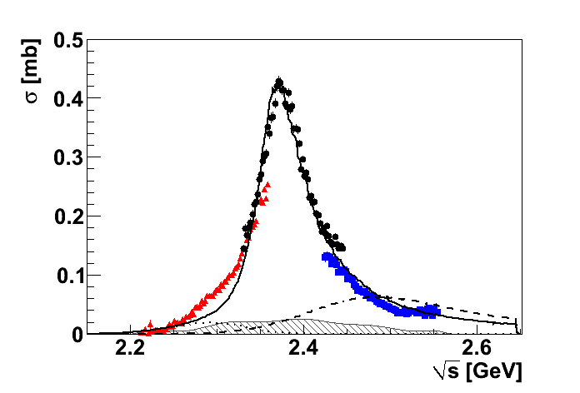
ABC effect in double pionic fusion - a new resonance?
Cross section for pn → dπ⁰π⁰
Phys. Rev. Lett. 106 (2011) 242302
Plenary talk by Anette Pricking: Monaday, June 4th, 13:00-13:30
Posters by Mikhail Bashkanov and Tatiana Skorodko
Notes:
That's our model.
What might be the discrepancy on the left side ?
XXX WYKLAD MIKHAILA Z PRAGI WZIĄĆ…!!!

Slide 43
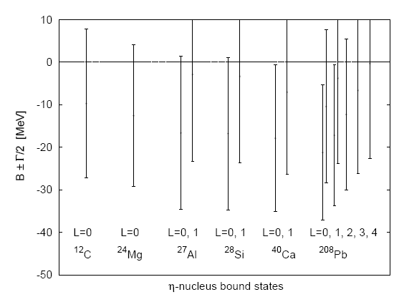
  Attractive interaction between η and N
  (R. Bhalerao and L. C. Liu, Phys. Lett. B54 (1985) 685 )‏
  possible existence of bound states
  of the η meson with nuclei for A>10
  (Q. Haider and L. C. Liu, Phys. Lett. B172 (1986) 257 )‏
  Optical potential η nucleus calculated in the frame of unitarized chiral perturbative approach
  (C.Garcia-Recio, T. Inoue, J.Nieves, E. Oset, Phys. Lett. B550 (2002) 47).

Slide 44
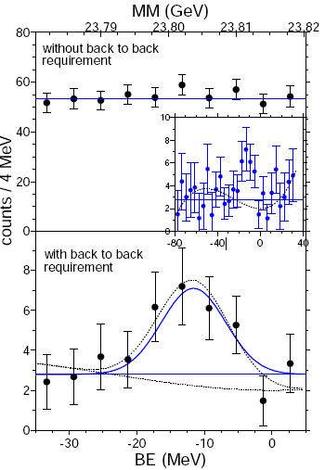
Search for the η-mesic nuclei in a recoil-free transfer reaction
COSY-GEM Collaboration
η-²⁵Mg
p + ²⁷Al → ³He + π⁻ + p + X
A. Budzanowski et al., Phys. Rev. C 79 (2009)

Slide 45
  η bound state possible with the light nuclei
³He-η ³H-η ⁴He-η
(C. Wilkin, Phys. Rev., C47 (1993) )
Supported by model calculations of:
- S. Wycech et al., Phys. Rev. C52(1995)544
(the multiple scattering theory)
- N. N. Scoccola and D. O. Riska, Phys. Lett. B444(1998)21
(the Skyrme model)
and by observations of:
- near threshold enhancements of the amplitudes for the
dd → ⁴He η and pd → ³He η reactions
(N. Willis et al.., Phys. Lett. B406(1997)14)
Q. Haider, L.C. Liu, Acta Phys. Pol. B Supp. 2 (2009) 121

Slide 46
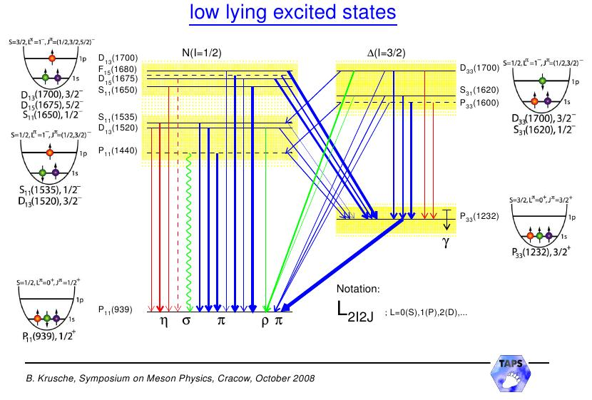
produkcja mezonu η :
production:
mocne oddziaływanie η - N
jądra mezonowe ?

Slide 47
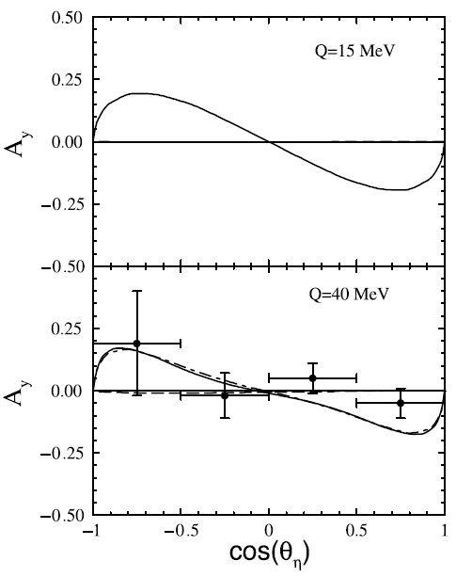
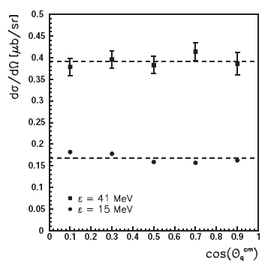
Dynamics of the ppppη reaction

Slide 48

Higher Partial Waves
* ηN FSI effects?
* P-wave contribution?
K. Nakayama et al., Phys. Rev. C 68 (2003) 045201

Slide 49


Slide 51


WASA-at-COSY
pp → pp η pd → ³He η
Notes:
Widma są po dopasowaniu kinematycznym:
pd jest z 3*10^7 et, natomiast pp z

