Slide 1


Phase portraits of quantum systems
Yu.A. Lashko, G.F. Filippov, V.S. Vasilevsky
Bogolyubov Institute for Theoretical Physics,
Kiev, Ukraine
Notes:
This slide template is for the title slide of a presentation. Consider repeating a key image from one of the slides later in the presentation. The image helps orient the audience to the key words in the title. This image also gives you the opportunity to say a few things about your work—perhaps addressing the work’s importance or providing key background information. Forcing yourself to spend more time with this slide is good because a common mistake in presentations is not to leave the title slide on long enough. Because of this mistake, many in the audience do not have the chance to comprehend the key details of the title. See pages 66, 69-71, and 177 of The Craft of Scientific Presentations (CSP).
This template shows one layout for the slide. You might want to rearrange the placement of the body’s wording to accommodate a different sized image.

Slide 2
We suggest analysis of quantum systems with phase portraits
in the Fock-Bargmann space
1d systems
Pauli principle in
1d systems
3d systems, L^{π}=0⁺
Notes:
Mapping slide for the presentation (note that a background slide or a slide justifying the importance might precede this slide). A common mistake with mapping slides is to give the audience simply a boring and unmemorable vertical list of topics (including the names “Introduction” and “Conclusion” and “Questions”). Such a list is quickly forgotten after the slide is removed.
On a mapping slide, take the opportunity to show a key image or perhaps a representative image for each major section of the presentation. In the second case, each image would be repeated on the first visual of the corresponding section and would remind the audience that they have arrived to a major section of the presentation’s middle.
In regards to the names “Introduction” and “Conclusion,” every talk has those sections, and the names are ignored by audiences. So why state them? Also, for the divisions that you do have, find a logical and parallel grouping. Note that groups of two’s, three’s, and four’s are much easier to remember and are not so nearly intimidating as groups of five’s, six’s, and seven’s. See the example mapping slide in the textbook. (CSP, pages 55-56, 74-75, 86, 143, 147, and 148)

Slide 3






Knowing the wave function of a state in the Fock-Bargmann space, we can find the probability distribution over phase trajectories in this state − the phase portrait of the system
Transform to the Fock-Bargmann space
phase space of coordinates ξ and momenta η:
Expansion of the wave function
in the harmonic-oscillator basis
number of oscillator quanta
A set of linear equations is solved
to give wave functions
The probability distribution
Bargmann measure

Slide 4



In the Fock-Bargmann space, the phase portrait of a quantum system contains all possible trajectories for fixed values of
the energy and other integrals of motion
Quantum phase portrait
Probability of realization of the phase
trajectory is proportional to the value of ρ_{E}(ξ,η)
Quantum phase trajectories
Quasiclassical phase trajectories
Coherent state
There is an infinite set of quantum trajectories and only one classical trajectory at a given energy

Slide 5

Part I: 1d-systems
Plane wave
Harmonic oscillator
classical trajectory
η
η
ξ
ξ

Slide 6


Phase portrait of free particle with energy E=k²/2, k=1 shows that maximum probability corresponds to a classical trajectory
classical trajectory
η
ξ
Phase portrait
Phase trajectories

Slide 7



All phase trajectories of 1d harmonic oscillator are circles
η
ξ
Phase portrait of 1d h.o., n=1

Slide 8
With increasing the number of oscillator quanta n, quantum trajectories condense near classical trajectory
η
ξ
Phase portrait of 1d h.o., n=10

Slide 9
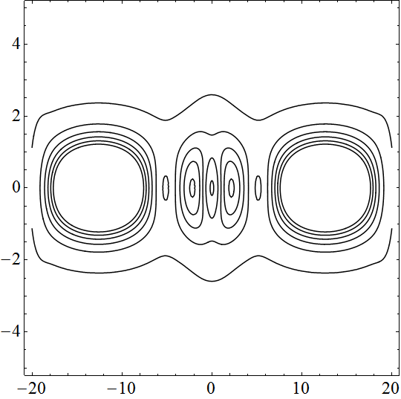

Part II: Pauli principle in 1d systems
Free particles
Particles in Gaussian potential
η
η
ξ
ξ

Slide 10

Symmetry requirements lead to some oscillations which are smoothed with increasing energy
η
ξ
Phase portrait and phase trajectories of a free particle
with energy E=k²/2, k=1.5 and negative parity

Slide 11
Positions of the maxima of the density distribution ρ_{k}(ξ,η=k) in the Fock-Bargmann space and in the coordinate space ρ_{k}(x)=Sin²(kx) are the same, but the amplitude of oscillations are different
ρ_{k}(ξ,η=k)
ρ_{k}(x)=Sin²(kx)

Slide 12
The probability density distribution for a bound state of a particle is localized in the phase space, all phase trajectories are finite
η
ξ
Phase portrait of a particle bounded in the field of Gaussian potential (V₀=-85 MeV, r₀=0.5b₀ ). Binding energy E₀=-3.5 MeV
Notes:
Blank slide for drafting mapping slide

Slide 13
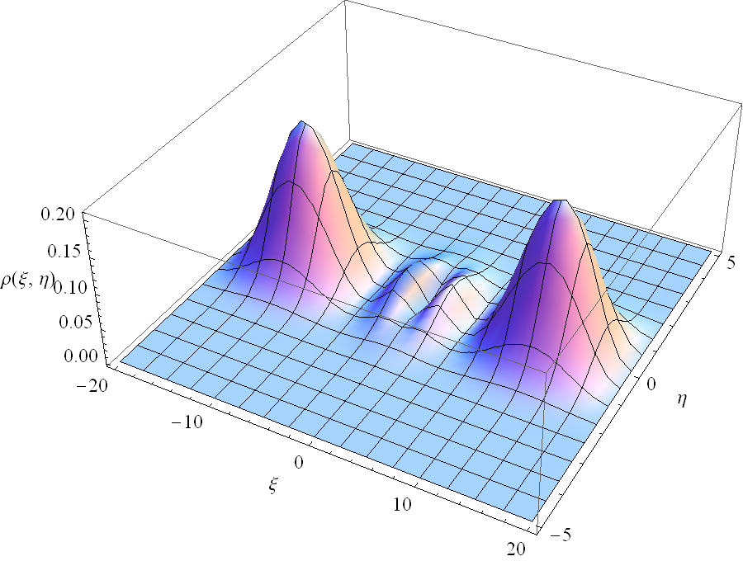
The probability density distribution of the low-energy continuum state has periodic structure
η
ξ
Phase portrait of the E₁=3.67 MeV continuum state of the particle
in the field of Gaussian potential (V₀=-85 MeV, r₀=0.5b₀ )
Notes:
Blank slide for drafting a body slide.

Slide 14
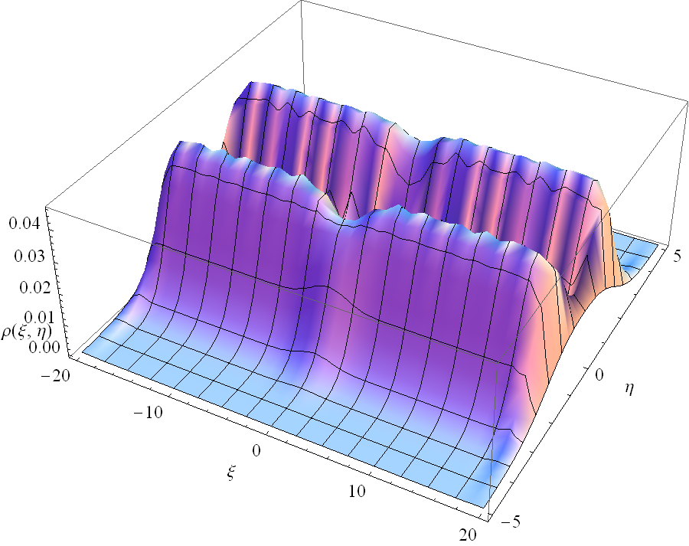
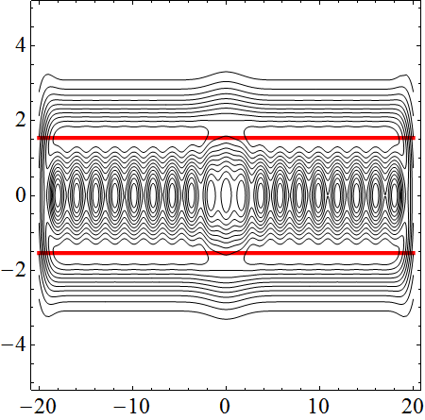
The higher the energy, the smaller the contribution of finite trajectories, while infinite trajectories are similar to classical ones
η
ξ
Phase portrait of the E₉=196.45 MeV continuum state of the particle
in the field of Gaussian potential (V₀=-85 MeV, r₀=0.5b₀ )
Notes:
Blank slide for drafting a body slide.

Slide 15
Part III: 3d systems, L^{π}=0⁺
Free particle
Particle in Gaussian potential
α
r
Two-cluster systems

Slide 16



Probability density distribution for a bound state of a 3d-particle with energy E₀=-3.5 MeV and L^{π}=0⁺ depend on two variables

Slide 17

With increasing the energy, quantum trajectories condense
near classical trajectory
α
r
Phase portrait of a free particle
with energy E=k²/2, k=1.5, L^{π}=0⁺

Slide 18


In terms of ξ,η classical trajectory of a 3d-particle in the state with L=0 is the surface, not the curve

Slide 19
We construct the phase portraits for two-cluster systems in the Fock-Bargmann space within algebraic version of the resonating group method

Slide 20
In conclusion, the Fock-Bargmann space provides a natural description of the quantum-classical correspondence
η
ξ
The phase portraits give an additional important information about quantum systems as compared to the coordinate or momentum representation

