Slide 1
Dineutron formation and breaking in ⁸He
arXiv:1305.4323 [nucl-th]
Department of Physics, Kyoto University
Fumiharu Kobayashi
Yoshiko Kanada-En’yo

Slide 2
Introduction

Slide 3
Dineutron correlation
dineutron
A dineutron : A compact spin-singlet pair of two neutrons.
Dineutron correlation is enhanced in some situations. (e.g. in the low-density region of the nuclear matter,
in the neutron-halo and -skin region of neutron-rich nuclei; ⁶He, ¹¹Li…)
core
M. Matsuo, PRC 67 (2006)…
G. F. Bertch and H. Esbensen, Ann. Phys. (NY) 209 (1991)
M. V. Zhukov et al., Phys. Rep. 231 (1993)
Our aim
To make clear the mechanism of the dineutron formation, and
the universal properties of the dineutron correlation.

Slide 4
⁸He
α + four valence neutrons
α
α
⁶He
(0p_{3/2})⁴-shell
developed two-dineutron
developed one-dineutron
the 0⁺₁ state
the 0⁺₂ state
(Y. Kanada-En’yo, PRC 76 (2007),
N. Itagaki et al. PRC 78 (2008))

Slide 5
Framework

Slide 6
Description of ⁸He
In order to describe ⁸He,
we superpose two kinds of wave functions,
extended ⁶He + 2n cluster wave functions
and ⁸He dineutron condensate (DC) wave functions.
N. Itagaki et al, PRC 71 (2005)
α
⁶He
F.K. and Y. Kanada-En’yo. PTP 126 (2011)
α
⁶He

Slide 7
Extended ⁶He+2n cluster w.f.
The ⁸He system is composed of ⁶He(H.O.(0p)²) core and two neutrons around it.
2n*
The dissociation effect in 2n cluster
due to the spin-orbit interaction
can be taken into account.
⁶He
We mainly describe H.O.(0p_{3/2})⁴ and one dineutron at the surface.

Slide 8
⁸He DC wave function
We assume that the system is composed of the core and one dineutron.
dineutron
One dineutron (spin-singlet 2n)
is distributed around the core
in the S-wave.
The DC wave function has
two characteristic parameters,
the dineutron size, b_{n},
the expansion from the core, β.
2b_{n}
2n*
β
α
We describe one- or two- developed dineutrons.

Slide 9
Result

Slide 10
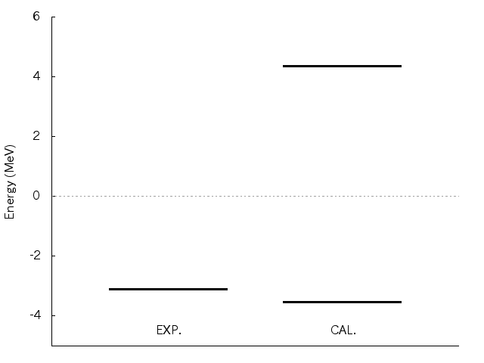
⁸He(0⁺_{1,2})
Dineutron condensate state
0⁺₂
α+4n threshold
(0p_{3/2})⁴-component
and
one-dineutron one
are important.
0⁺₁
0⁺₁
EXP.
CAL.
(0p_{3/2})⁴
+
⁶He
Poster session

Slide 11
Two-dineutron condensation in 0⁺₂
In ⁸He(0⁺₂),
valence neutrons form two compact dineutrons.
Two dineutrons and an α are expanded largely
with little correlation each other.
Two-dineutron condensation
characterized by a gas-like structure of a+2dineutron.
~3fm
~5fm

Slide 12
Summary

Slide 13
Summary
We investigated the dineutron correlation in ⁸He(0⁺).
In the excited 0⁺ state of ⁸He,
the two-dineutron condensation would exist,
characterized by a gas-like structure of an α and two dineutrons.
[Poster session 12th Sep. (Thu.)]
In ⁸He(0⁺₁),
(0p_{3/2})⁴- and developed one-dineutron components are mixed,
but developed two-dineutron one is minor
because of the fragility of the dineutrons.

Slide 15
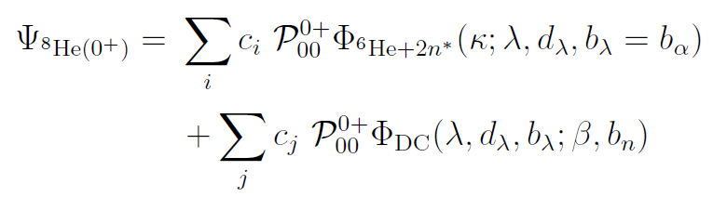
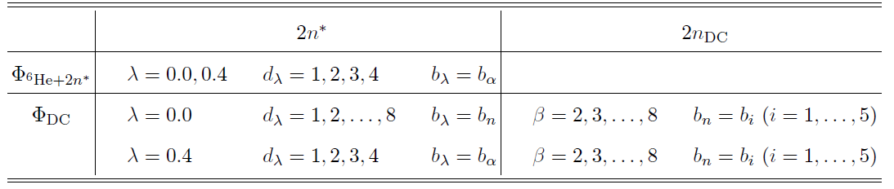
Description of ⁸He
⁶He+2n* → (0p_{3/2})⁴ sub-shell closure
⁶He in (0p)² + one dineutron around ⁶He
DC → ⁶He in (0p)² + one developed dineutron
α + two developed dineutron

Slide 16
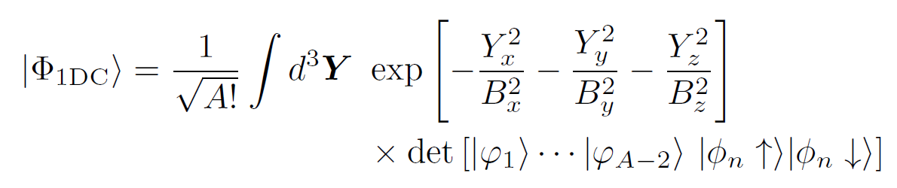

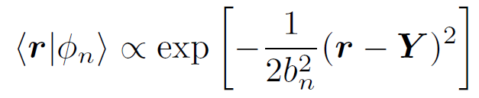
1-DC wave function
( Not a dineutron condensate state )
Assuming that the A-nucleon system is composed of (A-2)-nucleon core and one dineutron.
B
core (Brink)
dineutron
dineutron
n
Y
core
n
~ b_{n}
Here assuming that B = B_{x} = B_{y} = B_{z} .

Slide 17

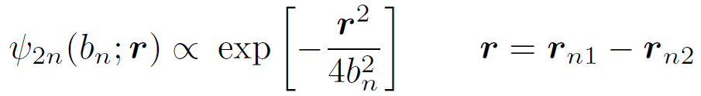
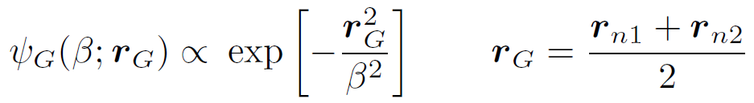
Transformation to relative and c.o.m. w.f.
coordinate transformation Y-integral
relative part
c.o.m. part
2b_{n}
n
r
(s-wave)
r_{G}
β
size of the dineutron
n
core
(S-wave)
spatial expantion of the dineutron

Slide 18
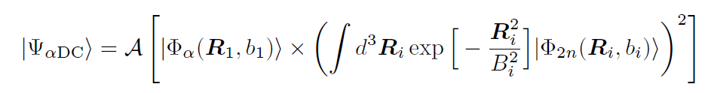
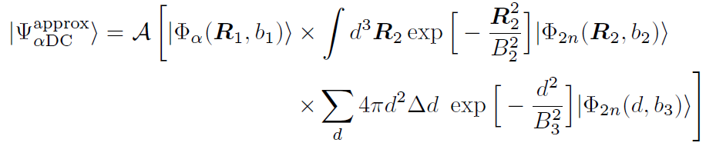
Dineutron condensate component
We calculate the overlap with αDC w.f. to see the dineutron condensate components in ⁸He.
Here we approximate αDC w.f. as follows.
replace one of the R-integal by the d-summation

Slide 19
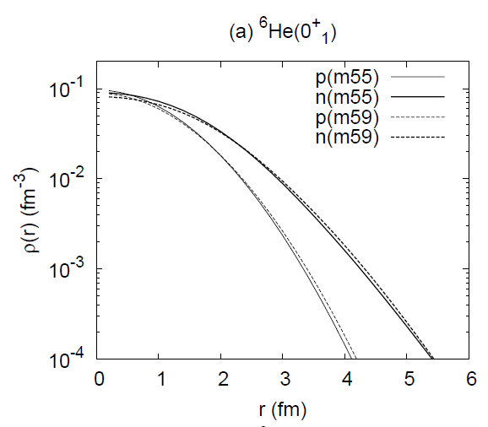
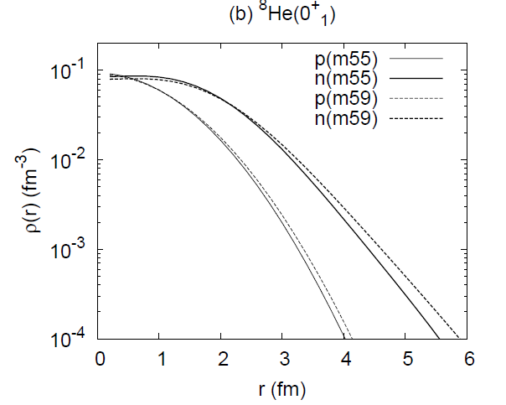
One-body density

Slide 20

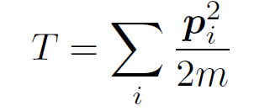
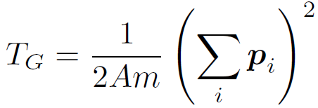


Hamiltonian
: Volkov No.2 m=0.55, b=h=0.125 (2n unbound) or m=0.59, b=h=0.0 (2n bound)
: LS part of G3RS v_{LS} = 2000 MeV

Slide 21
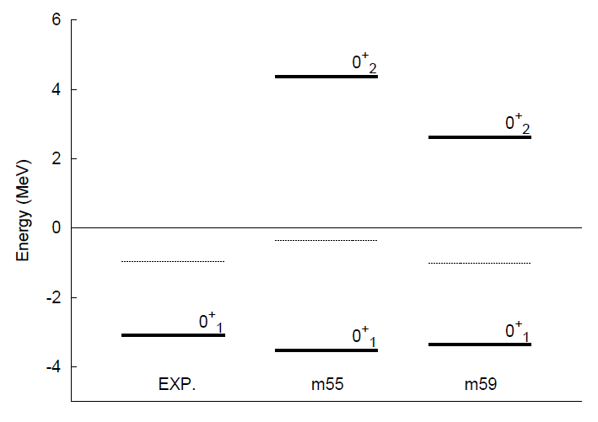
0⁺ energy spectra
0⁺₂
Two-dineutron
in the S-wave
α+n+n+n+n
⁶He+n+n
0⁺₁
competition of (0p_{3/2})⁴ and
one-dineutron
(2n unbound)
(2n bound)

Slide 22
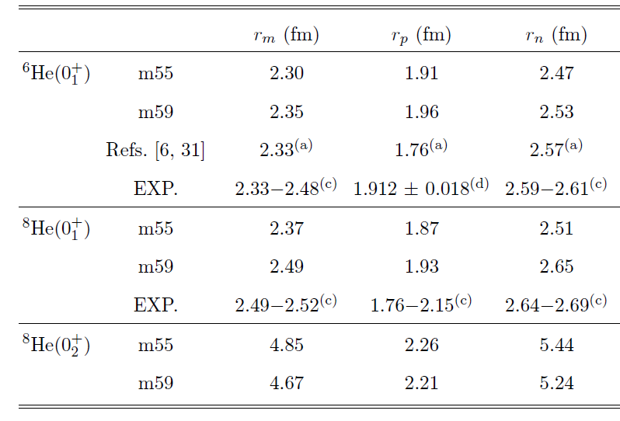
R.m.s. radii
(a) K. Arai et al, PRC 59 (1996)
Three body
model
The neutron expansion (halo, skin) in ^{6,8}He(0⁺₁) is reproduced.
⁸He(0⁺₂) has much larger neutron radius than that of ⁸He(0⁺₁).

Slide 23

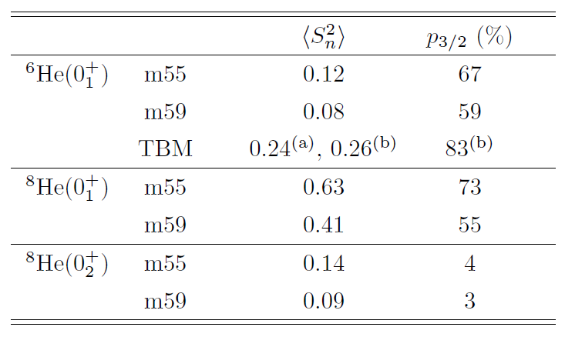
Degree of shell-model component
We calculate the squared spin and the 0p_{3/2}-shell component.
in (0p_{3/2})²
in (0p_{3/2})⁴
K. Arai et al, PRC 59 (1996)
K. Hagino et al, PRC 72 (2005)
Dineutron is major.
Shell-model and dineutron compete.
Dineutron is dominant.

Slide 24
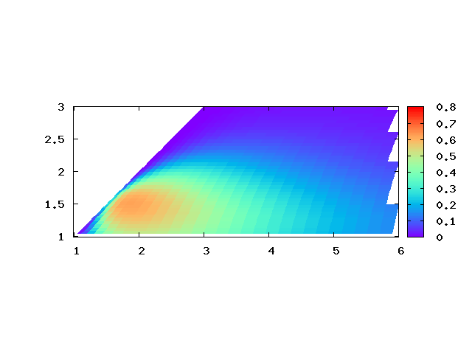
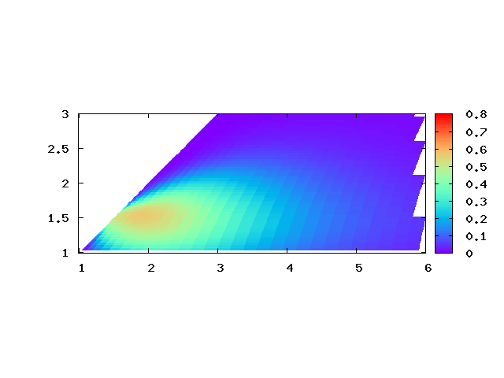
Dineutron component in 0⁺₁
one-dineutron component
In the ground state,
(0p_{3/2})⁴ -component
and
developed one-dineutron component
are significant.
Not only one
but also two compact dineutrons are formed
at the surface.
(β, b_{n})~ (2.0, 1.5)
2b_{n}
β
⁶He
(fm)
two-dineutron component
However,
the tail component
(β ≥ 4 fm) diminishes
in two-dineutron one.
A dineutron is fragile.
(0p_{3/2})⁴
+
b_{n} : dineutron size
2b_{n}
⁶He
α
β
β : dineutron expansion
(fm)

Slide 25

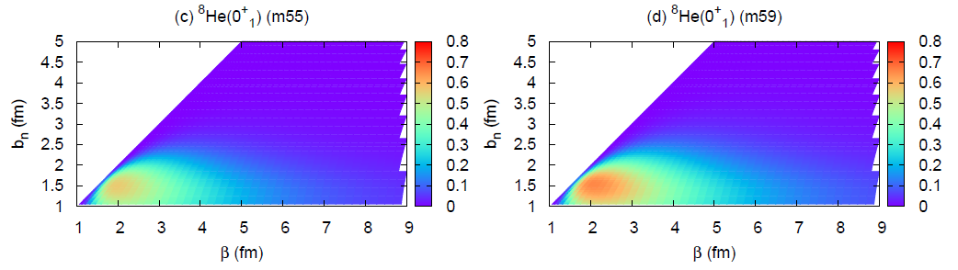
One-dineutron component in ⁸He(0⁺₁)
(fm)
m55
m59
b_{n} : dineutron size
(fm)
β : dineutron expansion
In m55 (strong α-n interaction),
the dineutron is more dissociated.
In m59 (strong n-n interaction),
the dineutron correlation is enhanced.
b_{n}
β
core

Slide 26
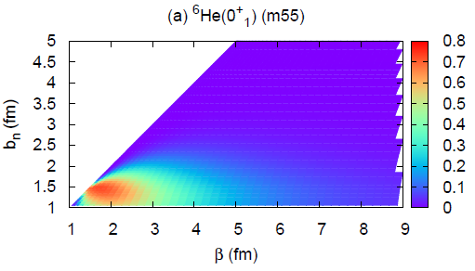
Comparison of ⁸He(0⁺₁) with ⁶He(0⁺₁)
(fm)
⁸He
⁶He
b_{n} : dineutron size
(fm)
β : dineutron expansion
In ⁶He, a dineutron is formed
at the surface.
In ⁸He, a dineutron is dissociated
at the surface due to the spin-orbit interaction.
b_{n}
β
core

Slide 27
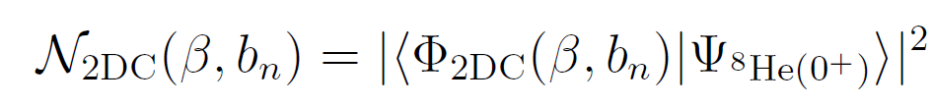
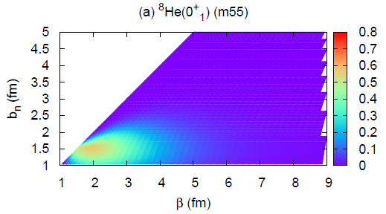
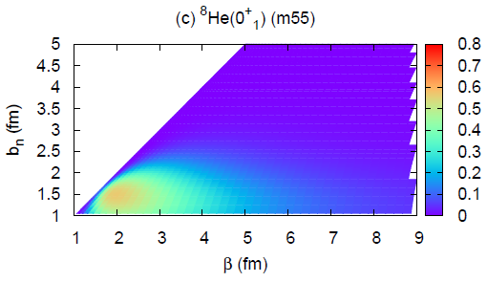
Two-dineutron component in ⁸He(0⁺₁)
(fm)
2DC
1DC
b_{n} : dineutron size
β : dineutron expansion
(fm)
β
The peak component is similar,
but the tail component is reduced in 2DC.
b_{n}
The component of two developed dineutrons is suppressed.

Slide 28
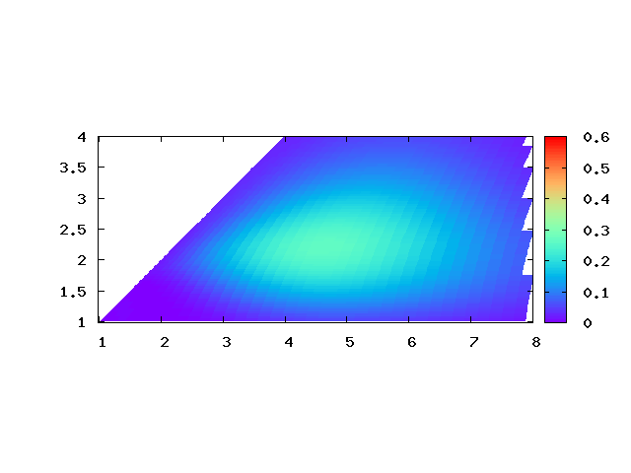
Dineutron condensation in 0⁺₂
(fm)
two-dineutron component
b_{n} : dineutron size
2b_{n}
β
β : dineutron expansion
(fm)
This state has a gas-like structure of
one α and two compact dineutrons expanded very largely.
Two-dineutron condensate state

Slide 29
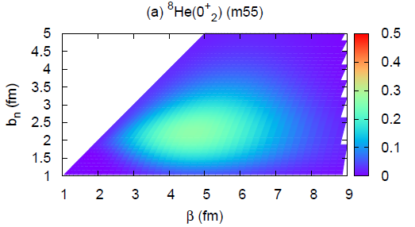
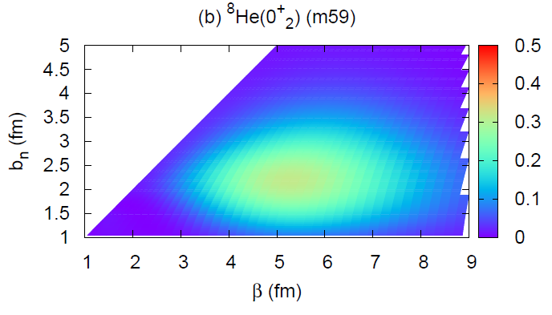
Two-dineutron condensation in ⁸He(0⁺₂)
(fm)
m55
m59
b_{n} : dineutron size
β : dineutron expansion
(fm)
⁸He(0⁺₂) contains swelled dineutrons
expanded largely from the origin.
b_{n}
β
Two-dineutron condensation

