Slide 1

Experimental study of universal few-body physics with ultracold atoms
Lev Khaykovich
Physics Department, Bar-Ilan University, 52900 Ramat Gan, Israel
Laboratoire Kastler Brossel, ENS, 24, rue Lhomond, 75231 Paris, France
EFB22, Krakow, 13/09/2013

Slide 2
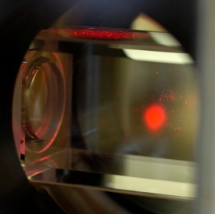
System: dilute gas of ultracold atoms
Magneto-optical trap of Li atoms
Close to the resonance (orbital electronic states) visible (laser) light – 671 nm (~2 eV)
Magnetic fields
Ultrahigh vacuum
environment
Dissipative trap
N ~ 5x10⁸ atoms
n ~ 10¹⁰ atoms/cm³
T ~ 300 μK
Dilute gas of atoms:
Notes:
After introducing you to people I shall meet you with atoms.

Slide 3
Motivation
Unique platform to study few-body phenomena
Efimov physics and universal trimers
Larger universal clusters
From few-body to many-body
Integrating out few-body degrees of freedom (due to separation of scales) helps to track down many-body problems (BEC-BCS transition).
Rapid convergence of high-temperature virial expansion (solving of few-body problems with more and more particles).

Slide 4
Prelude –
Ultracold collisions
And Feshbach resonances

Slide 5
Ultracold collisions: the scattering length
At low temperatures the scattering
is completely s-wave dominated.
Collisional cross-section for two identical bosons:
a is the s-wave scattering length
s-wave scattering length a
is determined by the last bound state
⁷Li :
Last bound
level.
³⁹K :
⁸⁵Rb :
¹³³Cs :
Range of the typical interatomic potential – the van der Waals length

Slide 6
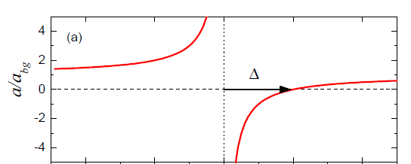
Feshbach resonance
Magnetic field tuning of the scattering length.
Closed channel: bound state
Open channel: free atoms
Open and closed channels
have different magnetic moments
Possible situation:

Slide 7
Two-Body domain

Slide 8
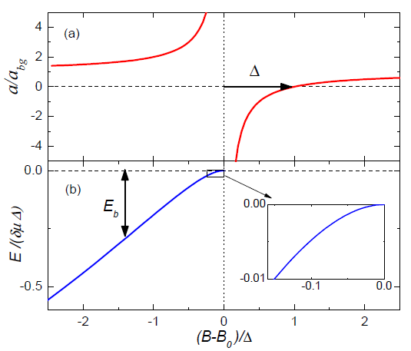
Feshbach molecule (universal dimer)
Feshbach molecule (quantum halo):
Bare state (non-universal) dimer:
Also: deuteron, He₂
Notes:
Molecule is possible when the bound state in the closed channel is lower in energy than the scattering continuum.

Slide 9
Universal dimer near 2-body resonance
k
van der Waals range:

Slide 10
Three-body domain: Efimov qunatum states

Slide 11
Efimov scenario – universality window
k
first excited
level
lowest
level
Borromean region:
trimers without
pairwise binding

Slide 12
Efimov scenario and real molecules
a < 0
a > 0
No 2-body bound states
One 2-body bound state
Real molecules:
many deeply bound states

Slide 13
Three-body recombination
Three body inelastic collisions result in a weakly (or deeply) bound molecule.
2E_{b}/3
E_{b}/3
U₀
Release of the binding energy causes loss of atoms from a finite depth trap
which probes 3-body physics.
Loss rate from a trap:
K₃ – 3-body loss rate coefficient [cm⁶/sec]
Notes:
3 – the number of atoms lost per 3-body recombination. I hope to convince you that this is a wrong number in most cases for the large scattering length.

Slide 14
Experimental observables
k
One atom and a dimer
couple to an Efimov trimer
Three atoms couple
to an Efimov trimer
Experimental observable - enhanced three-body recombination.

Slide 15
Experimental observables
k
Two paths for the 3- body recombination
towards weakly bound state interfere destructively.
Three atoms couple
to an Efimov trimer
Experimental observable – recombination minimum.

Slide 16
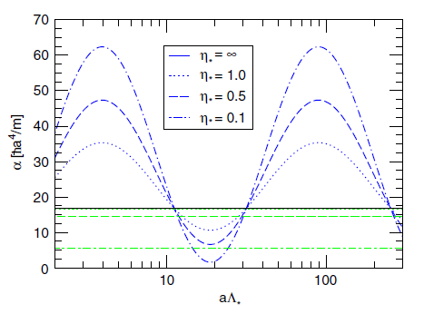
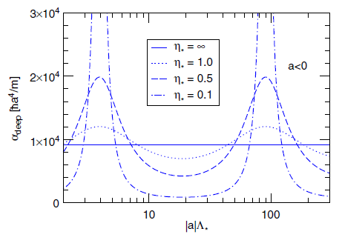
LO EFT for 3-body recombination
Dimensional analysis:
Including Efimov scenario:
Positive scattering length side:
Loss into shallow dimer
Loss into deeply bound molecules
Negative scattering length side:
Braaten & Hammer, Phys. Rep. 428, 259 (2006)

Slide 17
Efimov scenario: a short overview
Theoretical prediction (nuclear physics) – 1970.
For 35 years remains a purely theoretical phenomenon.
Efimov physics (and beyond) with ultracold atoms:
2006 - … ¹³³Cs Innsbruck
2008 – 2010 ⁶Li 3-component Fermi gas in Heidelberg, Penn State and Tokyo Universities.
2009; 2013 ³⁹K in Florence, Italy
2009 ⁴¹K - ⁸⁷Rb in Florence, Italy
2009; 2013 ⁷Li in Rice University, Huston, TX
2009 - … ⁷Li in BIU, Israel
2012 - … ⁸⁵Rb and ⁴⁰K - ⁸⁷Rb JILA, Boulder, CO

Slide 18
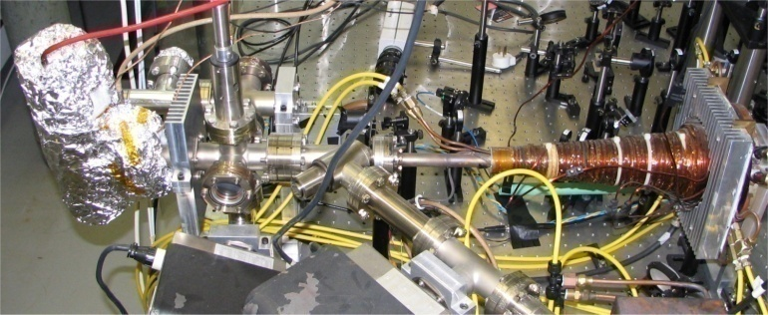
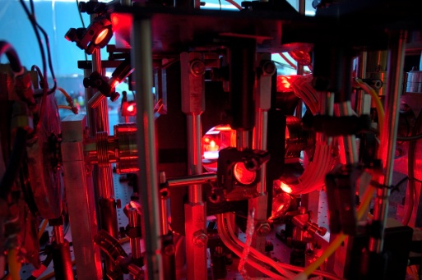
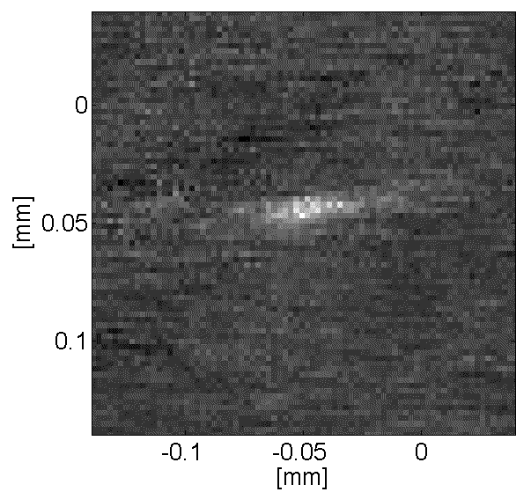
Experimental setup: ultracold ⁷Li atoms
Cooling:
Trapping: conservative atom trap
(our case: focus of a powerful infrared laser)
Zeeman
slower
Crossed-beam optical trap
Evaporation:
~2x10⁴ atoms
~1.5 μK
MOT
~10⁹ atoms
Typical numbers:
Temperature: ∼ μK
CMOT
~5x10⁸ atoms
(300 μK)
Relative velocities: few cm/sec
Collision energies: few peV
N. Gross and L. Khaykovich, PRA 77, 023604 (2008)
Notes:
It looks like a magic: having a single laser to perform cooling (dissipative force) and trapping (conservative force)

Slide 19
three-body recombination induced losses

Slide 20
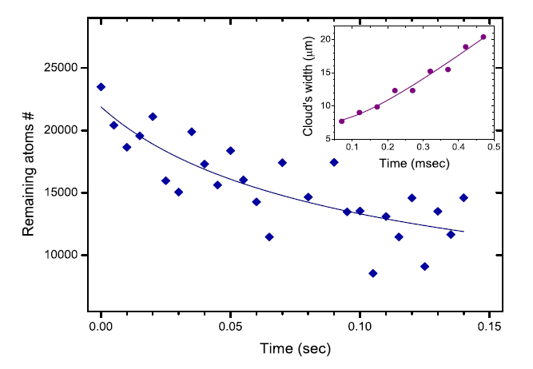
Three-body recombination
Typical set of measurements - atom number decay and temperature:
Loss rate from a trap:
K₃ – 3-body loss rate coefficient [cm⁶/sec]

Slide 21
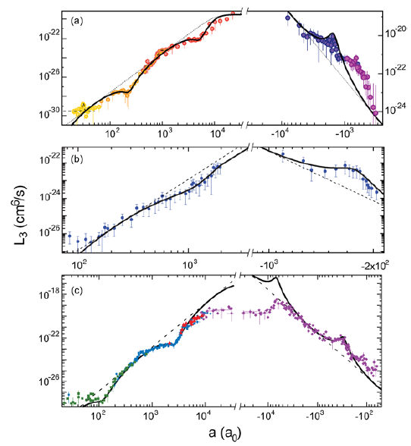
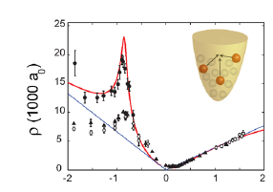
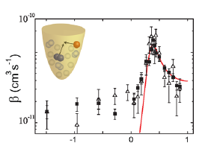
Gallery of the early experimental results
Innsbruck -
¹³³Cs
Florence -
³⁹K
Bar Ilan -
⁷Li (m_{F}=0)
Rice-
⁷Li (m_{F}=1)
F. Ferlaino, and R. Grimm, Physics 3,9 (2010)
Notes:
All these results qualitatively established the Efimov effect. But no quantitative understanding. Let us concentrate only on the negative scattering length side for sometime.

Slide 22
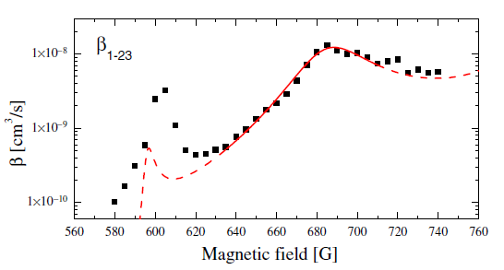
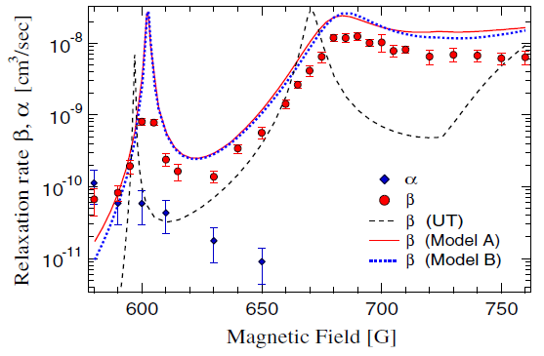
Gallery of the experimental results - ⁶Li
T. Lompe, T. B. Ottenstein, F. Serwane, K. Viering,
A. N. Wenz, G. Zurn and S. Jochim,
PRL 105, 103201 (2010).
S. Nakajima, M. Horikoshi, T. Mukaiyama,
P. Naidon and M. Ueda, PRL 105, 023201 (2010).

Slide 23
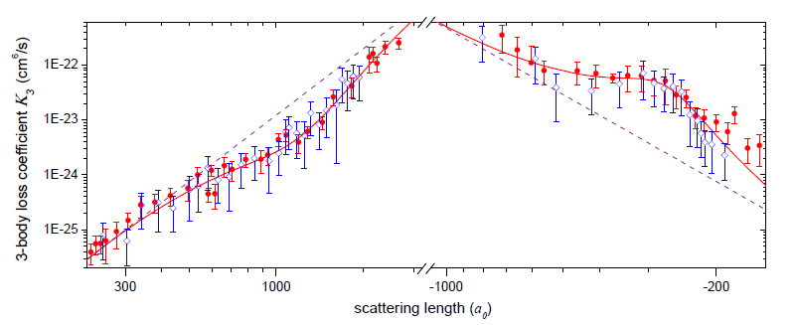
Gallery of the experimental results - ⁷Li
a > 0: T= 2 – 3 μK
a < 0: T= 1 – 2 μK
mf = 1; Feshbach resonance ~738G.
mf = 0; Feshbach resonance ~894G.
N. Gross, Z. Shotan, S. Kokkelmans and L. Khaykovich, PRL 103, 163202 (2009); PRL 105, 103203 (2010).

Slide 24
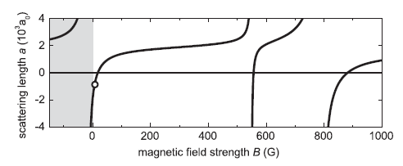
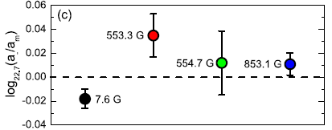
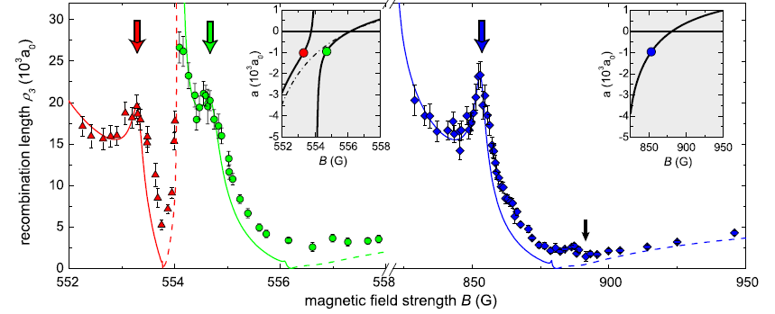
Gallery of the experimental results - Cs
Feshbach resonances in Cs.
Efimov resonances in Cs.
M. Berninger, A. Zenesini, B. Huang, W. Harm, H.-C. Nagerl, F. Ferlaino, R. Grimm, P. S. Julienne, and J. M. Hutson,
PRL 107, 120401 (2011)

Slide 25
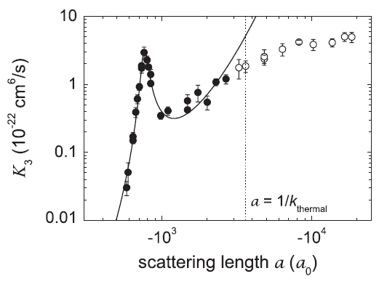
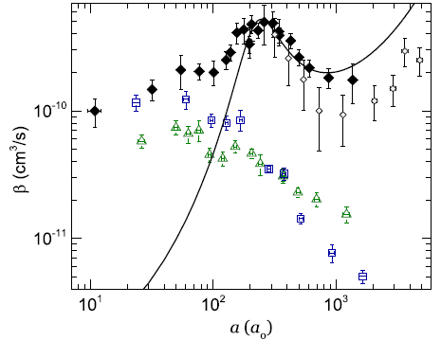
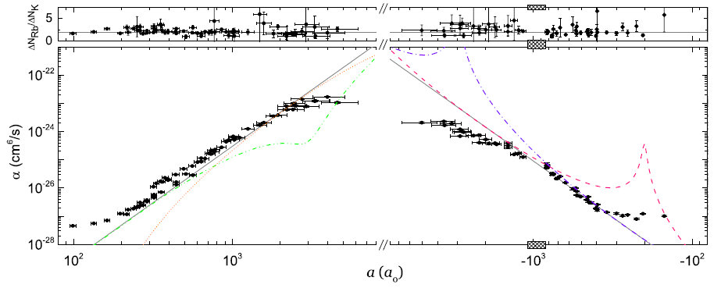
Gallery of the experimental results- JILA
⁸⁵Rb
⁴⁰K - ⁸⁷Rb
Atom-dimer (Rb+RbK)
resonance:
Expecting scaling factor:
R. J. Wild, P. Makotyn, J. M. Pino, E. A. Cornell and D. S. Jin, PRL 108, 145305 (2012).
R. S. Bloom, M.-G. Hu, T. D. Cumby, and D. S. Jin, PRL 111, 105301 (2013).

Slide 26
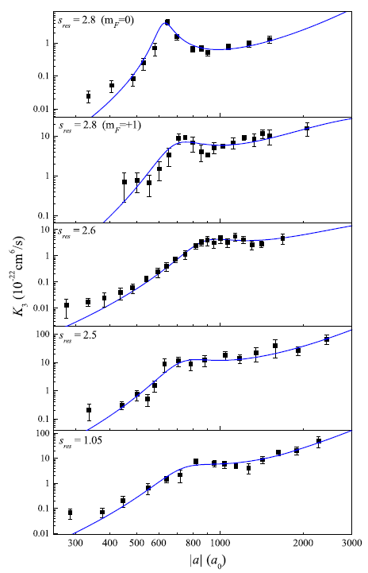
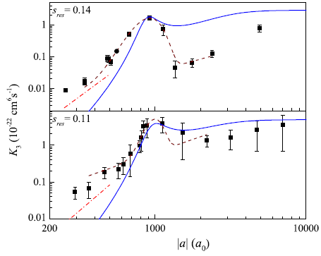
Gallery of the experimental results- ³⁹K
First Efimov resonance for
5+2 Feshbach resonances:
S. Roy, M. Landini, A. Trenkwalder, G. Semeghini, G. Spangniolli, A. Simoni, M. Fattori, M. Inguscio, and G. Modugno
PRL 111, 053202 (2013).

Slide 27
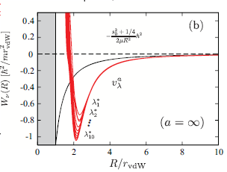
Universality of the 3-body parameter
J. Wang, J.P. D’Incao, B.D. Esry and C.H. Greene,
PRL 108, 263001 (2012).
A sharp cliff in the two-body interactions produces
a strongly repulsive barrier in the effective three-body
interaction potential.
(see also: C. Chin arXiv:1111.1484;
P. Naidon, S. Endo and M. Ueda, arXiv:1208.3912).
More:
R. Scmidt, S.P. Rath and W. Zwerger, EPJ B 85, 386 (2012).
P.K. Sorensen, D.V. Fedorov, A. Jensen and N.T. Zinner PRA 86, 052516 (2012).

Slide 28
Lifetime of Efimov trimers - η.
a < 0
a > 0
RESULT: Position of the Efimov resonance is universally related to r₀.
Lifetime of Efimov trimers is not universal (molecular levels in the short-range potential).
Notes:
Underling (short-range) molecular structure is nonuniversal.

Slide 29
Another experimental approach:
RF spectroscopy of the efimov quantum state

Slide 30
RF association of Efimov trimers
2010 - ⁶Li 3-component Fermi gas in Heidelberg Univerity (association of trimers from atm-dimer continuum).
2011 - ⁶Li 3-component Fermi gas at Tokyo Universities.
2012 - ⁷Li in BIU, Israel (association of trimers from three-atom continuum).

Slide 31
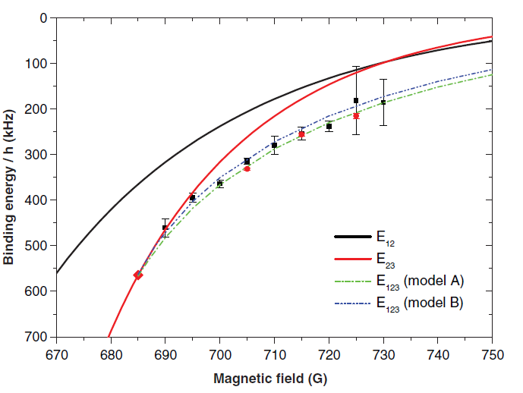
Rf association of Efimov trimers
3-component mixture of ⁶Li: atom-dimer to trimer transition
See similar experiment performed by Tokyo group - PRL 106, 143201 (2011)
T. Lompe, T.B. Ottenstein, F.Serwane, A.N. Wenz, G. Zurn, S. Jochim , Science 330, 940 (2010).
Notes:
The lifetime of trimers is expected to be short.

Slide 32
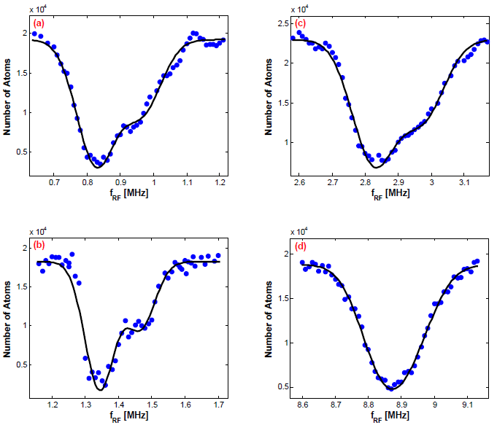

Rf association of Efimov trimers
Remaining atoms after rf-pulse at different magnetic fields.
O. Machtey, Z. Shotan, N. Gross, and L. Khaykovich, PRL 108, 210406 (2012).

Slide 33
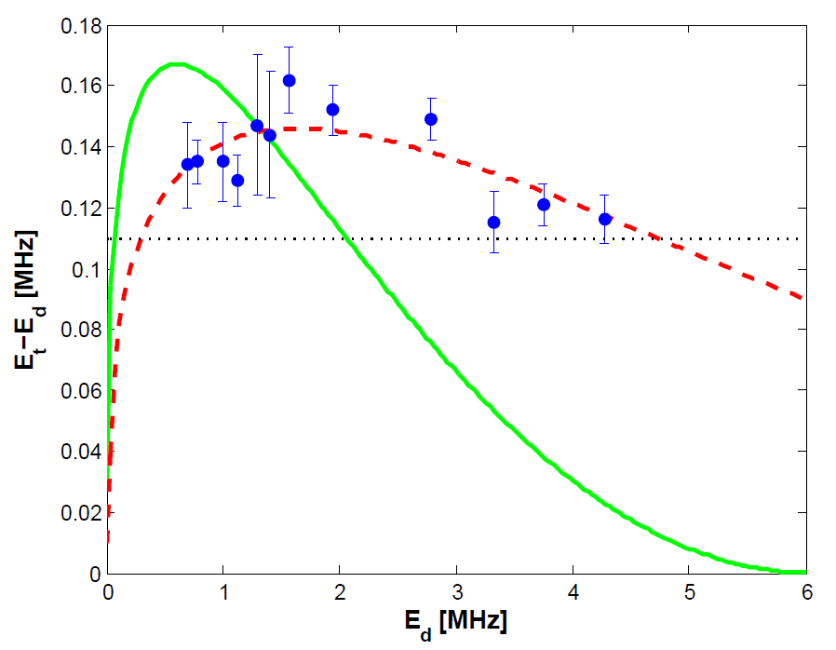
Trimer-dimer energy difference
Estimation:
O. Machtey, Z. Shotan, N. Gross, and L. Khaykovich, PRL 108, 210406 (2012).
Notes:
The universal theory is not completely wrong! It predicts correctly the depth of the Efimov trimer. However the tail is wrong.

Slide 34
Efimov resonances at the atom-dimer threshold – finite range corrections
RESULT: Position of the Efimov resonance at the atom-dimer threshold shows no
similar universality as the Efimov resonance at the three atom continuum.

Slide 35
Beyond efimov scenario

Slide 36
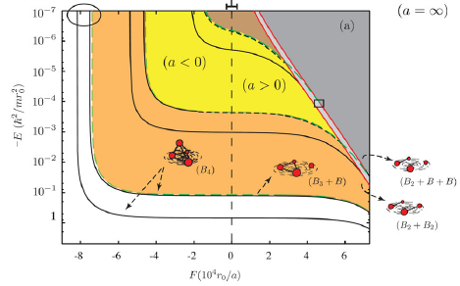
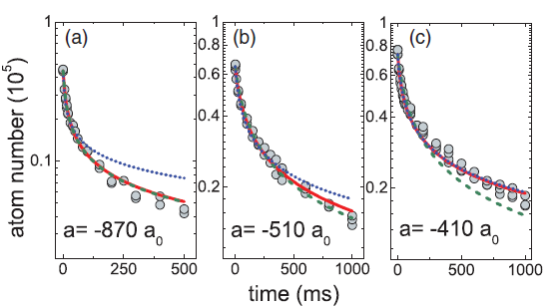
Universal 4-body states
J. Von Stecher, J.P. D’Incao, and C.H. Greene,
Nat. Phys. 5, 417 (2009).
4-body recombination:
F. Ferlaino, et. al., PRL 102, 140401 (2009).
3-body dominant
4-body dominant
M. Zaccanti, et. al., Nat. Phys. 5, 586 (2009).
See also:
S.E. Pollack, D. Dries, and R. G. Hulet, Science. 326, 1683 (2009).

Slide 37
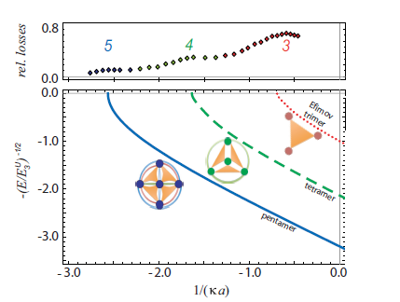
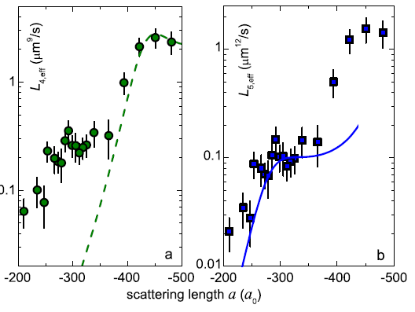
Universal 4- 5- … N-body states
4-body dominant
5-body dominant
RESULT: positions of the 4- and 5-body resonances correspond well to the predictions
of universal theory.
A. Zenessini, et. al., New J. Phys. 15, 043040 (2013).

Slide 38
Unitary Bose gas
How few-body physics affects the study of the
(inherently unstable) unitary Bose gas?

Slide 39
Saturation of L₃ at finite temperature
At finite temperature at unitarity ( ):
J.P. D’Incao, H. Suno, and B. D. Esry, PRL 93, 123201 (2004).
Refined analysis:
where:
Note: L₃T² is a log-periodic function of T (with a contrast of ~3% for identical bosons).
It is also a function of η.
For identical bosons :
B.S. Rem, A.T. Grier, I. Ferrier-Barbut, U. Eismann, T. Langen, N. Navon, L. Khaykovich,
F. Werner, D. S. Petrov, F. Chevy, and C. Salomon, PRL 110, 163202 (2013).

Slide 40
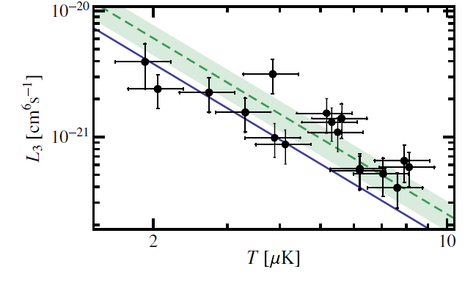
Three-body recombination at unitarity
⁷Li
Best linear fit: (μK)² cm⁶ s⁻¹
Theory (no adjustable parameters): (μK)² cm⁶ s⁻¹
B.S. Rem, A.T. Grier, I. Ferrier-Barbut, U. Eismann, T. Langen, N. Navon, L. Khaykovich,
F. Werner, D. S. Petrov, F. Chevy, and C. Salomon, PRL 110, 163202 (2013).

Slide 41
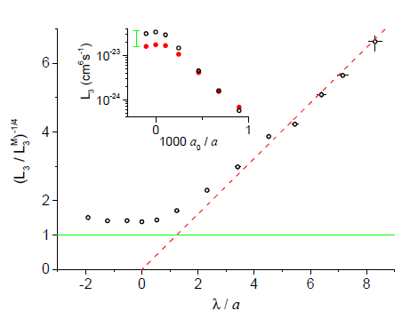
Three-body recombination at unitarity
³⁹K
Extracted value:
Best linear fit: (μK)² cm⁶ s⁻¹
RESULT: ³⁹K is more stable at unitarity than ⁷Li because of smaller η
(longer lifetime of Efimov trimers help to stabilize the unitary gas).
R. J. Fletcher, A. L. Gaunt, N. Navon, R. P. Smith, and Z. Hadzibabic, arXiv:1307.3193

Slide 42
Conclusions and outlook
A number Efimov features is observed by a number of experimental techniques in a number of atomic species and the three-body parameter is determined (turned out to be universal for van der Waals (short range) potential).
Recombination rate measurement is a strong tool in study of the universal bound states.
RF spectroscopy allows continuous probing of the Efimov energy levels.
Atom-dimer resonance position is an open question in some atomic species.
Efimov physics and narrow Feshbach resonances.
From few-body to many-body: study of unitary Bose gases.

