Slide 1
Structure of Be hyper-isotopes
Masahiro ISAKA (RIKEN)
Collaborators: H. Homma and M. Kimura (Hokkaido University)

Slide 2
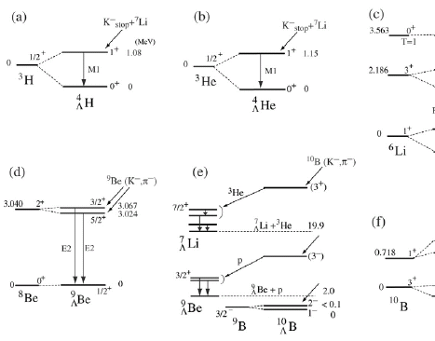
Structure study of Λ hypernuclei
Knowledge of ΛN effective interaction
  Through studies of s-p shell Λ hypernuclei
    Accurate solution of few-body problems ^{[1]}
    ΛN G-matrix effective interactions ^{[2]}
    Increases of experimental information ^{[3]}
Developments of theoretical models
  By structure studies of unstable nuclei
  Ex.: Antisymmetrized Molecular Dynamics (AMD)^{[4]}
      AMD describes dynamical changes of various structure
      No assumption on clustering and deformation
Systematic (theoretical) study of Λ hypernuclear structure
“Structure changes by hyperon as an impurity”
[1] E. Hiyama, NPA 805 (2008), 190c, [2] Y. Yamamoto, et al., PTP Suppl. 117 (1994), 361.,
[3] O. Hashimoto and H. Tamura, PPNP 57 (2006), 564., [4] Y. Kanada-En’yo et al., PTP 93 (1995), 115.

Slide 3






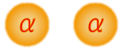
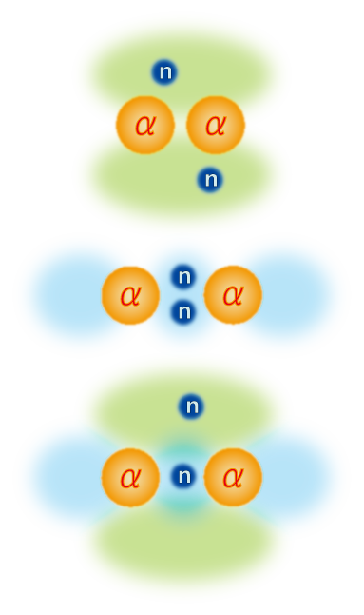
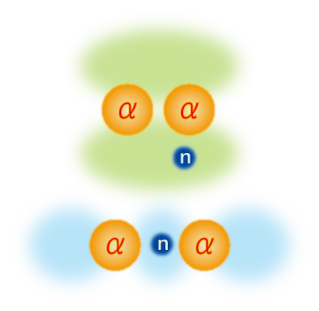
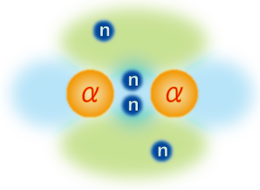
Structure of Be isotopes
  Be isotopes have a 2α cluster structure
    2α cluster structure is changed depending on the neutron number
“molecular-orbit”
Y. Kanada-En’yo, et al., PRC60, 064304(1999)
N. Itagaki, et al., PRC62 034301, (2000).
π² config.
σ² config.
σ-orbit
πσ config.
π-orbit
πσ config.

Slide 4
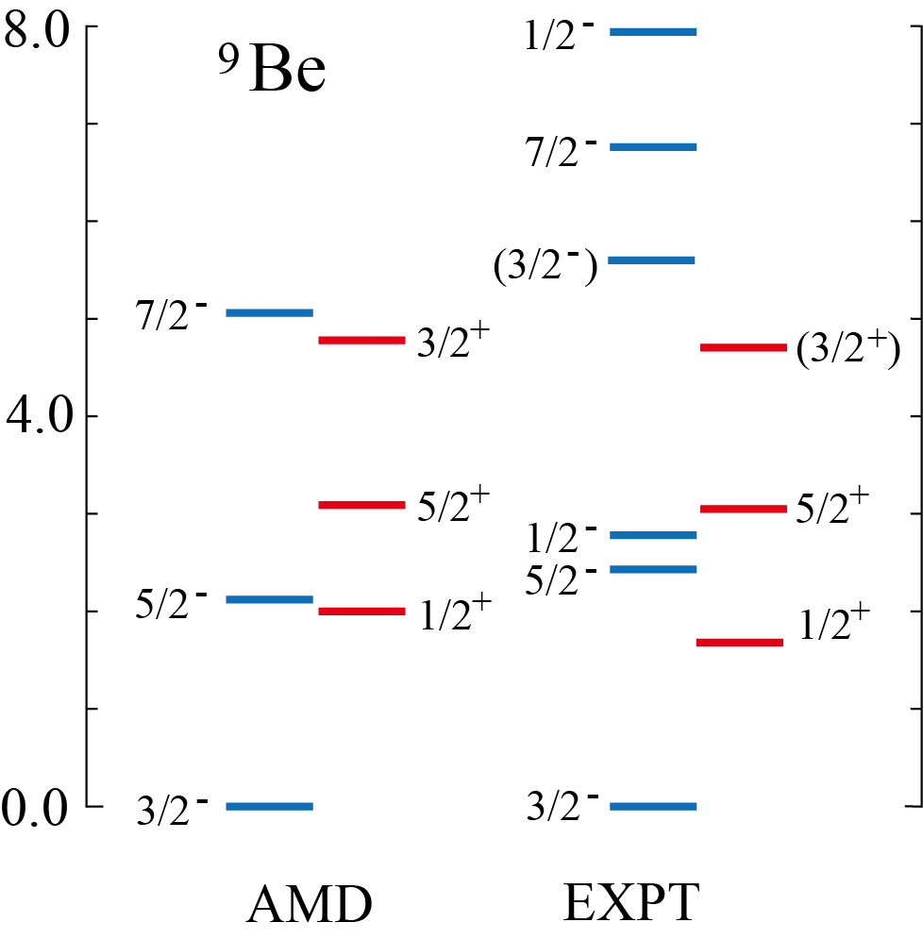
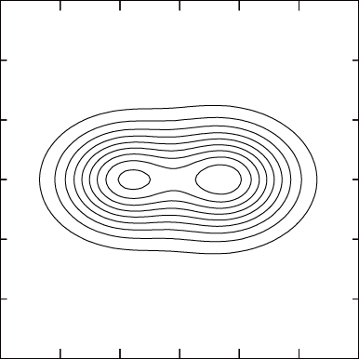
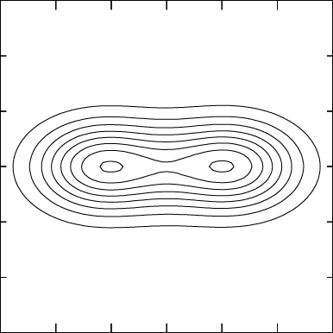
Structure of ⁹Be
⁹Be has a 2α + n structure
  The difference of the orbit of the last neutron leads to the difference of deformation
3/2⁻
1/2⁺
β = 0.73
β = 1.02
⁸Be(0⁺) + n(p-orbit)
⁸Be(0⁺) + n(s-orbit)
Centrifugal barrier
due to L=1
No barrier
Large deformation
Small deformation
(compact)

Slide 5
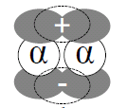
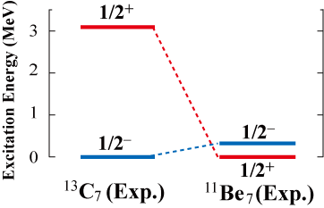

Exotic structure of ¹¹Be
₄
Parity inversion of the ¹¹Be₇ ground state
  The ground state of ¹¹Be is 1/2⁺
  One of the reasons of the parity inversion is the molecular orbit structure of the 1/2+ and 1/2- states.
¹¹Be 1/2⁻
Vanishing of the magic number N=8
inversion
Extra neutrons in π orbit^{[1]}
(small deformation)
¹¹Be 1/2⁺
Extra neutrons in σ orbit^{[1]}
(large deformation)
Difference of deformation
[1] Y. Kanada-En’yo and H. Horiuchi, PRC 66 (2002), 024305.

Slide 6
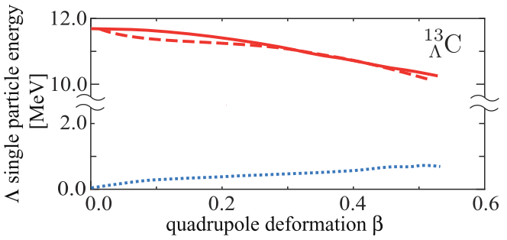
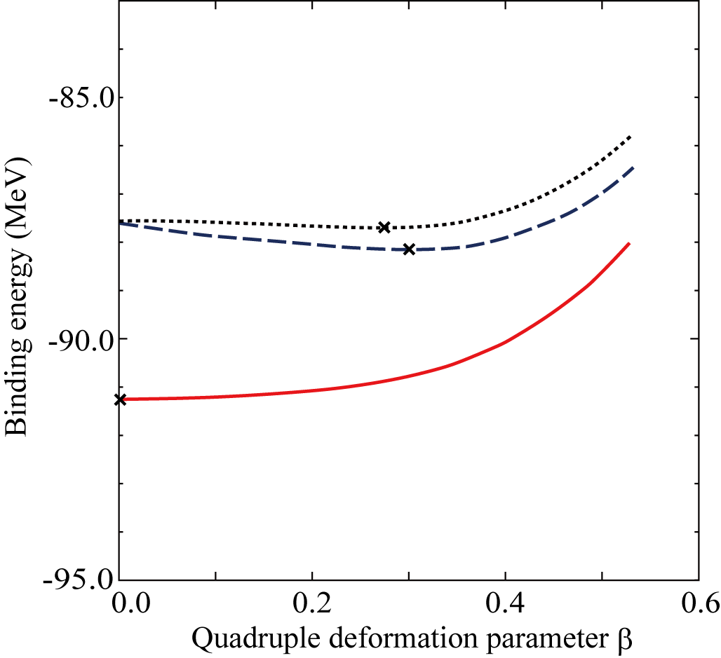
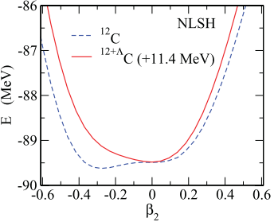
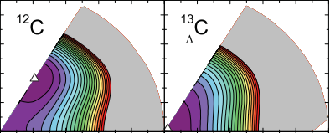
Λ binding energy as a function of β
  Λ in s-orbit is deeply bound with smaller deformation
Example: ¹³_{Λ}C Binding energy of Λ
M. Isaka, et. al., PRC 83 (2011), 044323.
Energy curves of ¹³_{Λ}C
¹²C(Pos.)⊗Λ(s)
¹²C(Neg)⊗Λ(s)
¹²C Pos.
Λ binding energy [MeV]
E energy (MeV)
¹²C(Pos)⊗Λ(p)
¹²C(Pos)⊗Λ(p)
¹²C(Pos)⊗Λ(s) + 8.0MeV
2
Spherical
1
M. T. Win and K. Hagino, PRC78, 054311(2008)
Bing-Nan Lu, et al., PRC 84, 014328 (2011)

Slide 7
Purpose of this study
Purpose of this study
  To reveal how Λ hyperon affects and modifies the low-lying states of Be isotopes with different deformation
  Examples
  ¹⁰_{Λ}Be: ground and 1/2+ resonance states of ⁹Be
  ¹²_{Λ}Be: abnormal parity ground state of ¹¹Be
Method
  HyperAMD (Antisymmetrized Molecular Dynamics for hypernuclei)
    No assumption on 2α cluster structure
    AMD has succeeded in the structure studies of Be isotopes
  YNG-interaction (NSC97f, NF)
(Produced by JLab experiments)
(It will be possible to produce ¹²_{Λ}Be at J-PARC)

Slide 8
Theoretical framework: HyperAMD
  We extended the AMD to hypernuclei
  HyperAMD (Antisymmetrized Molecular Dynamics for hypernuclei)
Hamiltonian
    NN：Gogny D1S
    ΛN：YNG interaction (NSC97f, NF^{[１]})
Wave function
Nucleon part：Slater determinant
Spatial part of single particle w.f. is
described as Gaussian packet
Single particle w.f. of Λ hyperon:
Superposition of Gaussian packets
Total w.f.：
[1] Y. Yamamoto, T. Motoba, H. Himeno, K. Ikeda and S. Nagata, Prog. Theor. Phys. Suppl. 117 (1994), 361.
[2] E. Hiyama, M. Kamimura, T. Motoba, T. Yamada and Y. Yamamoto, Prog. Theor. Phys. 97 (1997), 881.

Slide 9
Theoretical Framework (AMD^{[1],[2]})
Procedure of the calculation
Variational Calculation
Imaginary time development method
Variational parameters:
Angular Momentum Projection
Generator Coordinate Method(GCM)
Superposition of the w.f. with different configuration
Diagonalization of and
[1] Y. Kanada-En’yo, H. Horiuchi and A. Ono, Phys. Rev. C 52 (1995), 628.
[2] H. Matsumiya, K. Tsubakihara, M. Kimura, A. Doté and A. Ohnishi, To be submitted

Slide 10
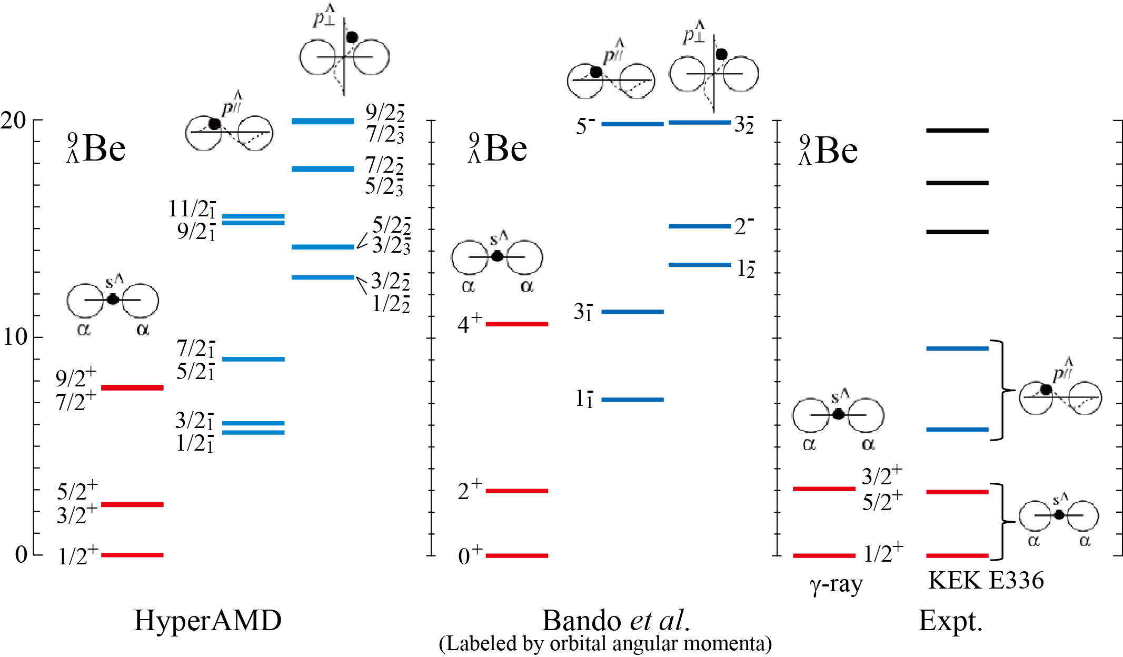
Application to ⁹_{Λ}Be hypernucleus
[2]
[3]
[1]
[1] Bando et al., PTP 66 (1981) 2118.
[2] M. May et al., PRL 51 (1983) 2085; H. Akikawa et al., PRL 88 (2002) 082501.
[3] O. Hashimoto et al., NPA 639 (1998) 93c

Slide 11
Level structure of ¹⁰_{Λ}Be

Slide 12
Structure of ⁹Be
⁹Be has 2α + n structure
  The difference of the orbit of the last neutron leads to the difference of deformation
1/2⁺
3/2⁻
β = 1.02
β = 0.73
⁸Be(0⁺) + n(s-orbit)
⁸Be(0⁺) + n(p-orbit)
No barrier
Centrifugal barrier
due to L=1
Large deformation
Small deformation
How does Λ hyperon modify the level structure with different deformation?

Slide 13
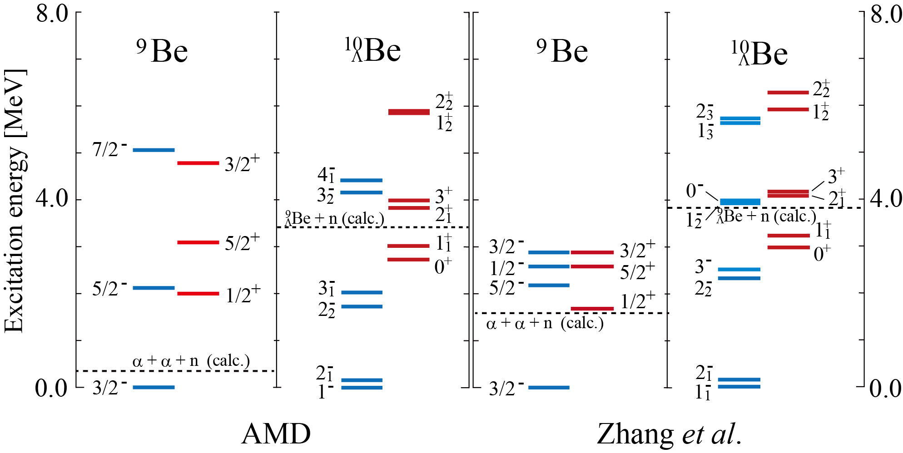
Excitation spectra of ¹⁰_{Λ}Be
Four-body cluster model

Slide 14
Excitation spectra of ¹⁰_{Λ}Be
Four-body cluster model
Y. Zhang, E. Hiyama, Y. Yamamoto, NPA 881, 288 (2012).
Positive parity states in ¹⁰_{Λ}Be are shifted up by Λ hyperon

Slide 15
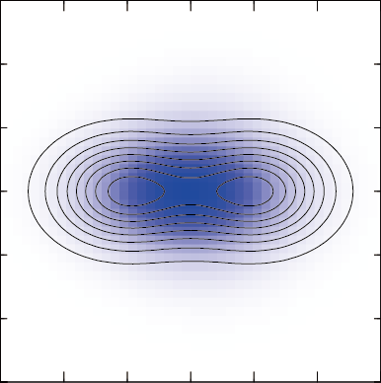
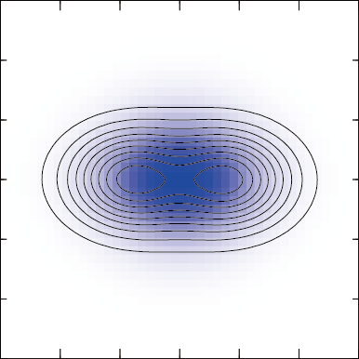
Binding energy of Λ hyperon
Shift up of the positive parity states
  Λ hyperon coupled to the 3/2⁻ state is more deeply bound due to the smaller deformation.
  Λ hyperon in s-orbit is deeply bound with small nuclear deformation
0⁺ (1/2⁺⊗Λs)
1/2⁺
⁹Be
¹⁰Be
_{Λ}
r = 2.94fm
B_{Λ}= 8.2 MeV
2.0 MeV
β = 0.92
β = 1.02
r = 2.82fm
r = 2.55fm
1⁻ (3/2⁻⊗Λs)
3/2⁻
B_{Λ}= 8.9 MeV
2.7 MeV
r = 2.46fm
β = 0.70
β = 0.73

Slide 16
Ground state parity of ¹²_{Λ}Be

Slide 17
Exotic structure of ¹¹Be
₄
Parity inversion of the ¹¹Be₇ ground state
  The ground state of ¹¹Be is 1/2⁺
  One of the reasons of the parity inversion is the molecular orbit structure of the 1/2+ and 1/2- states.
¹¹Be 1/2⁻
Vanishing of the magic number N=8
inversion
Extra neutrons in π orbit^{[1]}
(small deformation)
¹¹Be 1/2⁺
Extra neutrons in σ orbit^{[1]}
(large deformation)
Difference of deformation
How does the Λ hyperon affect the parity-inverted ground state?
[1] Y. Kanada-En’yo and H. Horiuchi, PRC 66 (2002), 024305.

Slide 18
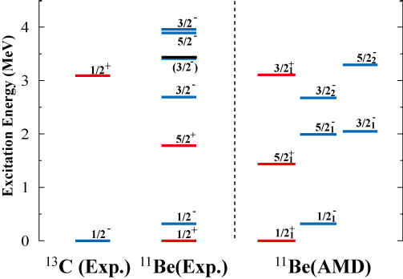
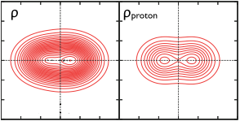
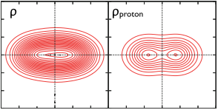
Excitation spectra of ¹¹Be
¹³C(Exp)
¹¹Be(Exp)
¹¹Be(AMD)
¹¹Be 1/2⁻
β=0.52
¹¹Be 1/2⁺
β=0.72
Deformation of the 1/2⁻ state is smaller than that of the 1/2⁺ state
Λ hyperon in s orbit is deeply bound at smaller deformation
  Parity reversion of the ¹²_{Λ}Be ground state may occur by Λ in s orbit

Slide 19
Excitation spectra of ¹¹Be
¹³C(Exp)
¹¹Be(Exp)
¹¹Be(AMD)
¹¹Be 1/2⁻
β=0.52
¹¹Be 1/2⁺
B_{Λ}
B_{Λ}
β=0.72
Reversion?
¹²_{Λ}Be
Deformation of the 1/2⁻ state is smaller than that of the 1/2⁺ state
Λ hyperon in s orbit is deeply bound with smaller deformation
  Parity reversion of the ¹²_{Λ}Be ground state may occur by Λ in s orbit

Slide 20
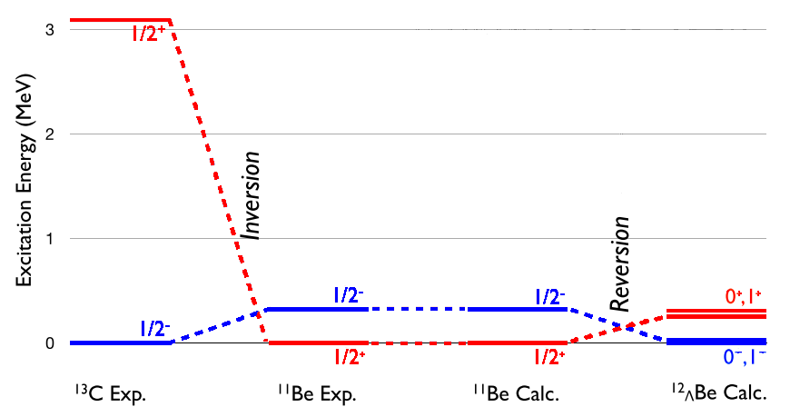
Results: Parity reversion of ¹²_{Λ}Be
Ground state of ¹²_{Λ}Be
  The parity reversion of the ¹²_{Λ}Be g.s. occurs by the Λ hyperon
3.0
2.0
¹³C₇
¹¹Be₇
¹¹Be₇
¹²_{Λ}Be
(Exp.)
(Exp.)
(AMD)
Excitation Energy (MeV)
(HyperAMD)
1.0
0.0

Slide 21
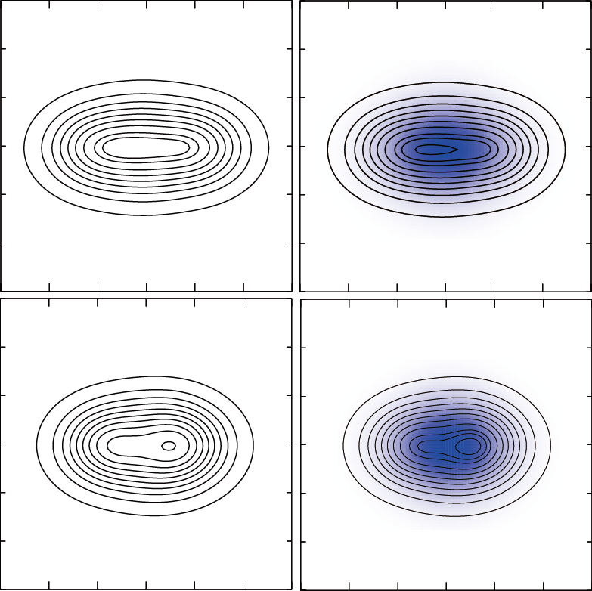
Deformation and Λ binding energy
  Λ hyperon coupled to the 1/2⁻ state is more deeply bound than that coupled to the 1/2⁺ state
    Due to the difference of the deformation between the1/2⁻ and 1/2⁺ states
1/2⁻
¹¹Be
¹²Be
_{Λ}
0⁺ (1/2⁺⊗Λs)
(Calc.)
(Calc.)
r = 2.53 fm
β=0.52
0.32 MeV
B_{Λ} = 10.24 MeV
β=0.70
1/2⁺
r = 2.69 fm
0⁻ (1/2⁻⊗Λs)
B_{Λ} = 9.67 MeV
r = 2.67 fm
0.25 MeV
β=0.72
r = 2.51 fm
β=0.47

Slide 22
Glue-like role in ¹⁰_{Λ}Be

Slide 23
Glue-like role of Λ hyperon in ¹⁰_{Λ}Be
Y. Zhang, E. Hiyama, Y. Yamamoto, NPA 881, 288 (2012).
The resonance (virtual) state 1/2+ will bound by adding Λ hyperon

Slide 24
Glue-like role of Λ hyperon in ¹⁰_{Λ}Be
Y. Zhang, E. Hiyama, Y. Yamamoto, NPA 881, 288 (2012).
The resonance (virtual) state 1/2+ will bound by adding Λ hyperon

Slide 25
Summary
Summary
  To reveal how Λ hyperon affects and modifies the low-lying states of Be isotopes with different deformation, we applied the HyperAMD to ¹⁰_{Λ}Be and ¹²_{Λ}Be.
  We focus on the positive and negative parity states in ¹⁰_{Λ}Be and ¹²_{Λ}Be
    Λ hyperon coupled to compact state is more deeply bound
    ¹⁰_{Λ}Be: pos. parity states are shifted up by Λ hyperon
    ¹²_{Λ}Be: the parity reversion of the ground state will occur.
  In ¹⁰_{Λ}Be, the resonance state 1/2⁺ in ⁹Be will be bound by Λ hyperon
Future plans
  To reveal how Λ hyperon affects the 2α clustering and orbit of extra neutrons
  To predict production cross section of ¹⁰_{Λ}Be, ¹²_{Λ}Be etc.
Consistent with the prediction of ¹⁰_{Λ}Be and ¹³_{Λ}C by Hiyama et al.
Systematic structure study of Be hyper isotopes

Slide 27
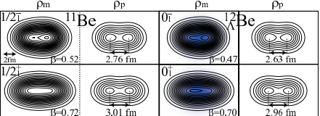
Backup: Density distribution of ¹²_{Λ}Be

Slide 28
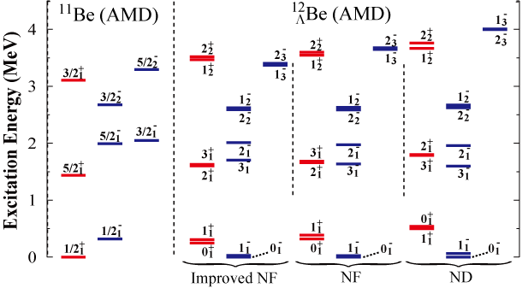
Excitation spectra
Improved YNG-NF[2]
YNG-NF[1]
YNG-ND[1]
The 1/2⁻⊗Λs state always becomes the ground state of ¹²_{Λ}Be
Parity reversion will occur with all of these 3 kinds of ΛN interactions
[1] Y. Yamamoto, et al., PTPS 117 (1994), 361. [2] E. Hiyama, et al.,PTP 97 (1997), 881.

Slide 29
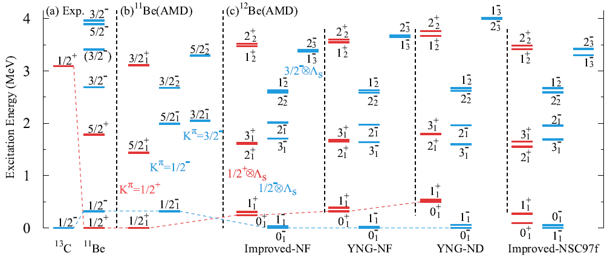
Excitation spectra
[1]
[2]
[2]
[3]
[1] E. Hiyama, et al., PTP 97, 881 (1997).
[2] Y. Yamamoto, et al., PTPS 117 (1994), 361.
[3] E. Hiyama, et al., PTP 185, 106 (2010)

Slide 30
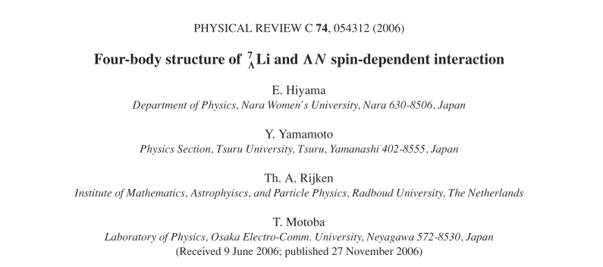

Backup: LS interaction between Λ and N

Slide 31
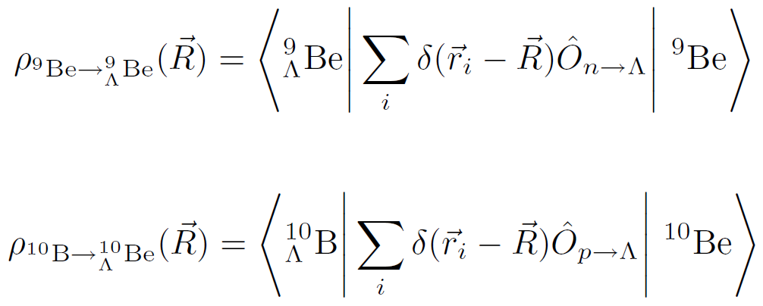
Backup: Transition density
Transition density
  Transition density is an input to perform DWIA calculation
  Transition density will be calculated based on the AMD wave function
Structure described by AMD wave function
Ex.) ⁹_{Λ}Be production reaction
Ex.) ¹⁰_{Λ}Be production reaction

Slide 32
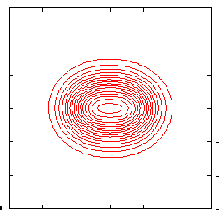
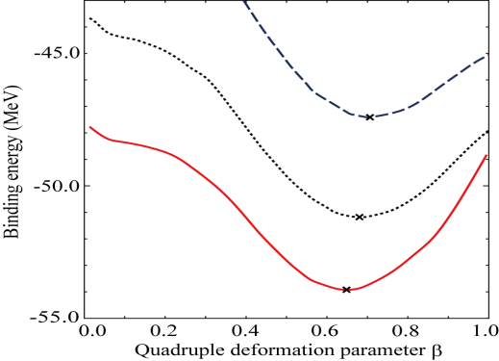
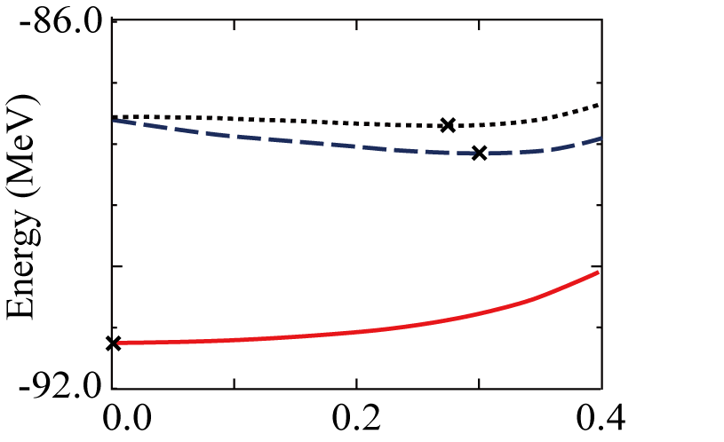
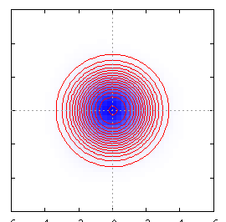
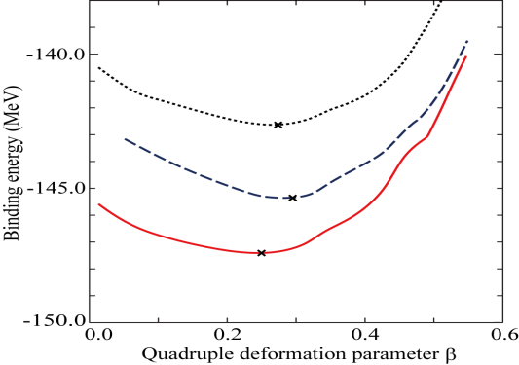
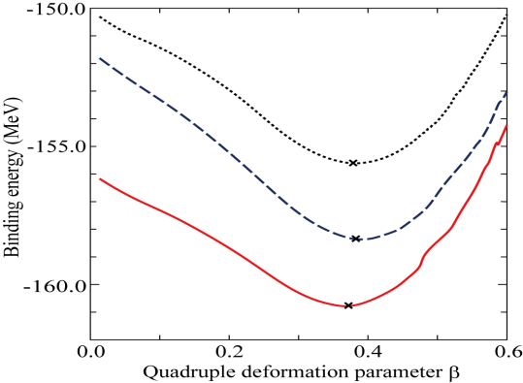
Deformation change by Λ in s-orbit
From changes of energy curves
¹²C (Pos)
¹³
C
⁹_{Λ}Be
_{Λ}
β = 0.27
¹²C (Pos)⊗Λ(s)
¹²C Pos.
adding Λ in s-orbit
β = 0.00
²⁰_{Λ}Ne
¹²C(Pos)⊗Λ(s) + 8.0MeV
quadrupole deformation β
1.5
Spherical
1
Λ in s-orbit reduces the nuclear deformation
²¹_{Λ}Ne

Slide 33
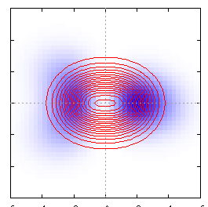
Deformation change by Λ in p-orbit
From changes of energy curves
¹²C (Pos)
¹²C(Pos)⊗Λ(p)
¹³
C
⁹_{Λ}Be
_{Λ}
β = 0.30
β = 0.27
¹²C Pos.
¹²C(Pos)⊗Λ(p)
adding Λ in p orbit
²⁰_{Λ}Ne
quadrupole deformation β
1.5
Spherical
1
Λ in p-orbit enhances the nuclear deformation
Opposite trend to Λ in s-orbit
²¹_{Λ}Ne

Slide 34
Λ binding energy
Variation of the Λ binding Energy
  Λ in s-orbit is deeply bound at smaller deformation
  Λ in p-orbit is deeply bound at larger deformation
¹³_{Λ}C
Binding energy of Λ
¹³_{Λ}C
Energy curves
¹²C(Pos.)⊗Λ(s)
¹²C Pos.
¹²C(Neg)⊗Λ(s)
Λ binding energy [MeV]
¹²C(Pos)⊗Λ(p)
E energy (MeV)
¹²C(Pos)⊗Λ(p)
¹²C(Pos)⊗Λ(s) + 8.0MeV
  Variation of the Λ binding energies causes
  the deformation change (reduction or enhancement)

