Slide 1
Study of Neutron-Rich Λ Hypernuclei
Tomokazu FUKUDA
Osaka Electro-Communication
University

Slide 2
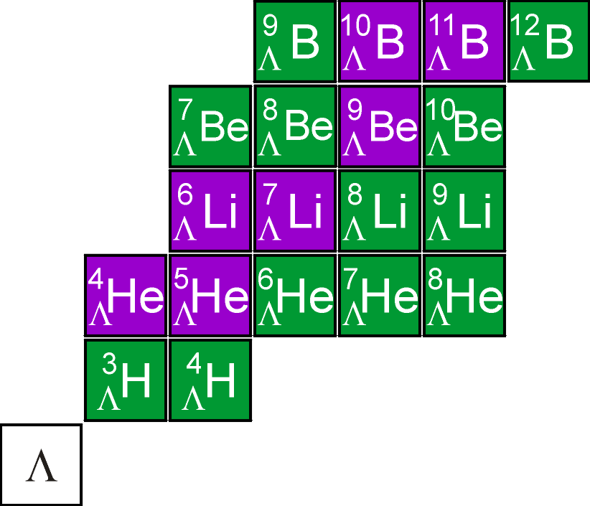
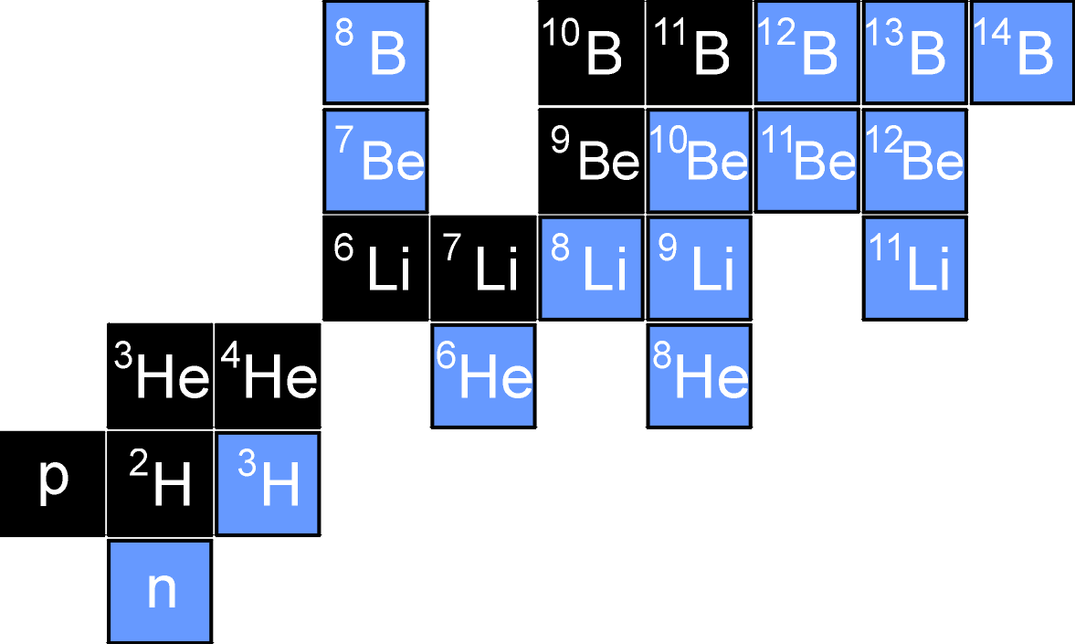
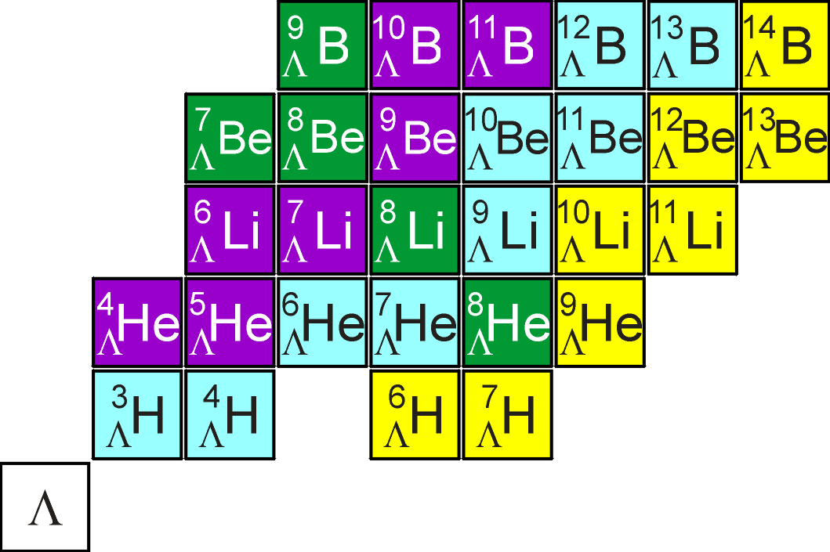
Expand the Hypernuclear Chart
Isospin=0 or 1/2
Non Charge-Exchange
Ordinary Nuclei
Hyperfragments
by Emulsion Exp.
Isospin=3/2 or 2
KEK-E521
Single CX
Double CX
J-PARC E10

Slide 3
ΛN-ΣN Mixing in Λ Hypernuclei
B.F. Gibson et al. PRC 6 (1998) 433c.
if core isospin=0
ordinary
nuclei
hypernuclei
A(I=0)
A(I=0)
ΔN
ΣN
Λ
Σ
77MeV
Small wave
function overlap
A*(I≠0)
290MeV
ΛN
Σ
if core isospin≠0
A(I≠0)
A(I≠0)
NN
S=0
S= -1
Λ
OK!
Σ
Important in neutron-rich Λ-hypernuclei (large isospin)

Slide 4
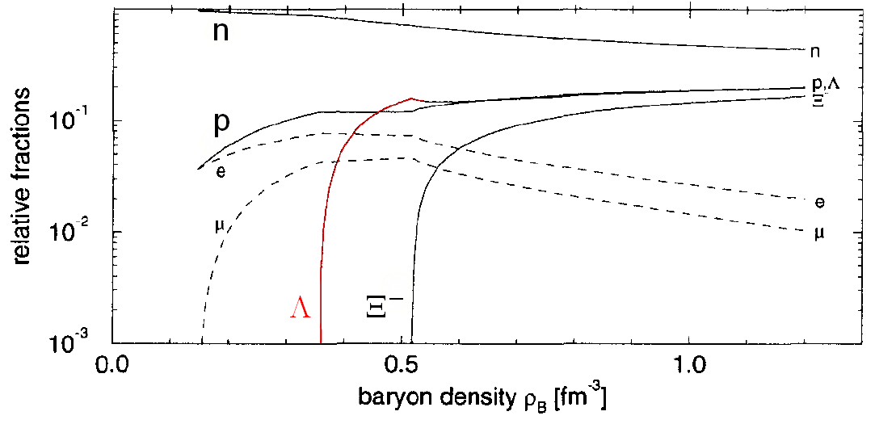
EoS in neutron star
large isospin
ΛN-ΣN mixing effect
Ξ－N interaction is not yet known
study of Ξ－ hypernuclei is also important
Quasi-particle

Slide 5
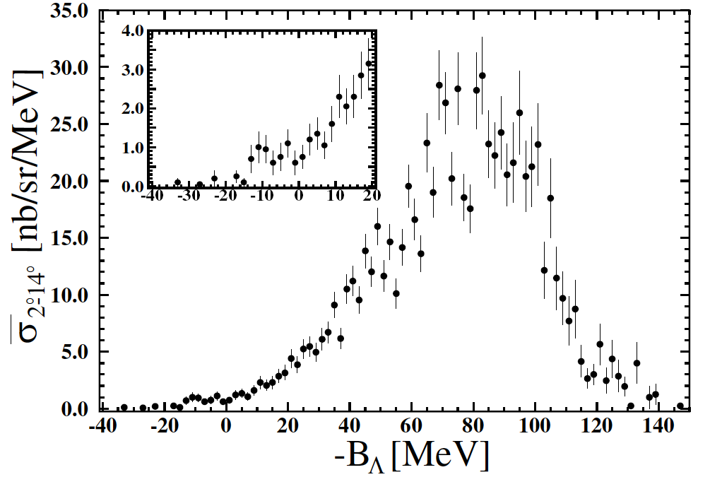
First production of neutron-rich Λ hypernuclei
Λ spectrum by DCX (π⁻,K⁺) reaction at 1.2GeV/c
KEK-PS-E521
P. K. Saha, et al., PRL94(2005)052502
Cross sections
- p_{π}=1.20 GeV/c
11.3±1.9 nb/sr
2.5 MeV FWHM
g.s.
11.3±1.9 nb/sr
- p_{π}=1.05 GeV/c
5.8±2.2 nb/sr
⁹Li+Λ
～1/1000
⁹Li+Λ
g.s.
(1.2 GeV/c)
17.5±0.6 μb/sr

Slide 6
Theoretical Analysis by T. Harada
Two-step process:
One-step process:
Doorway
via Σ⁻ doorways caused
by ΛN-ΣN coupling

Slide 7
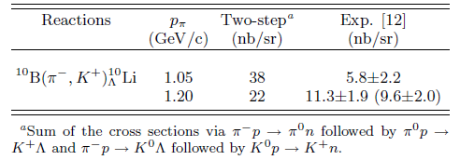
Two-step process:
Pioneer theoretical works by Tretyakova and Lanskoy.
Phys.At.Nucl.66(2003)1651
arXiv:nucl-th/0411004v1
Exp.data.
Two-step
-- The momentum dependence of the cross section
is different from that of the data.
1.05
1.20

Slide 8
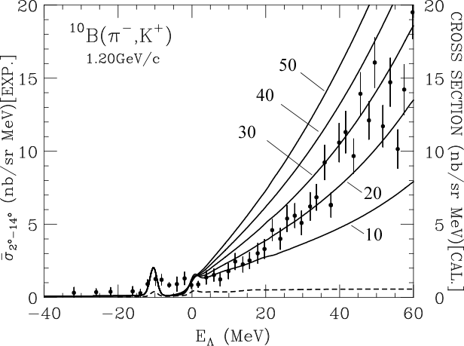
Results (1)
Λ spectrum by DCX (π⁻,K⁺) reaction at 1.2GeV/c
Spreading potential dep.
is fixed. P_{Σ-}=0.57%
¹⁰B
⁹Li+L
-W_{Σ}=
3⁺
2⁻
(p_{Λ})
(s_{Λ})
Harada, Umeya,
Hirabayashi,
PRC79(2009)014603
Two-step mechanism
The calculated spectrum with -W_{Σ}= 20-30 MeV can reproduce the shape of the data in the continuum region, and these values of -W_{Σ} are consistent with the analysis of Σ⁻ QF production by the (π⁻, K⁺) reactions.

Slide 9
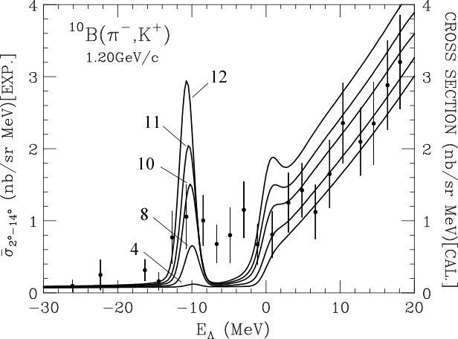
Results (2)
Λ spectrum by DCX (π⁻,K⁺) reaction at 1.2GeV/c
Coupling Λ-Σ potential dep.
is fixed.
¹⁰B
0.68%
s_{Λ}
0.57%
p_{Λ}
0.47%
0.30%
Harada, Umeya,
Hirabayashi,
PRC79(2009)014603
0.075 %
Not take into account
a fine structure
With the order of V_{X} = 10-12 MeV (P_{Σ-}~ 0.5 %), the calculated spectra can fairly reproduce the data.

Slide 10
⁶_{Λ}H

Slide 11
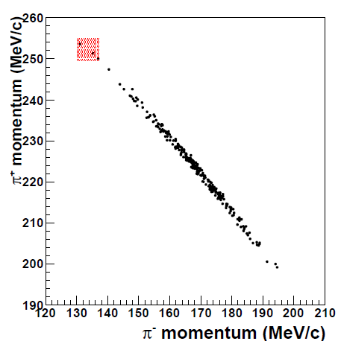
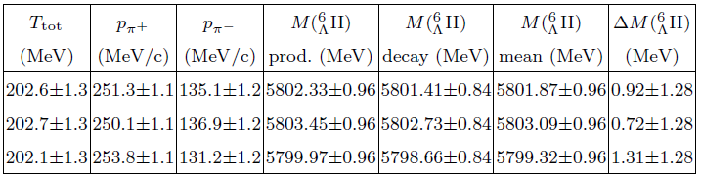
⁶_{Λ}H production @ FINUDA
M. Agnello et al., FINUDA Collaboration, PRL 108 (2012) 042501
⁶Li(stopped K⁻,π⁺) reaction
Measured formation and weak decay in coincidence
cut on T(π⁺)+T(π⁻)
3 events of candidates
11

Slide 12
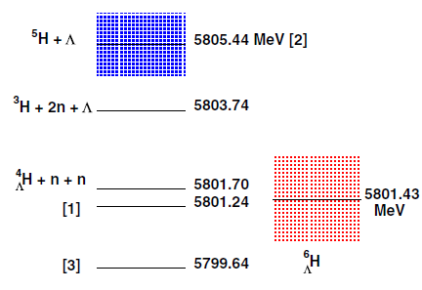
Theoretical approach
E. Hiyama
4-body calculation of tnnΛ
R. H. Dalitz
ΛN interaction
Y. Akaishi
Coherent ΛNN interaction
Hiyama
5802.87
Dalitz
Akaishi
E.Hiyama et al., NPA 908(2013)29.
R.H.Dalitz et al., Nuovo Ciment 30(1963)489.
Y. Akaishi et al., PRL 84(2000)3539.

Slide 13
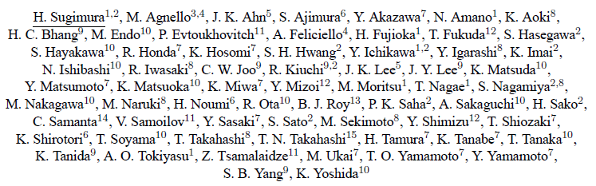
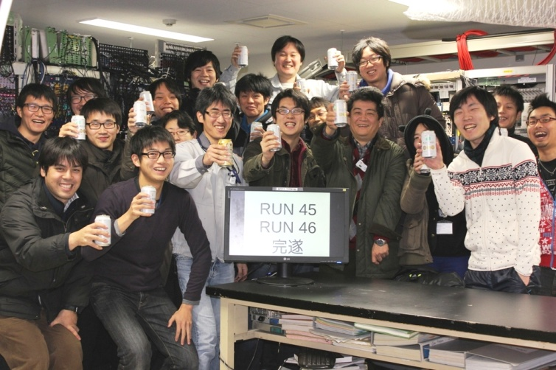
J-PARC E10 Experiment Dec. 2012 – Jan. 2013

Slide 14
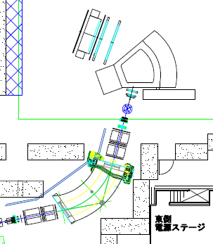
Experimental Setup
LC
SDC4
K1.8 Beamline
1.2GeV/c π⁻ Beam
Δp/p ~3.3x10⁻⁴
Momentum is calculated by the
Transfer Matrix
BFT(x)-BC3,4(x,y,x’,y’)
SKS Spectrometer
Central Momentum 0.9GeV/c
Δp/p~1.0x10⁻³
Momentum is calculated
by Runge-Kutta method
SFT,SDC2(x,y,x’,y’)-SDC3,4(x,y,x’,y’)
Scattered Kaon identified TOFxLCxAC in
online trigger
SDC3
K⁺
SKS
AC
SDC2
TOF
BH2
SFT
BC4
SSD
BC3
π⁻
GC
BFT
BH1
J-PARC
K1.8 Beam Line

Slide 15
Yield estimation in E10 proposal
Parameters | Values
Pion beam momentum Pion beam intensity Total number of pions (6 s acc. cycle) Target thickness (⁶Li) DCX cross section (assumed) SKS acceptance Spectrometer efficiency (due to K decay) Analysis efficiency | 1.2 GeV/c 10M/spill 3x10¹²pions 3.5 g/cm² 10 nb/sr 100 msr 0.5 0.5
Estimated ⁶_{Λ}H yield in 3 weeks | 265

Slide 16
Run conditions of E10
reaction | Momentum | Intensity (pions/spill) | time
Production Run -> Total number of pions : 1.65x10¹²
⁶Li(π⁻,K⁺)⁶_{Λ}H | 1.2GeV/c | 1.0-1.2x10⁷ | 11.5days
Calibration Run – To confirm the performance of SKS system, and to calibrate the absolute missing mass value with two magnet polarity settings
p(π⁻,K⁺)Σ⁻ | -1.37GeV/c | 1.0x10⁷ | 4hours
p(π⁺,K⁺)Σ⁺ | +1.37GeV/c | 3.5x10⁶ | 1hours
¹²C(π⁺,K⁺)¹²_{Λ}C | +1.2GeV/c | 3.5x10⁶ | 1day
Beam Through Run – To measure the energy loss in the target and to see the consistency between beam line magnet and SKS
 | +1.2,+1.0,+0.9, +0.8GeV/c |  | 2hour
Production run
-1.2GeV/c ⁶Li(π⁻,K⁺)⁶_{Λ}H run -11.5days(10,12Mpions/spill)
Integrated pion beam reached to 1.65x10¹² pions
Calibration run
-1.37GeV/c p(π⁻,K⁺)Σ⁻ run - 4hours(10Mpions/spill)
+1.37GeV/c p(π⁺,K⁺)Σ⁺ run - 1hour (3.5Mpions/spill)
+1.2GeV/c ¹²C(π⁺,K⁺)¹²_{Λ}C run - 1day (3.5Mpions/spill)
Beam through run
+1.2,+1.0,+0.9,+0.8GeV/c (w/ and w/o target)

Slide 17
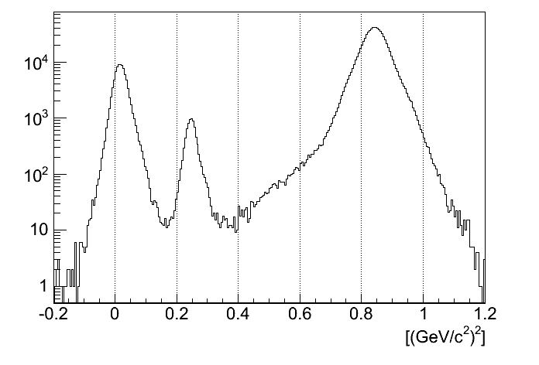
Particle ID
accepted
M²(t,p,L)=p²(1-β²)/β²
= p²(c²t²/L²-1)
t: flight time vertex to TOF
p:scatterd particle momentum
L: flight path vertex to TOF
π
K
P
Mass Square
Mass square is calculated by time, momentum and path
Selected Kaon Mass [0.2<m²<0.3]

Slide 18
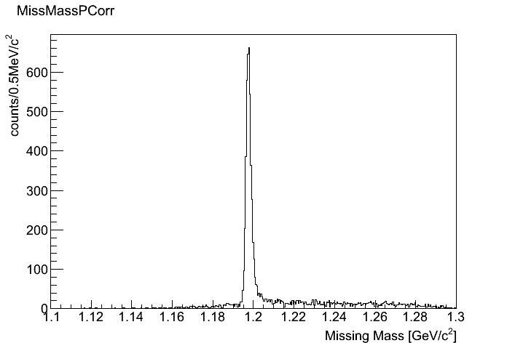
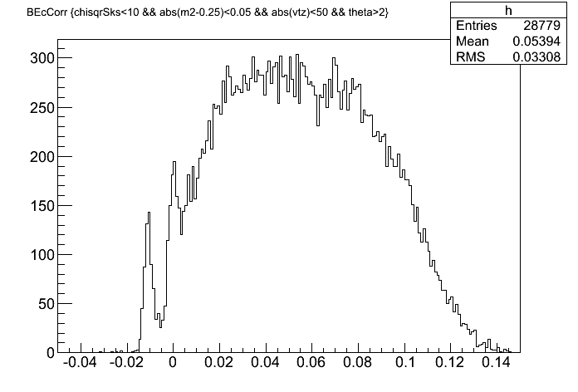
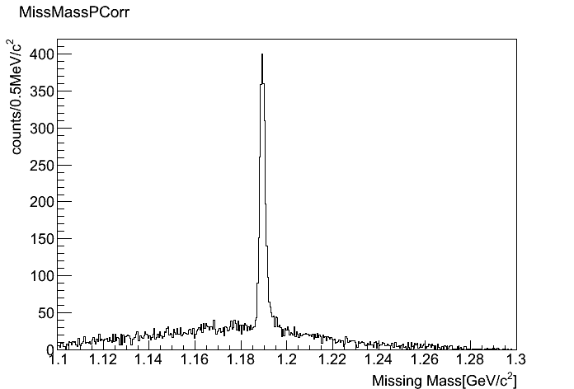
Calibration Runs
p(π⁻,K⁺) Σ⁻
ΔM:2.5MeV/c²
(FWHM)
Results of analysis
+1.20GeV/c ¹²C(π⁺,K⁺)¹²_{Λ}C
- 1.37GeV/c p(π⁻,K⁺)Σ⁻
+1.37GeV/c p(π⁺,K⁺)Σ⁺
Preliminary
Measure:1197.48MeV
PDG: 1197.45MeV
Yield : ~6000events
¹²C(π⁺,K⁺)¹²_{Λ}C
ΔB_{Λ}:2.8MeV/c²
(FWHM)
Ex(p_{Λ})
p(π⁺,K⁺) Σ⁺
ΔM:2.6MeV/c²
(FWHM)
g.s.(s_{Λ})
Preliminary
Preliminary
Measure: 1189.35MeV
PDG: 1189.37MeV
Yield : ~2000 events
Yield (g.s):
~600events

Slide 19
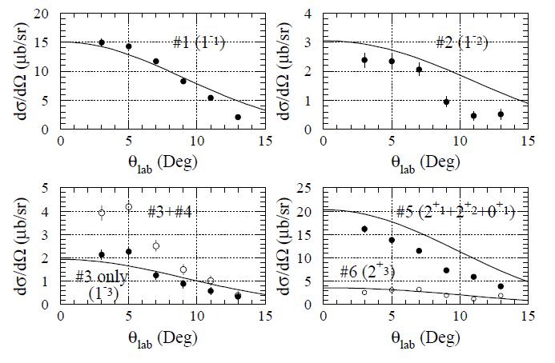
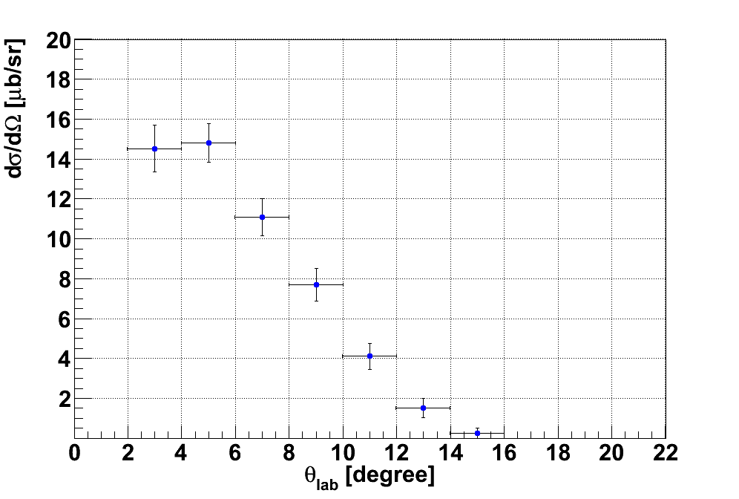
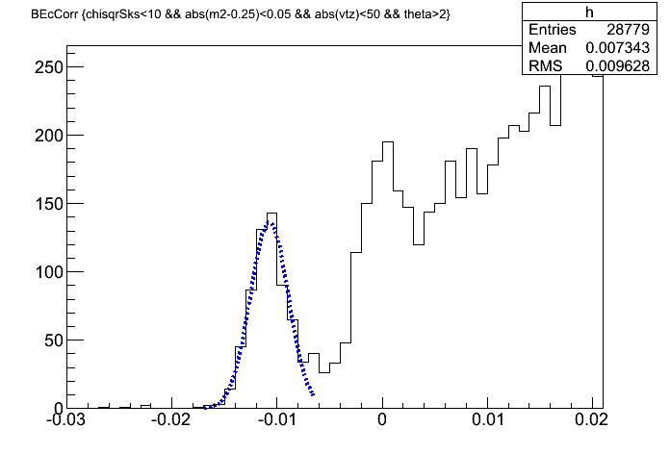
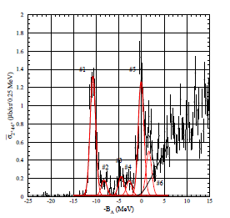
Cross Section of ¹²_{Λ}C
#1+#2
Cross section and binding energy are roughly consistent with
previous experiments
(E369,E521)
#1
#1:-10.74MeV
#2
-B_{Λ}(GeV)
Our Data : ¹²C(π⁺,K⁺)¹²_{Λ}C at +1.2GeV/c
KEK-E369 : ¹²C(π⁺,K⁺)¹²_{Λ}C at +1.05GeV/c

Slide 20
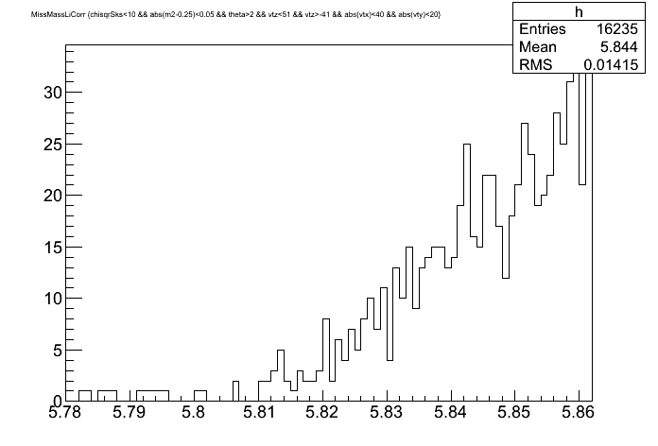
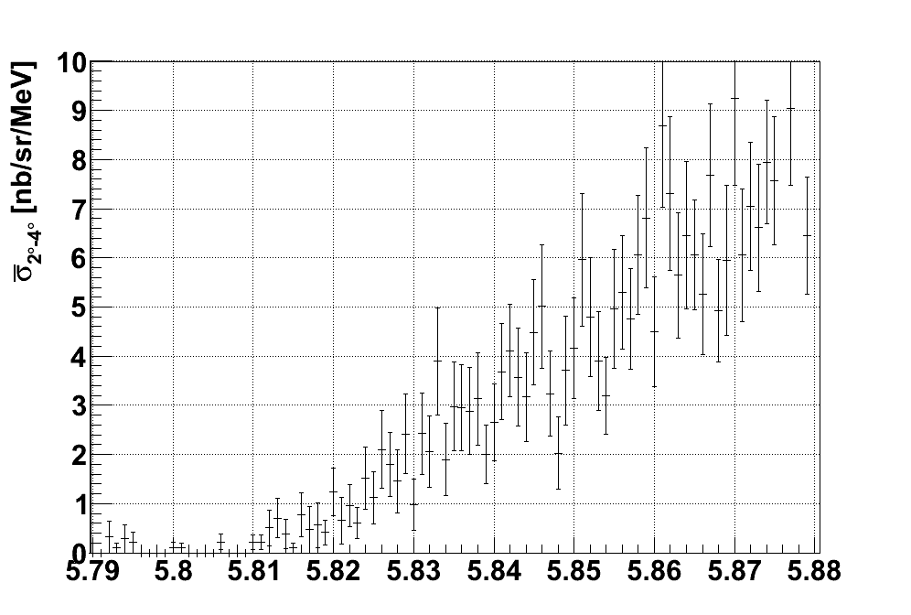
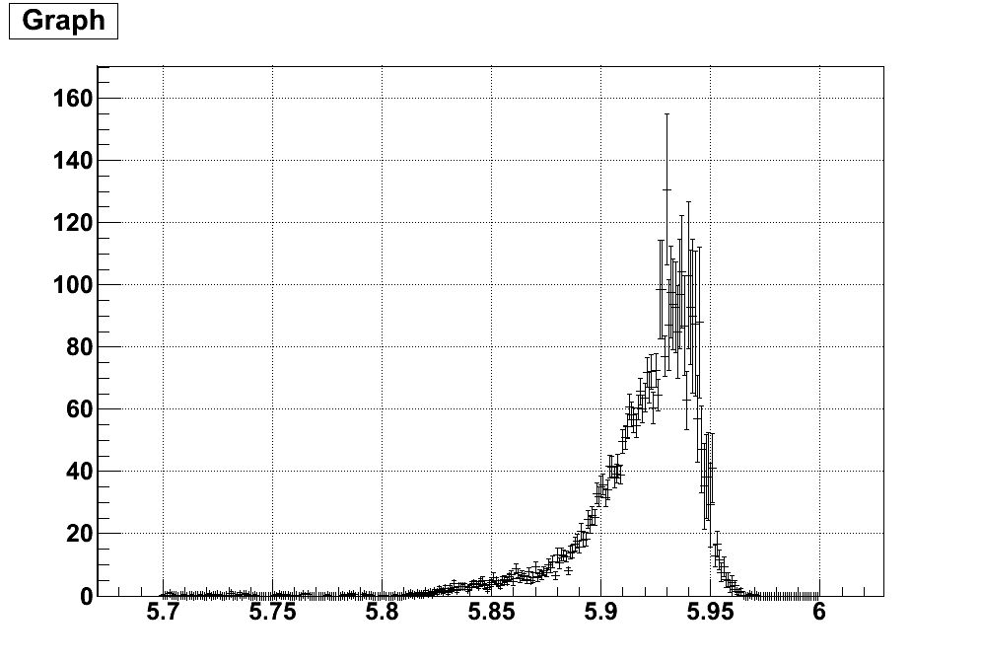
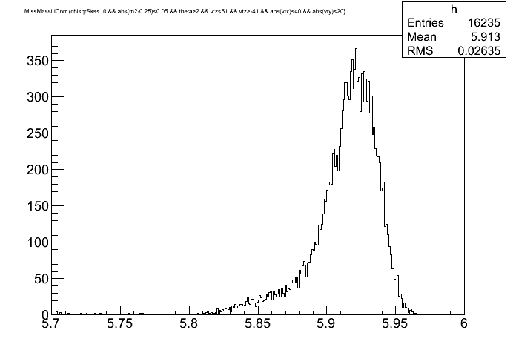
Missing Mass
Preliminary
Preliminary
Preliminary
t+2n+Λ
Σ-
continuum
Λ-
continuum
FINUDA
⁴_{Λ}H+2n = 5801.70 MeV
t+2n+Λ = 5803.74 MeV
5H+Λ = 5805.44 MeV
d+3n+Λ = 5809.99 MeV
p+4n+Λ = 5812.2 MeV
We could measure not only Λ-continuum
region but also Σ-continuum region.
Background level is about 0.5event/MeV,
corresponding to 0.1nb/sr/MeV.

Slide 21
Summary
KEK-PS E521 (¹⁰_{Λ}Li)
Σ mixing probability ~ 0.5 %
⁶_{Λ}H
J-PARC E10 experiment measured missing mass spectra
from the bound region to Λ-continuum state and also
Σ-continuum state.
Around the t+2n+Λ threshold, there is no peak structure with 10nb/sr.
Production cross section of ⁶_{Λ}H may be smaller than
what we expected (10nb/sr) or ⁶_{Λ}H may not exist.

