Slide 1
Four-body Faddeev-Yakubovsky equations
using two-cluster RGM kernels
-- Applications to 4N, 4d’ and 4α systems --
Y. Fujiwara: Kyoto University, Japan
1. Introduction
2. Three- and 4-cluster Faddeev-Yakubovsky equations using
2-cluster RGM kernels
3. Quark-model baryon-baryon interaction fss2
4. 3N and 4N bound-state problems by AV8’ and fss2
5. Coulomb effect and charge dependence of the nuclear force
6. Application to the 4α system
7. Summary
Notes:
1
2008.6.4. Colloquium

Slide 2
Introduction
Comprehensive understanding of few-baryon systems in terms of quark-model baryon-baryon interaction fss2
（3-baryon systems)
³H (n+n+p), ³_{Λ}H (n+p+Λ) : binding energies and rms radii
Scattering observables of 3-nucleon systems (nd and pd elastic scattering, 3-body breakup processes) with K. Fukukawa
(3-cluster systems）
¹²C (3α), ⁹Be (n+2α), ⁹_{Λ}Be (Λ+2α), ⁶He (2n+α), ⁶_{ΛΛ}He (2Λ+α) bound-state calculations using α, nα, Λα RGM kernels
General framework: 3-cluster and 4-cluster Faddeev-Yakubovsky equations using 2-cluster RGM kernels

Slide 3

Prerequisites of many-cluster Faddeev-Yakubovsky equations
1. Equivalence to variational approach using h.o. basis, SVM, Gaussian
expansion method, etc. for the bound-state problems
2-cluster RGM kernels are constructed from the 2-body force of constituent particles (not the phenomenological 2-cluster potentials)
→ Pauli forbidden state u is naturally induced as the orthogonality
conditions for the relative motion of clusters … i.e. , pairwise
orthogonality condition model (OCM) introduced by H. Horiuchi
For example, 2α, 3α, 4α should be consistently discussed.
Induced 3-body force (anti-symmetrization effect among 3-clusters)
and effect of the off-shell transformation (like 1/ N effect from the
elimination of the energy-dependence) can be discussed.
... could be a hint for V_{low-k} and SRG transformation for the NN force.
When existing Pauli forbidden state between 2-clusters, Faddeev redundant component should be eliminated properly and the equation becomes solvable. (non-trivial in 4-body case and more)
$√$

Slide 4
Four-cluster Faddeev-Yakubovsky formalism using two-cluster RGM kernels
Removal of the energy dependence by the renormalized RGM
Matsumura, Orabi, Suzuki, Fujiwara, Baye, Descouvemont, Theeten
3-cluster semi-microscopic calculations using 2-cluster non-local RGM kernels:
Phys. Lett. B659 (2008) 160; Phys. Rev. C76, 054003 (2007)
[ - H₀ - V_{RGM}() ]  = 0 with V_{RGM}()=V_{D}+G+ K
⇒ ☹[ - H₀ - V_{RGM}] ☹ = 0 with V_{RGM}=V_{D}+G+W
( = E - E_{int} )
Extra non-local kernel
N=1-K
RGM T-matrix
: Prog. Theor. Phys. 107 (2002) 745; 993
(also obtained by Kukulin's method )

Slide 5
4α case
_{i<j} |u_{i,j} ↑u_{i,j}|ψ=|ψ in |ψ  [4]
Projection operator onto the (pairwise) Pauli-allowed state
● = 0 : Pauli allowed Þ = |ψ ↑ψ |
● > 0 : Pauli forbidden |ψ= (1/) _{i<j} |u_{i,j} ↑u_{i,j}|ψ 
: 4-cluster OCM using V_{RGM}
Equivalent !
: 4-cluster Faddeev-Yakubovsky
equation using RGM T-matrix
Cf. Non [4]-symmetric trivial solutions in the 4α system are removable.
(Faddeev redundant components)

Slide 6
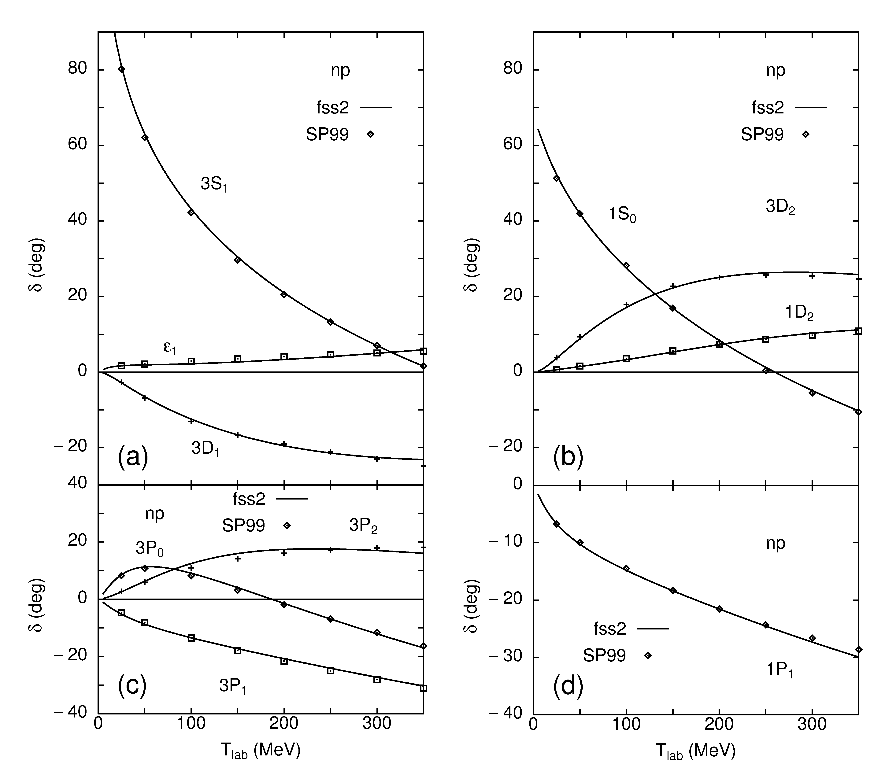
NN phase shifts by fss2
I ≤ 2

Slide 7
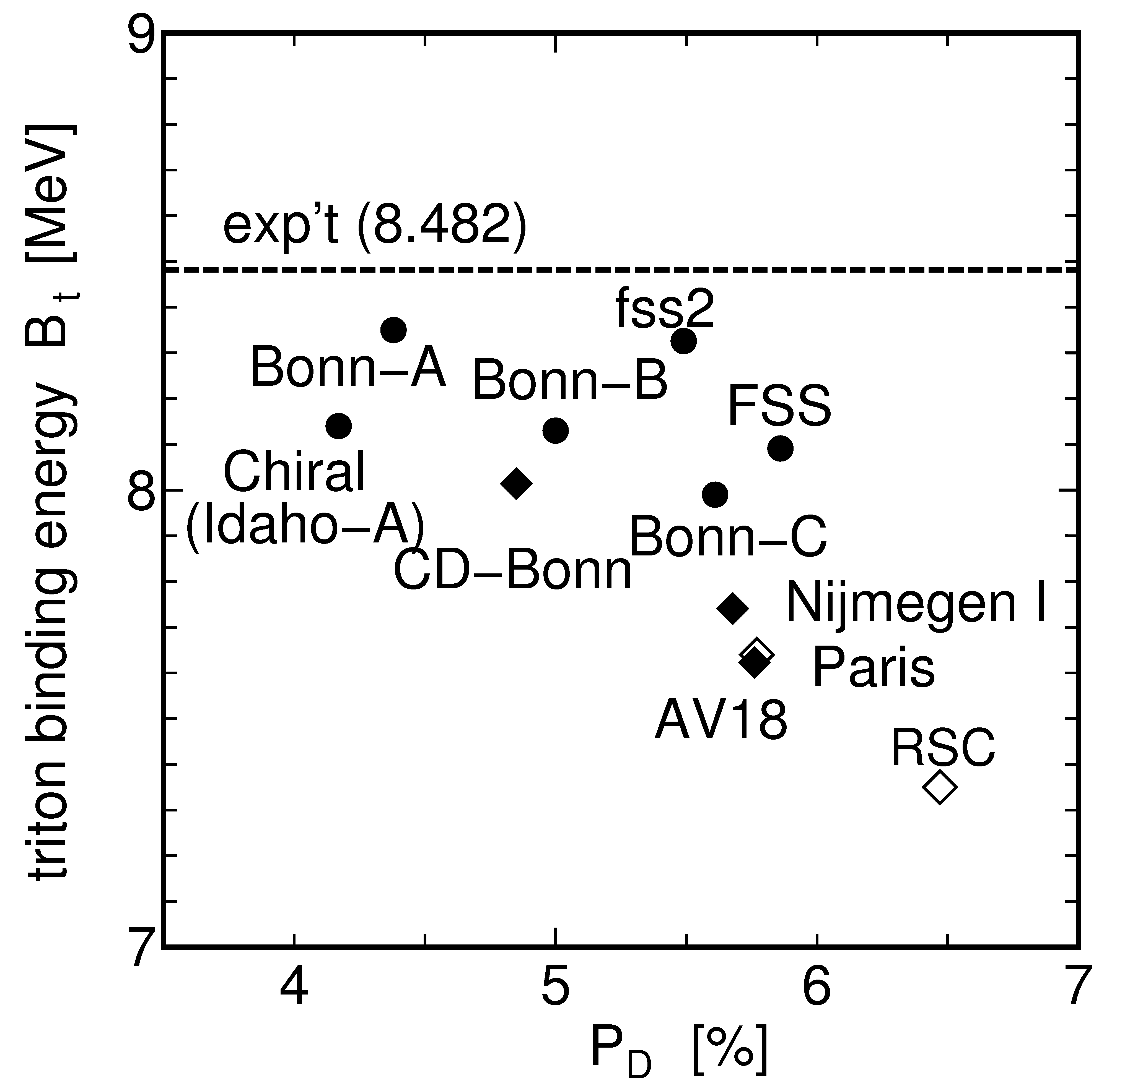
(triton)
³H
P_{D} = 5.49 %
E_{B} = 8.326 MeV
effect of
charge dependence
190 keV
5.86 %
8.091 MeV
Effect of
3-body force
 350 keV ?
almost half of
0.5 – 1 MeV
for the meson
exchange models
50 channels ( I  6 ) with np force
PRC66 (2002) 021001(R), PRC77 (2008) 027001
deuteron D-state
probability

Slide 8
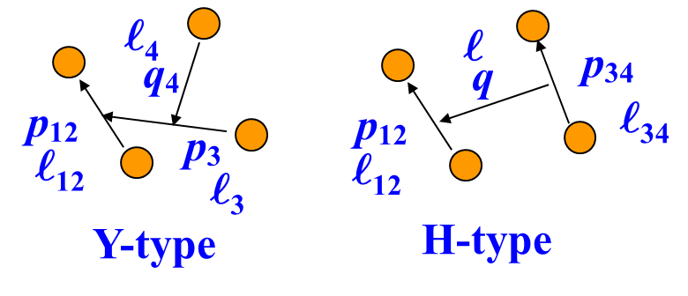
Faddeev-Yakubovsky equations for 4-identical fermions
q₃
p₃
ℓ₃
ℓ₁₂
(₁₂s₁₂)I₁₂ ≤ I_{max}= 6
₁₂+₃+₄, ₁₂+₃₄+ ≤ (^{sum})_{max}
by A. Nogga, Ph.D. thesis

Slide 9
Benchmark test
H. Kamada et. al., Phys.
Rev. C64, 044001 (2001)
⁴He | fss2 | 10-10-5 |  | AV8’ | 10-10-5
ℓ ^{sum}_{max} | E (MeV) | KE (MeV) | R_{c} (fm) | E (MeV) | KE (MeV) | R_{c} (fm)
2 | −24.73 | 76.52 | 1.498 | −21.46 | 83.07 | 1.607
4 | −27.32 | 85.84 | 1.443 | −24.88 | 97.29 | 1.512
6 | −27.75 | 88.05 | 1.433 | −25.52 | 100.90 | 1.493
8 | −27.92 | 88.60 | 1.430 | −25.89 | 102.35 | 1.485
10 | −27.95 | 88.73 | 1.429 | −25.94 | 102.65 | 1.483
Stochastic Variational Method |  |  |  | −25.92 | 102.35 | 1.486
4 digits accuracy
R_{c}^{exp} (⁴He)=1.457(4) fm
deuteron | fss2 | AV8’ (SVM) |  | AV18
ε_{d} (MeV) | 2.2246 | 2.2436 | 2.242 | 2.2246
P_{d} (%) | 5.49 | 5.78 | 5.77 | 5.76
rms (fm) | 1.960 | 1.961 | 1.961 | 1.967
Q_{d} (fm2) | 0.270 | 0.269 |  | 0.270
η | 0.0252 | 0.0252 |  | 0.0250
μ_{d} (μ₀) | 0.849 | 0.847 |  | 0.847
KE (MeV) | (17.49) | 19.89 | 19.881 | 19.814
Deuteron properties
³H binding energy
∼ 350 keV missing in fss2: almost half of 0.5 – 1 MeV for meson exch. models

Slide 10
Coulomb effect and charge dependence of the nuclear force
(3q)-(3q) folded cut-off Coulomb with R_{cou} = 10 fm
“smaller” than point Coulomb 800 keV
¹S₀ charge independence breaking (CIB) of fss2 200 ×2 keV
Approximate treatment in the isospin basis:
H. WitalaW. Glöckle and H. Kamada, Phys. Rev. C43, 1619 (1991)
Scatt. length | a_{s} (fm) | F_{BB}
pp | −17.80 | 0.9934
nn | −18.0 | 0.9944
np | −23.76 | 1
reduction factor
only for ¹S₀
for isospin I=1 pairs

Slide 11
³H , ³He , ⁴He(α)
 | Coul (keV) | CIB (keV) | E (MeV) | E^{exp} (MeV) | diff (MeV)
³H | − | 182 | −8.143 | −8.482 | 0.34
³He | 682 | 208 | −7.436 | −7.718 | 0.28
⁴He | 810 | 538 | −26.64 | −28.30 | 1.66
(⁴He calculation is by n=6-6-3)
mesh | accyuracy
n=4-4-2 | 2 digits
n=6-6-3 | 3 digits
n=10-10-5 | 4 digits
10 10 10 5 points
0 1 fm⁻¹ 5 fm⁻¹ 16 fm⁻¹ for fss2
0 1.2 3 16 for AV8’

Slide 12
Comparison with other calculations
A. Nogga, H. Kamada, W. Glöckle, and B.R. Barrett, Phys. Rev. C65, 054003 (2002)
model | P_{d} (%) | ³H (MeV) | ³He (MeV) | ⁴He (MeV) | diff (MeV)
fss2 | 5.490 | −8.143 | −7.436 | −26.64 | 1.66
CD-Bonn | 4.833 | −8.013 | −7.288 | −26.26 | 2.04
AV18 | 5.760 | −7.628 | −6.917 | −24.25 | 4.02
Nijm I | 5.678 | −7.741 | −7.083 | −24.98 | 3.32
Nijm II | 5.652 | −7.659 | −7.008 | −24.56 | 3.74
Nijm93 | 5.755 | −7.668 | −7.014 | −24.53 | 3.77
Exp. |  | −8.482 | −7.718 | −28.296
0.5 – 1 MeV 3 – 4 MeV missing in MEP’s
Ours: − 28.0 MeV + 0.8 MeV (Coulomb) + 0.5 MeV (CIB) = − 26.7 MeV
1.7 MeV missing → almost half of standard MEP’s

Slide 13
Faddeev redundant components
4α (and 4d’) system
redundant component for the 3-body subsystem
in the Y-type Jacobi coordinates : (1+P)|uf⟩=0
redundant component of the core-exchange type in the H-type Jacobi coordinates : (1+P)|uu⟩=0
3) genuine 4-body redundant component :
∼
∼
∼
∼
⇒ we can prove
∼
∼
trivial solution

Slide 14
4) modified Faddeev-Yakubovsky equation :
∼
∼
∼
∼
for identical 4-boson systems

Slide 15
4α energy and rms radius
Volkov No.2 m=0.605, b=1.36 fm
Faddeev-Yakubovsky (4-4-2)
h.o. variation (red: with Coulomb)
ℓ^{sum} ^{max} | E_{4α} (MeV) | KE (MeV) | R_{α} (fm) | rms (fm)
0 | −4.21 | 15.51 | 3.67 | 3.95
2 | −4.16 | 15.20 | 3.69 | 3.96
4 | −6.53 | 20.71 | 3.27 | 3.57
6 | −7.28 | 23.10 | 3.07 | 3.40
8 | −11.56 | 43.08 | 2.71 | 3.07
10 | −15.82 | 66.39 | 2.19 | 2.62
12 | −39.06 | 142.33 | 1.57 | 2.13
14 | −39.15 | 141.80 | 1.57 | 2.13
N^{tot} ^{max} | E_{4α} (MeV) | c₍₀₀₎ | KE (MeV) | R_{α} (fm) | rms (fm)
12 | −34.14 | 1 | 184.98 | 1.38 | 2.00
 | −19.99 | 1 | 184.98 | 1.38 | 2.00
14 | −37.04 | 0.964 | 160.34 | 1.48 | 2.07
 | −23.47 | 0.958 | 158.60 | 1.49 | 2.07
16 | −38.27 | 0.935 | 150.87 | 1.53 | 2.10
 | −24.90 | 0.924 | 148.05 | 1.54 | 2.11
18 | −38.76 | 0.917 | 145.95 | 1.55 | 2.12
 | −25.50 | 0.901 | 142.43 | 1.57 | 2.13
20 | −38.96 | 0.907 | 143.39 | 1.57 | 2.13
 | −25.77 | 0.888 | 139.37 | 1.59 | 2.15
(rms)_{exp}= 2.710±0.015 fm
largely overbound
change suddenly at ℓ^{sum}_{max}=12 owing to [(40)(40)](04)(40):(00) channel
b →large, rms radius → large, but still over-binding
E_{2α}= −1.105 (0.252) MeV
E_{3α}= −7.391 (−2.307) for N_{tot}=60
Cf. S. Oryu, H. Kamada, H. Sekine, T. Nishino, and H. Sekiguchi, Nucl. Phys. A534 (1991)221

Slide 16
Summary
We have studied the binding energy and charge rms radius of α-particle using our quark-model baryon-baryon interaction fss2. The framework is
“4-cluster Faddeev-Yakubovsky equations using 2-cluster RGM kernel”. The results are − 28.0 MeV without Coulomb, and rms radius is 1.43 fm
which is slightly too small. If we incorporate the Coulomb force and the effect of the charge-independence breaking of the NN force, we obtain
E_{α} = −26.64 MeV ∼ −28.0 + 0.8 + 0.5 vs. E_{α}^{exp} = −28.296 MeV
charge rms radius = 1.439 fm vs. exp : 1.457 ± 0.004 fm
The missing −1.66 MeV from experiment is almost half of the standard meson-exchange potentials, which is consistent with the 3N case.
A method to eliminate the Faddeev redundant components in the 4d’ and
4α systems is proposed and applied to the practical calculations.
Future problems
⁴_{Λ}H, ⁴_{Λ}He systems (under progress: full inclusion of ΛN-ΣN coupling )
⁴_{ΛΛ}He : ΛN-ΣN coupling and ΛΛ-ΞN-ΣΣ coupling should be
simultaneously treated.

