Slide 1
A METHOD FOR AN UNAMBIGUOUS DETECTION OF A HYPOTHETICAL BOUND TWO-NEUTRON SYSTEM
Kazimierz Bodek
M. Smoluchowski Institute of Physics, Jagiellonian University, Cracow, Poland

Slide 2
Abstract
A recent announcement of a discovery of bound di-neutrons existing in loosely bound nuclei [1] revived interest to these hypothetical, electrically neutral light nuclei despite it was clear that the observed effect is, probably, due to emission of a correlated pair of neutrons originating from an anti-bound singlet spin state: negative value of the scattering length ¹a_{nn} = 18.7 fm was used to interpret the measured data. The phenomenon is very similar to the so called nn final state interaction (nn-FSI) peak observed frequently in many nuclear reactions in a specific kinematical configuration where the neutron pair with low relative momentum is emitted back-to-back with the recoiling system. Among them are neutron induced breakup reactions on deuterium and other light nuclei, radiative μ⁻ capture on deuterium and ordinary π⁻ absorption on helium isotopes. The shape of the FSI peak was astonishingly well modeled by K.M. Watson and A.B. Migdal already in 1952 [2] and is dependent on ¹a_{nn}. The sign of ¹a_{nn}, which is decisive for the existence or non-existence of a bound state, must be established from a coherent neutron-neutron scattering. Since such an experiment has not been done yet, the negative sign of ¹a_{nn} is mainly motivated by lack of observation of bound multi-neutron systems, consistency in the description of the experimental data by the model nucleon-nucleon forces and isospin conservation in strong interactions. As all these arguments give only limited confidence (see e.g. [3]), the nonexistence of bound di-neutrons is still an open question.
In the presentation, we will propose an experiment aiming at an unambiguous detection of mass A = 2 neutral particles via elastic scattering and neutron exchange reaction on protons in a plastic scintillating fibre detector. Di-neutrons would be produced in an ordinary π⁻ absorption on ³He and ⁴He isotopes together with tagging charged particles (p and d, respectively). The basic advantages of the proposed process are the strict collinearity and opposite, and constant momenta of di-neutrons and recoiling particles in LAB reference system. Moreover, the detection cross sections (²n + p → p + n; ²n + p → d + n) are calculable with three-nucleon codes based on ¹a_{nn} dependent nn interactions.
[1] A. Spyrou et al., Phys. Rev. Lett. 108, 102501 (2012).
[2] K.M. Watson, Phys. Rev. 88, 1163 (1952), A.B. Migdal, JETP (Sov. Phys.) 1 (1955) 2.
[3] H. Witala and W. Gloeckle, Phys. Rev. C 85, 064003 (2012).

Slide 3
Questions about multi-neutron systems
Do they exist?
If so – what is their nature?
What are the consequences – does theory need (tolerate) such creatures?
What are the empirical evidences pro/contra multi-neutrons?
How can we improve experimental searches for multi-neutron bound states?

Slide 4


Yeti – Abominable Snowman
Many respectable people reported to have seen him – nobody locked him in a cage!
Reports contain mainly footprints, dilute photographs and possible remnants
Reinhold Messner

Slide 5

Empirical evidences (?)
How can we improve experimental searches for “yeti”?

Slide 6
Nomenclature
What is a di-neutron ? – no unique definition
Bound state of two neutrons in vacuum, respectively strong interactions
Resonance in two-neutron system in vacuum
Virtual (anti-bound) state in two-neutron system in vacuum
Correlated neutron pair emitted from loosely bound nuclei
Correlated neutron pair (cluster) in nuclear matter (nuclei)
Im k
Bound
Re k
Virtual
Resonances
Analytical properties of S-matrix
Similar applies to multi-neutron systems: tri-neutron, tetra-neutron, …

Slide 7
Hints from theory (?)
Generally, theory is reluctant to the existence of bound, neutral nuclei – see e.g. N.K. Timofeyuk, J. Phys. G: Nucl. Part. Phys. 29 (2003) L9–L14
But…
Low energy model n-n interactions are biased by… nonobservation of multi-neutron bound states
Structure calculations of neutron rich (neutron-halo) nuclei are limited by model space
Persistent inconsistencies in description of low energy nnp observables – H. Witala, W. Gloeckle, Phys.Rev. C 85, 064003 (2012)
Lattice QCD calculations suggest bound ²n system – T. Yamazaki et al., Phys. Rev. D 86, 074514 (2012) (m_{π} = 0.51 GeV)
Effect of bound di-neutrons on big bang nucleosynthesis – J.P. Kneller, G.C. McLaughlin, Phys. Rev. D 70, 043512 (2004) – important only if ²n binding > 3 MeV
Dependence of nuclear binding on hadronic mass variation – V.V. Flambaum and R.B. Wiringa, Phys. Rev. C 76, 054002 (2007); S.R. Beane, et al., Phys. Rev. Lett. 97, 012001 (2006) – partially contradictory conclusions

Slide 8
Conclusion
Theory analyses and predictions are not encouraging but sufficiently incomplete and inconsistent to leave enough room for serious searches for bound multi-neutron systems

Slide 9
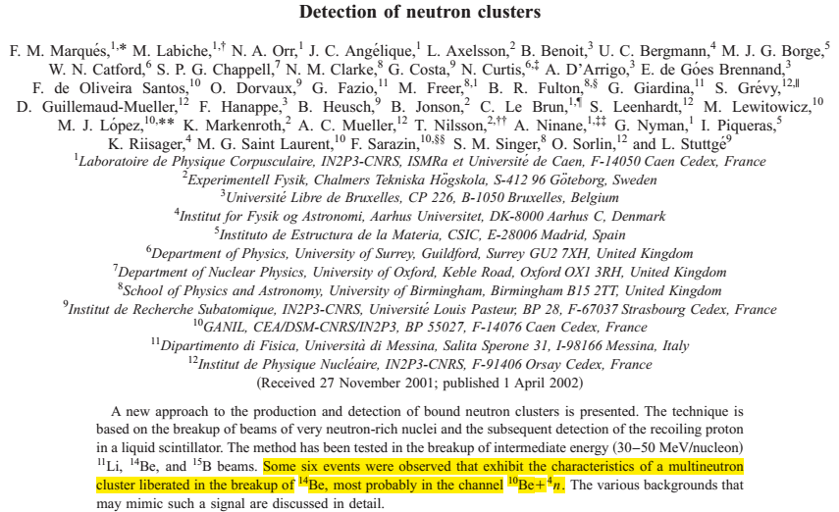
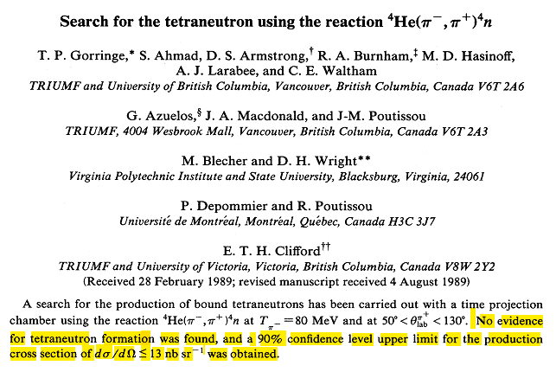
Search for multi-neutrons
Event rate = production rate × detection probability
Production processes concentrated on:
Double pion exchange (DPE) reactions (π⁻,π⁺)
Neutron rich light nuclei close to n-drip line (n-halo)
Phys. Rev. C 65, 044006 (2002)
Phys. Rev. C 40, 2390 (1989)
Questioned by B.M. Sherrill and C.A. Bertulani,
Phys. Rev. C 6, 027601 (2004)

Slide 10
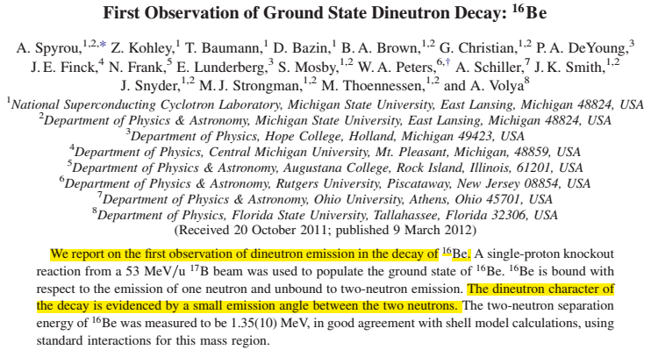
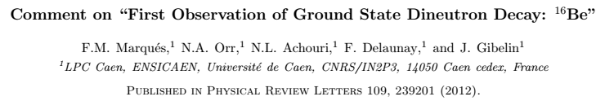
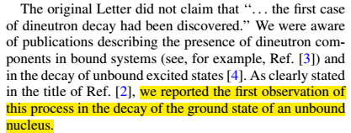
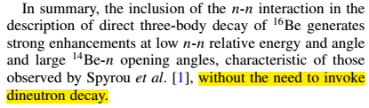
Search for multi-neutrons
Phys. Rev. Lett. 108, 102501 (2012)
Phys. Rev. Lett. 109, 239201 (2012)
Phys. Rev. Lett. 109, 239202 (2012)

Slide 11
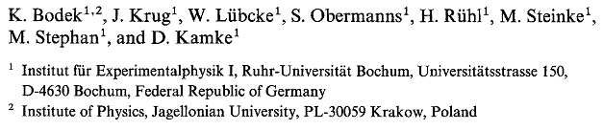
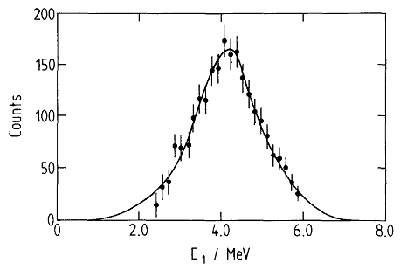
Search for multi-neutrons
Searching for multi-neutron clusters in complicated systems needs severe model assumptions – 3-body model with 2-body interactions may not be adequate
Few-Body Systems 5, 23-35 (1990)
Core
n
n
⁸Be_{GS}
n
n
E_{ex}(¹⁰Be) ≅ 16 MeV
Watson-Migdal model fit with |¹a_{nn}| = 16.5 ± 1.0 fm

Slide 12
Search for multi-neutrons
Is there any chance to identify or discard multi-neutron bound states in a more direct way (without exclusively relying on unrealistic model calculations)?
Confine searches to few-nucleon systems where ab initio calculations are possible
Produce multi-neutrons in 2-body final state at fixed energy
Detect reaction products in hydrogen rich detector
Identify multi-neutrons by pure kinematics (reconstruct all momenta event-by-event)
Tagging charged particle
²n
Charged recoil
Calculations with model NN potentials are not necessary to identify multi-neutron signatures – they only help to estimate production and detection cross sections

Slide 13
Di-neutron production in π⁻ absorption at rest on ³He
Exploit peculiarities of π⁻ absorption at rest by nuclei:
Formation and decay of pionic atoms
Charge depletion of the final state
Large energy release (comparable with pion mass)
LAB system = CM system
π⁻ absorption at rest by ³He leads to 2- and 3-body final states:
d + n
p + n + n
p + ²n (?)
d
n
E_{d} = 45.3 MeV, E_{n} = 87.5 MeV
p
n
E_{p}+ E_{n}+ E_{n} = 130.6 MeV
n
p
²n
E_{p} = 85.8 MeV, E_{2n} = 44.8 MeV
Calculable (ab initio) with realistic π⁻N, 2N and 3N potentials

Slide 14
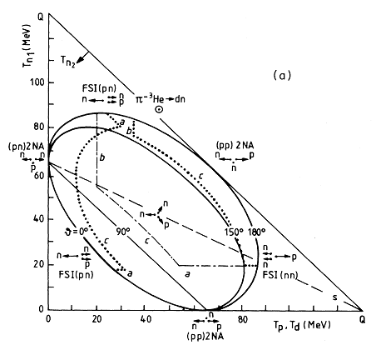
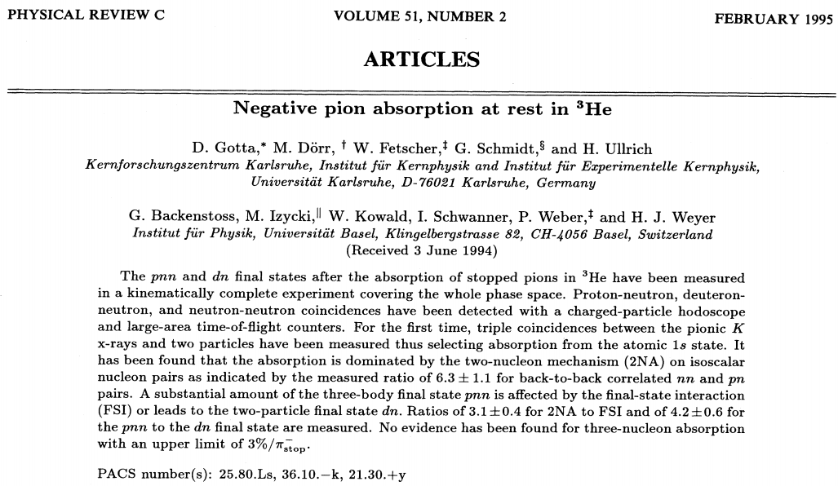
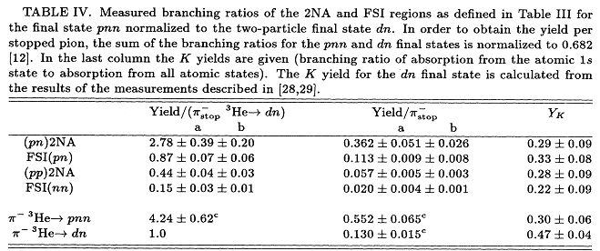
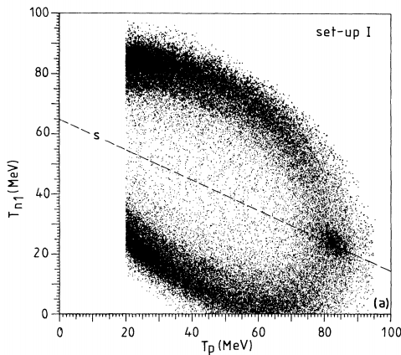
Di-neutron production in π⁻ absorption at rest on ³He

Slide 15
Di-neutron detection
Di-neutrons produced in π⁻ absorption at rest on ³He will have constant and relatively large kinetic energy (~45 MeV)
Can interact with protons via:
²n + p → p + ²n (elastic scattering)
²n + p → d + n (neutron exchange)
²n + p → p + n + n (breakup)
p
²n
θ_{p}
²n
²n can be detected via momentum measurement of charged recoil particle (p, d)
d
²n
θ_{d}
π⁻+³He → p+²n
n
+p → p+²n
→ d+n
→ p+n+n
+p → p+n
p
Tagging proton
²n
θ_{p}
p
n
n

Slide 16
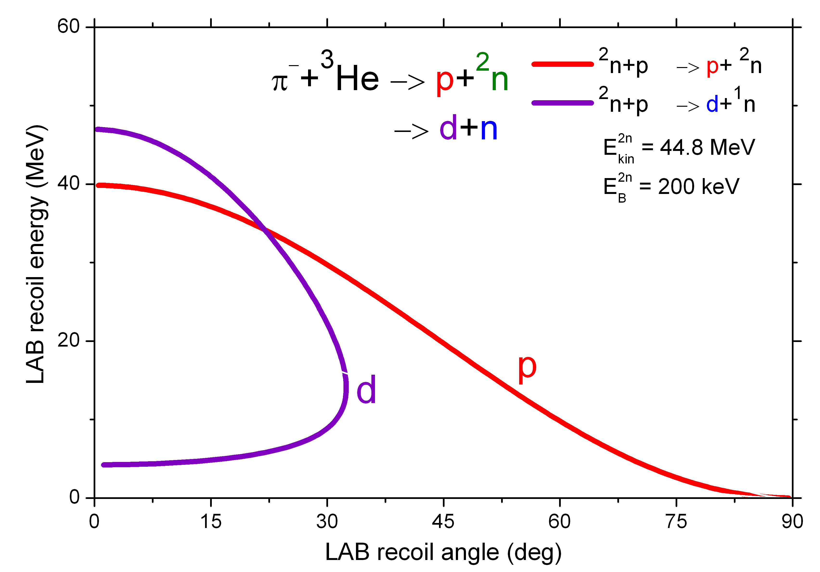
Di-neutron detection
Detected recoiling protons and deuterons with ²n signature must appear:
along 2-body kinematics (for 2-body channels)
along 3-body kinematics (for breakup)
Detection exploits kinematical selectivity and high cross section
Detection cross sections are calculable (ab initio) with the same 2N and 3N potentials as used for π⁻ absorption
3N Faddeev codes can be modified: usual initial state d+N should be replaced by ²n+N (¹S₀)
dσ/dΩ
²n+p→p+²n
²n+p→d+n
0º
LAB recoil angle
90º

Slide 17
Detecting system
p
θ_{p}
Two blocks of highly segmented plastic scintillator (scintillating fibers)
Trigger: detected proton of E_{p} = 85.8 MeV (range, dE/dx)
²n
π⁻
³He
Analysis: search for charged recoils from A = 2 neutral particle with energy E_{kin}= 44.8 MeV, collinear to the tagging proton and interacting with protons in scintillator via:
2n+p → p+2n
2n+p → d+n
2n+p → p+n+n
p

Slide 18
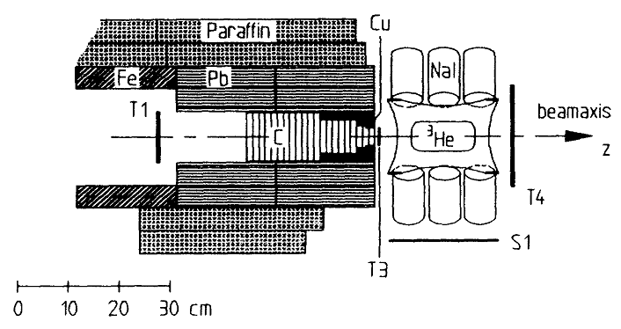
π⁻+³He → p+²n
Experimental
setup
+p → p+²n
→ d+n
→ p+n+n
+p → p+n
D. Gotta et al., Phys. Rev. C 5, 409 (1995)
Scintillating fiber block #1
Scintillating fiber block #2

Slide 19
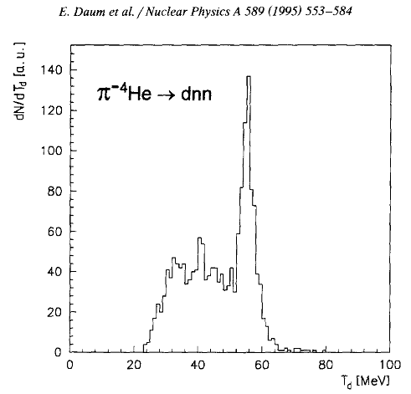
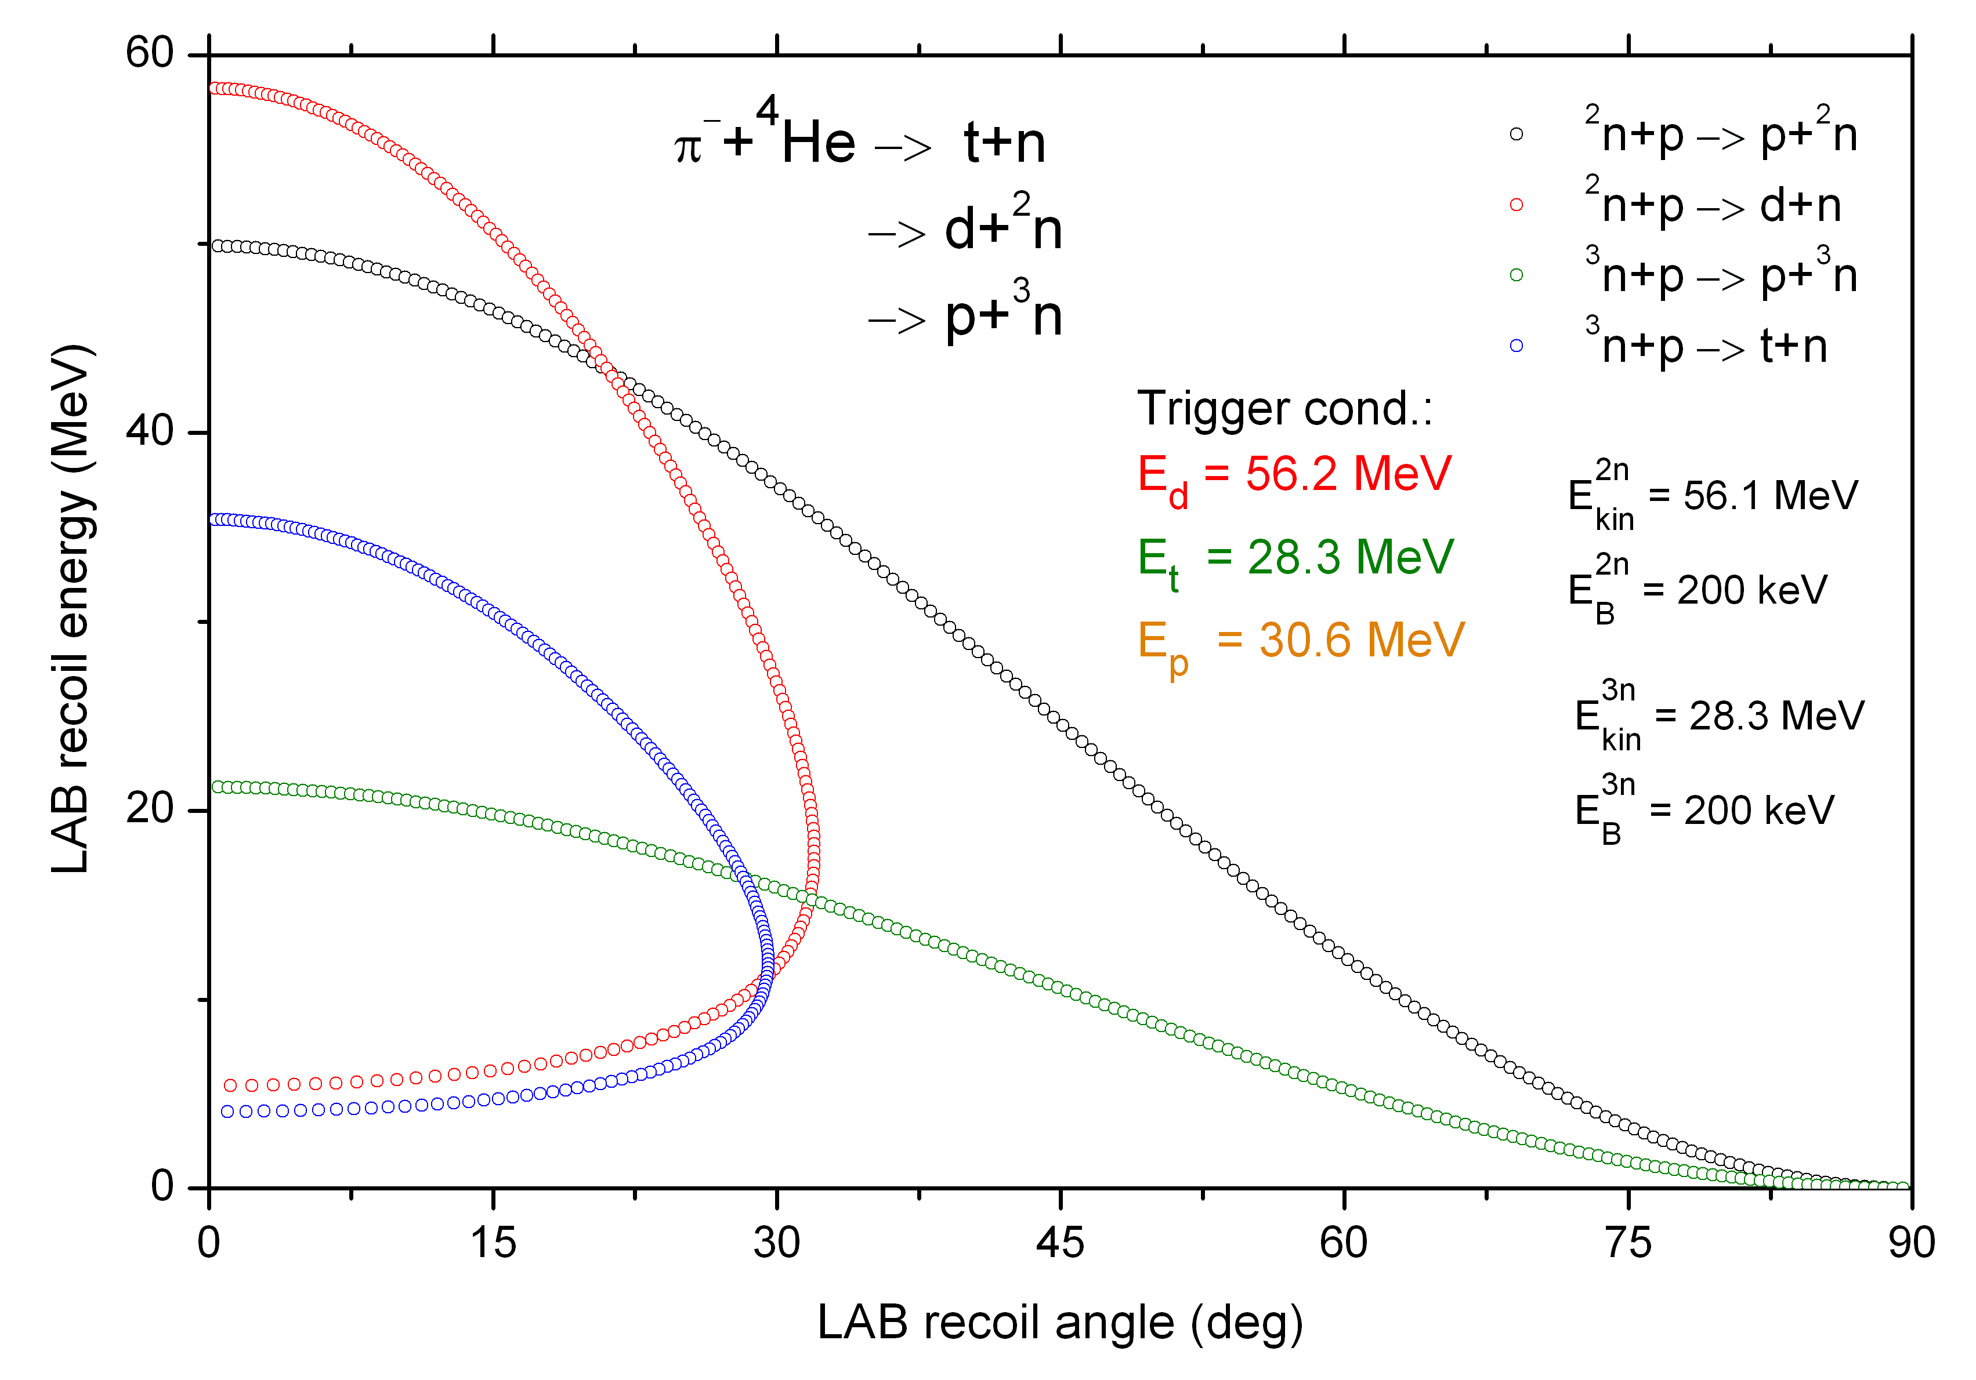
²n and ³n production in π⁻ absorption at rest on ⁴He
Experiment can be repeated with ⁴He target
π⁻ absorption at rest by ⁴He leads to 2- 3- and 4-body final states:
t + n
d + n + n
d + ²n
p + n + n + n
p + ³n
nn-FSI
Ab initio calculation of production cross section as well as detection of ²n and ³n – more problematic

Slide 20
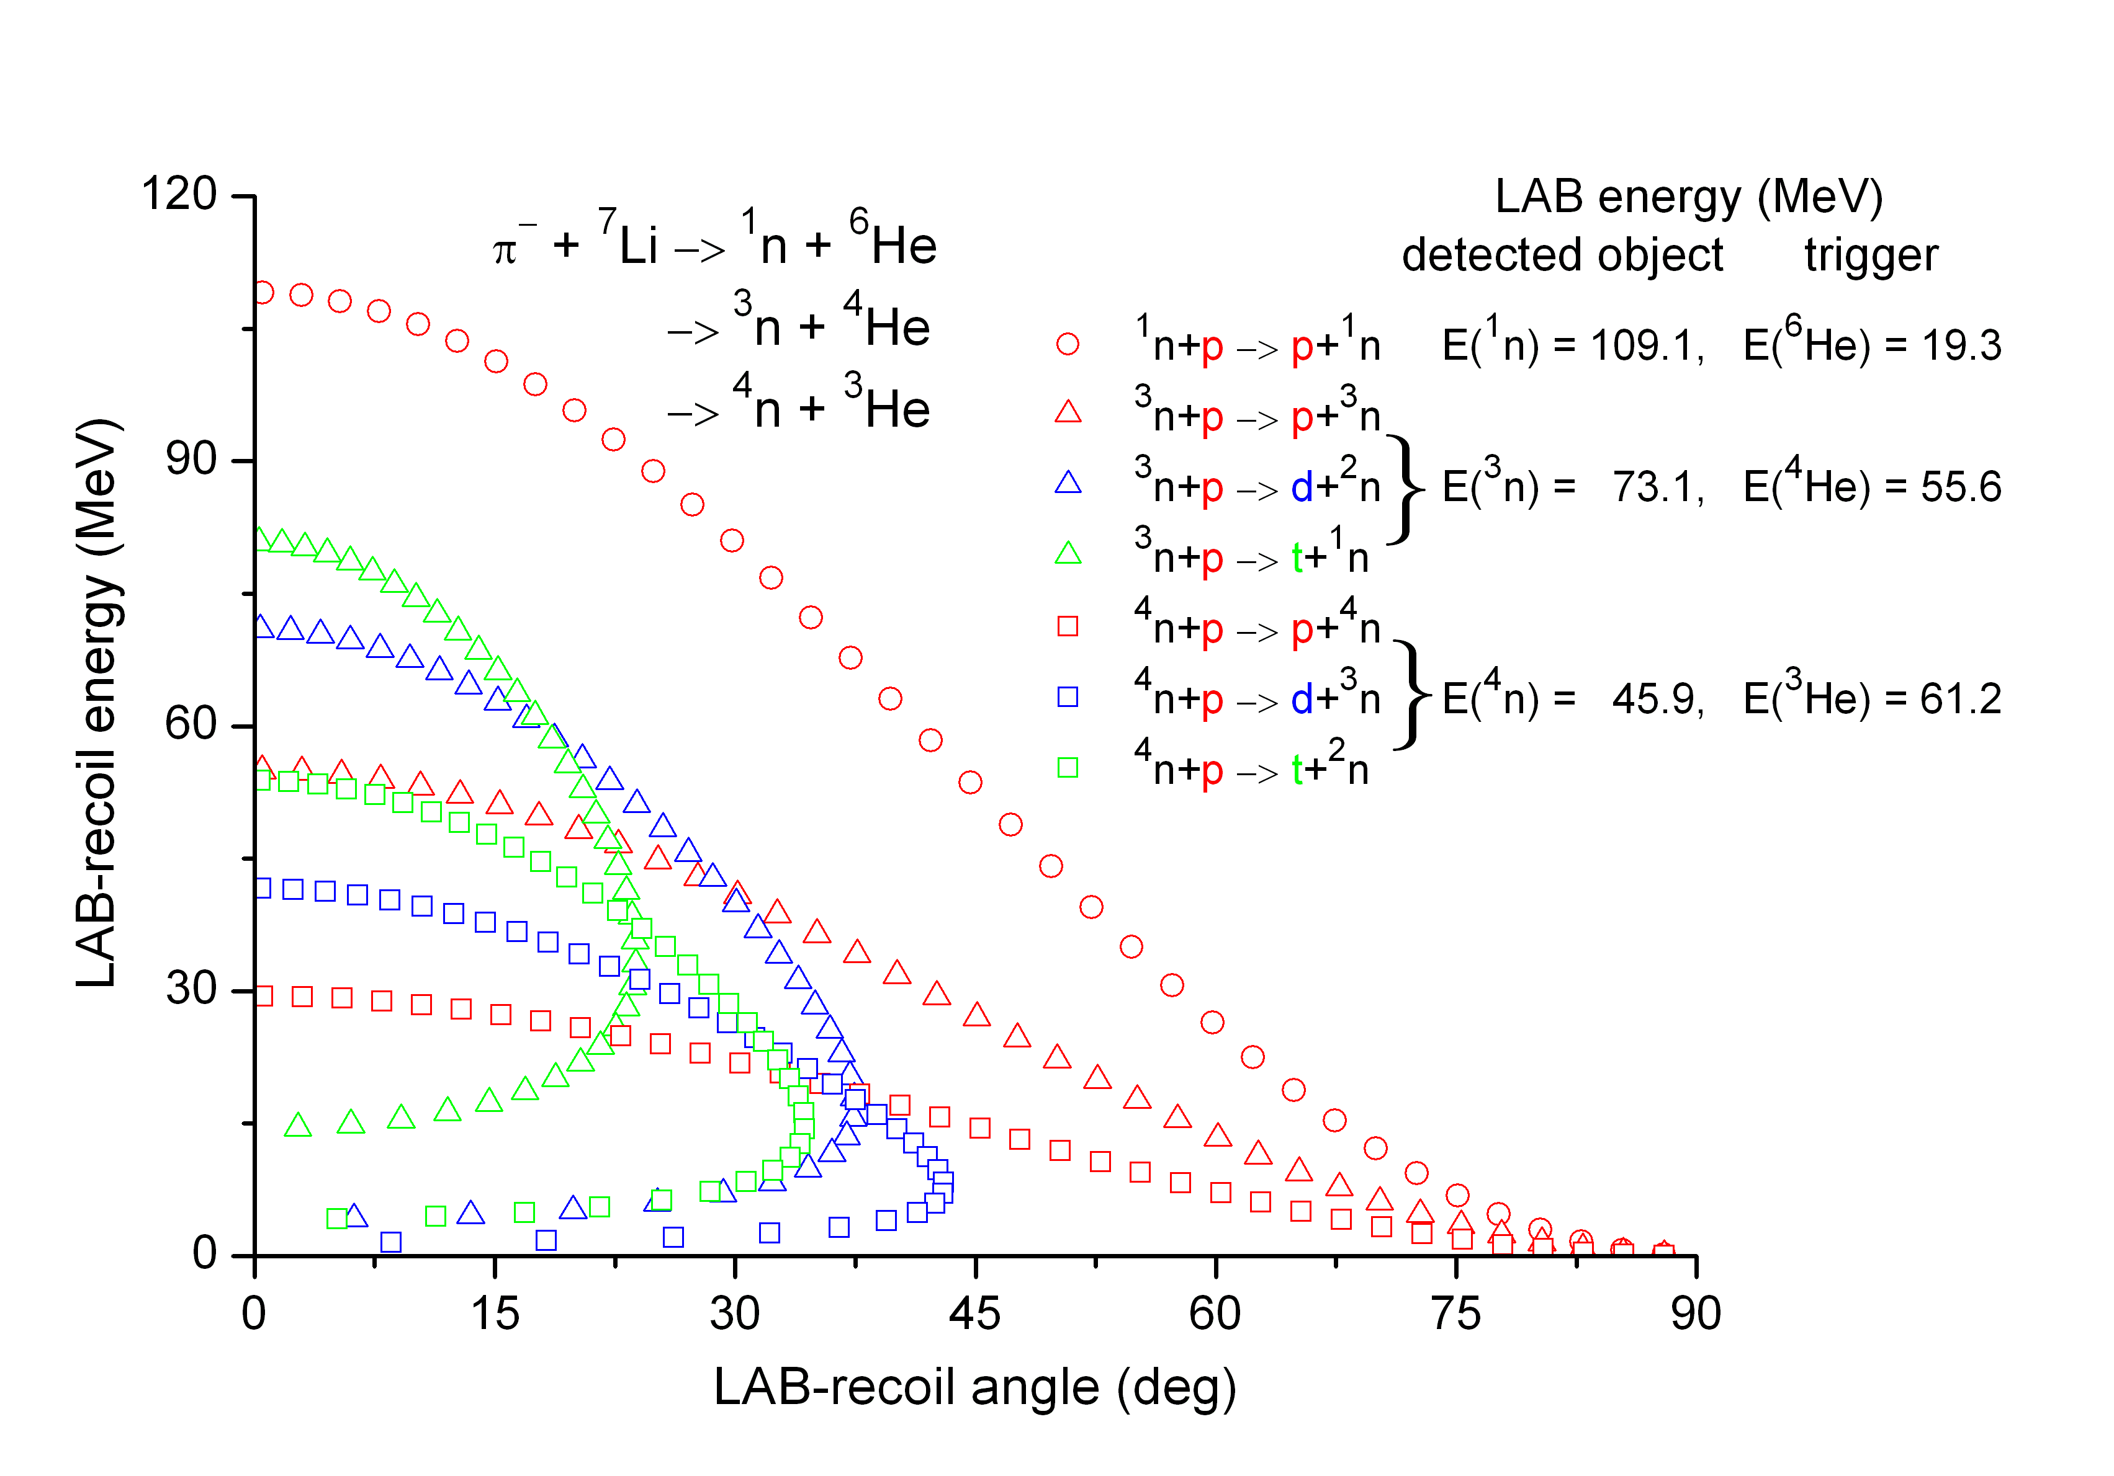
²n, ³n and ⁴n production in π⁻ absorption at rest on ⁶Li and ⁷Li
Experiment can be setup also with ⁶Li and ⁷Li targets – access to ²n, ³n, ⁴n
Target assembly more difficult but feasible
Ab initio calculation of multi-nucleon production cross section with realistic π⁻N, 2N and 3N potentials – difficult
Theoretical detection cross sections for ³n and ⁴n – more problematic

Slide 21
Conclusions
A method of kinematical identification of multi-neutron bound states emitted after π⁻ absorption at rest on light nuclei is proposed.
For ³He and ⁴He, both the production and the detection cross sections can be calculated ab initio with model interactions.
Measurement of charged recoil particles is accomplished by stacks of scintillating fibers.
Simple topology of events and dE/dx particle identification promise high selectivity and unprecedenced sensitivity of measurements (pbarn regime).
The proposed method is an alternative to searches in nucleon-, photon-induced and DPE reactions as well as in decays of neutron-halo nuclei.
Application of the method to lithium isotopes seems to be feasible as well.

Slide 22
Backup slides

Slide 23
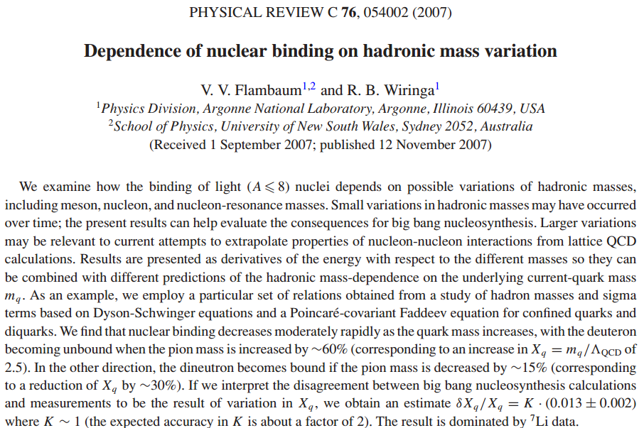
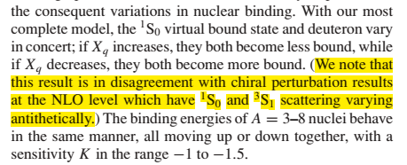
S.R. Beane, et al., Phys. Rev. Lett. 97, 012001 (2006)

Slide 24
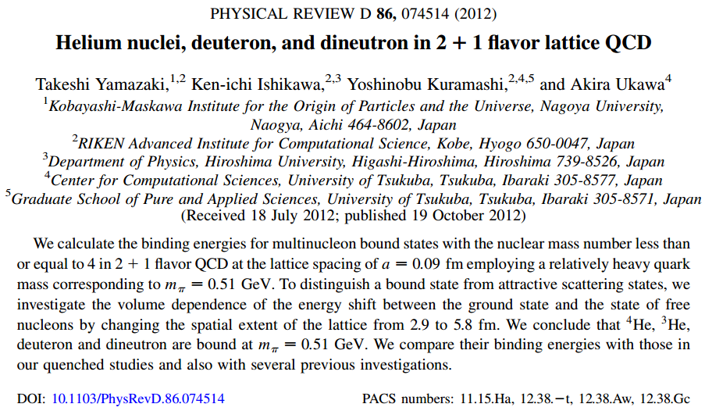

Slide 25
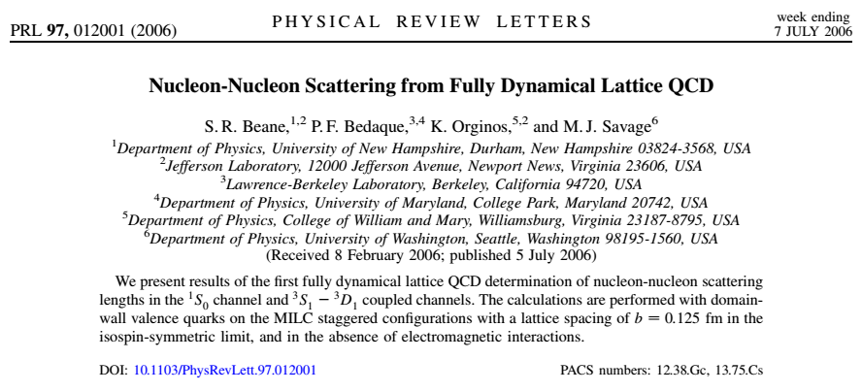

Slide 26
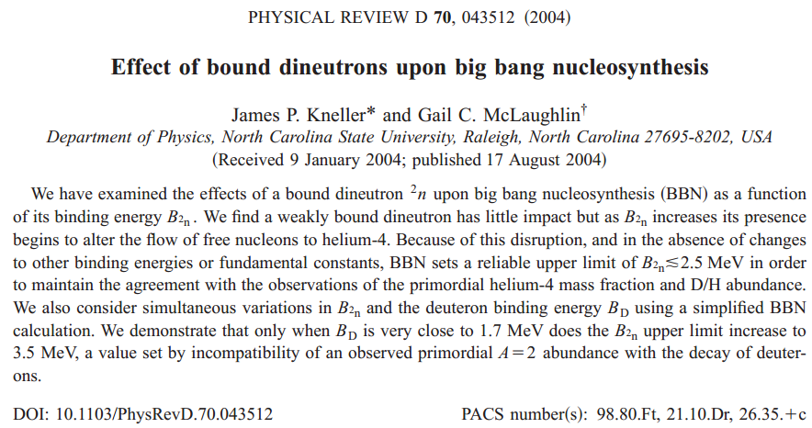
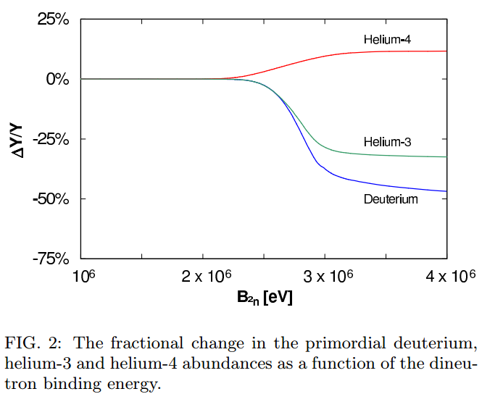

Slide 27
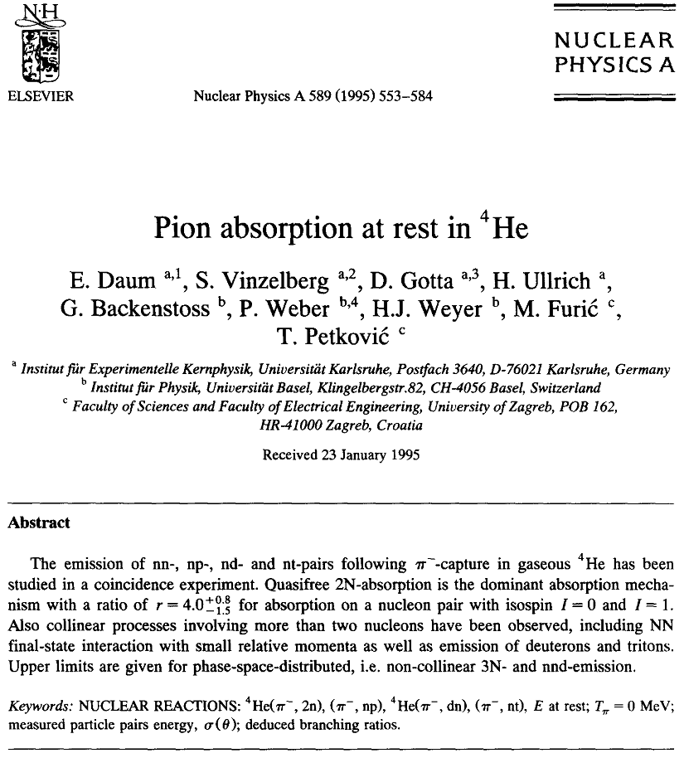
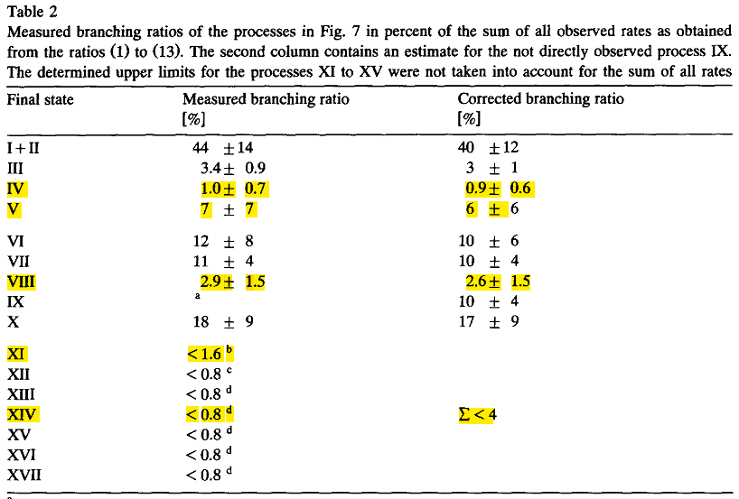
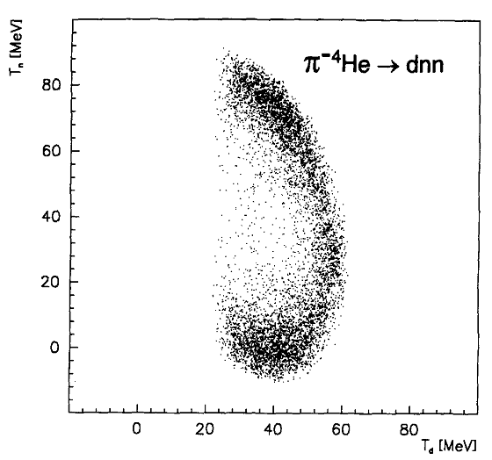
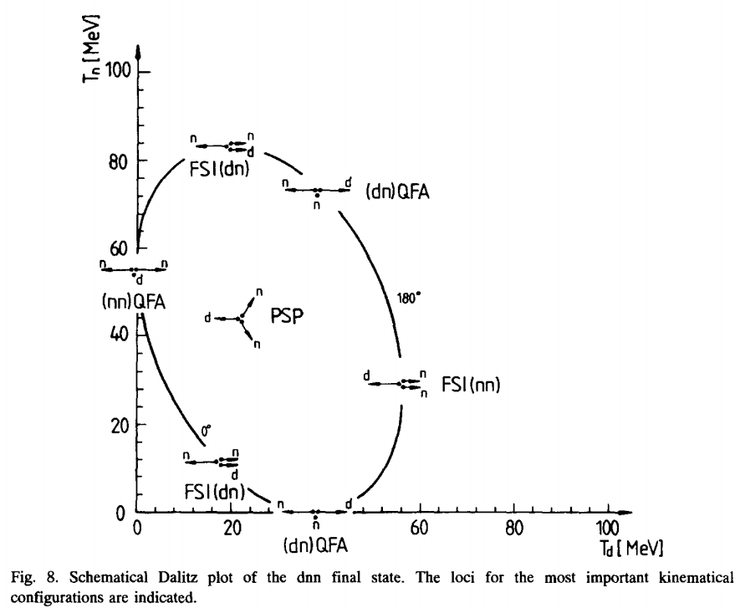
nn-FSI
nn-FSI

Slide 28
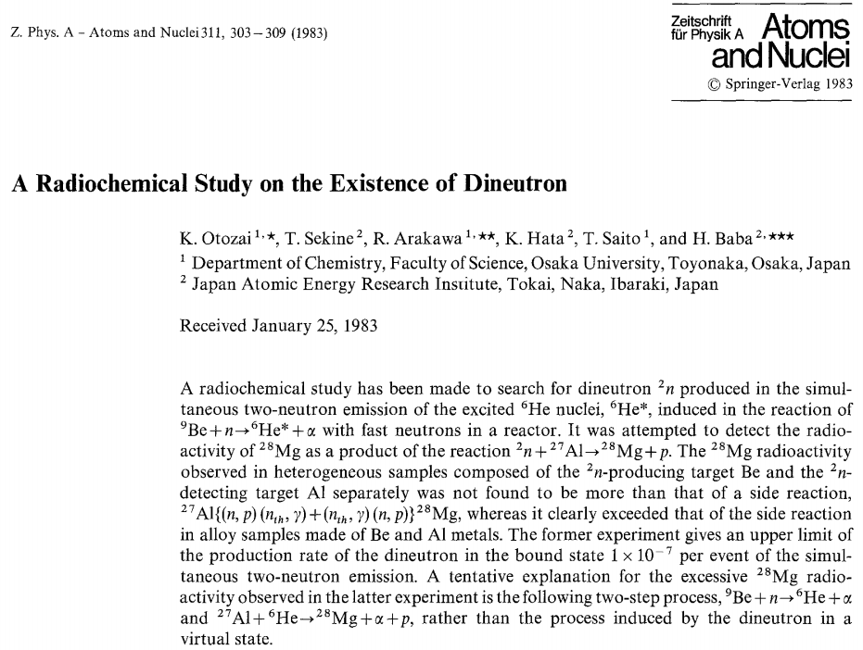

Slide 29
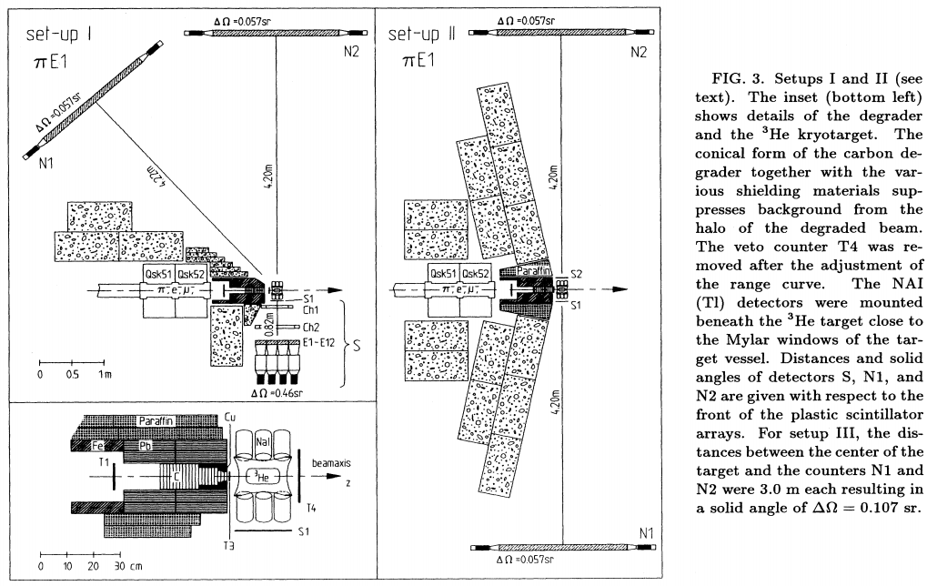

Slide 30
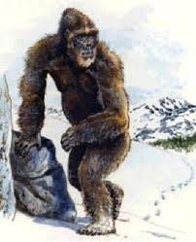

Yeti – Abominable Snowman
Does it exist?

Slide 31
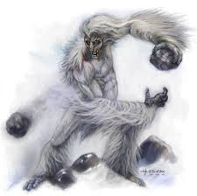


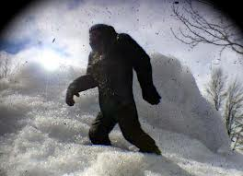
Yeti – Abominable Snowman
If so – what is its nature?

Slide 32

Yeti – Abominable Snowman
What are the consequences – does theory need (tolerate) such creatures?

Slide 33
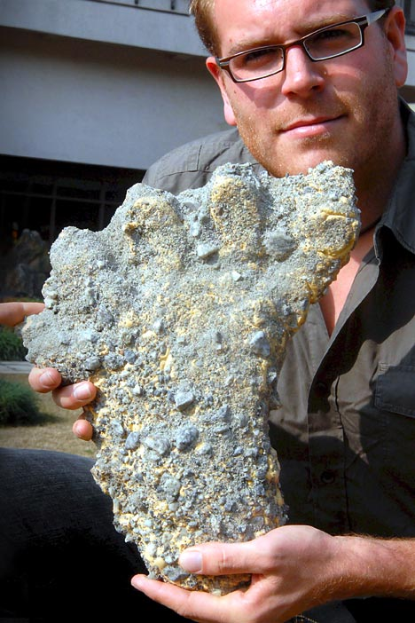


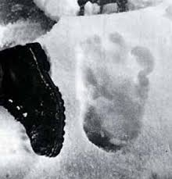

Yeti – Abominable Snowman
What are the empirical evidences pro/contra yeti?

