Slide 1
Physics of Small Recoil Momenta in One photon – Two electron ionization of Heium
M. Ya. Amusia^{1, 2} , E. G. Drukarev ^{1,3} , E. Z. Liverts ¹
1) Racah Institute, Hebrew University, Jerusalem
2) Physical-Technical Institute, St. Petersburg
3) Petersburg Nuclear Physics Institute, Gatchina

Slide 2
Contents
I. Two-electron photoionization by 1 photon
II. Shake-off and direct knock-out
III. Quasi-free ionization
IV. Energy and angular distribution
V. Double-to-single ionization ratio
VI. Experimental results prior 2011
VII. “Back-to-back” discovery in 2011-2013
VIII. Dependences on recoil momentum
IX. Other ionization objects and processes
X. Expectations of the future

Slide 3
I.1 Two-electron photoionization
A free electron cannot absorb a photon
Two free electrons cannot absorb a single photon
This is valid for any number of free electrons.
Reason – photon is dipole, free electrons do not have a time-dependent dipole moment.
A nucleus or another center of force is needed
One –electron ionization is broadly studied – for atoms, molecules, clusters etc.

Slide 4
I.2Two-electron photoionization
Suggested by A. Sommerfeld in the early thirties
Discussed again at the sixties, mainly in high photon energy limit with unexpected result in 1975
Activity picked in the 90x, both experimental and theoretical.
Primary target – He. Low attention to A>He
2011-2013 - experimental confirmation of 1975 prediction – photoionization with back-to-back electron emission do exists

Slide 5
I.3Two-electron photoionization
The problem is unsolvable by direct calculations using best computers even now.
Approximating approaches inevitable.
They are of interest by itself since clarify dominative mechanism.
Physics is about what can be neglected in a complex natural process.
Discussing the option of surgical correction of dead retina, a prominent US surgeon said: How you can teach him to see if you cannot teach him to pee? (connect and 2 nerves)

Slide 6
II.1 Shake-off and direct knock-out
Two-electron photoionization -
Photon momentum is small
Dominative mechanism – shake-off, direct knock –out. In both cases

Slide 7
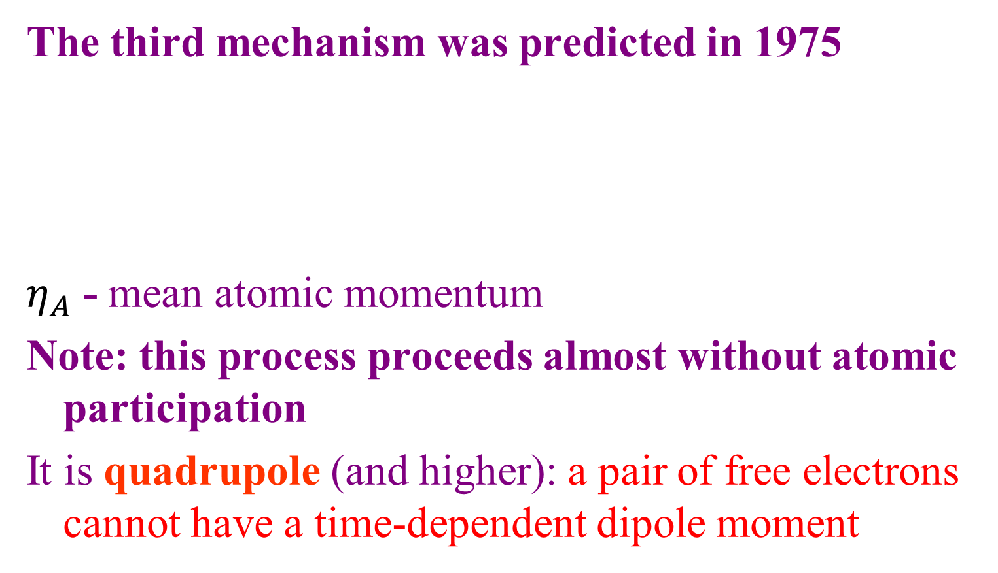
III. Quasi-free ionization
The third mechanism was predicted in 1975
$η_{A}$ - mean atomic momentum
Note: this process proceeds almost without atomic participation
It is quadrupole (and higher): a pair of free electrons cannot have a time-dependent dipole moment
.

Slide 8


IV. Energy and angular distributions
Dependence of electron yield upon the electron energy
Left – shake-off and direct knock-out,
Right – quasi-free or back-to-back emission
,
$$\left|\vec{q}\right|≫η_{A}$$
$$|\vec{q}|≈η_{A}$$

Slide 9
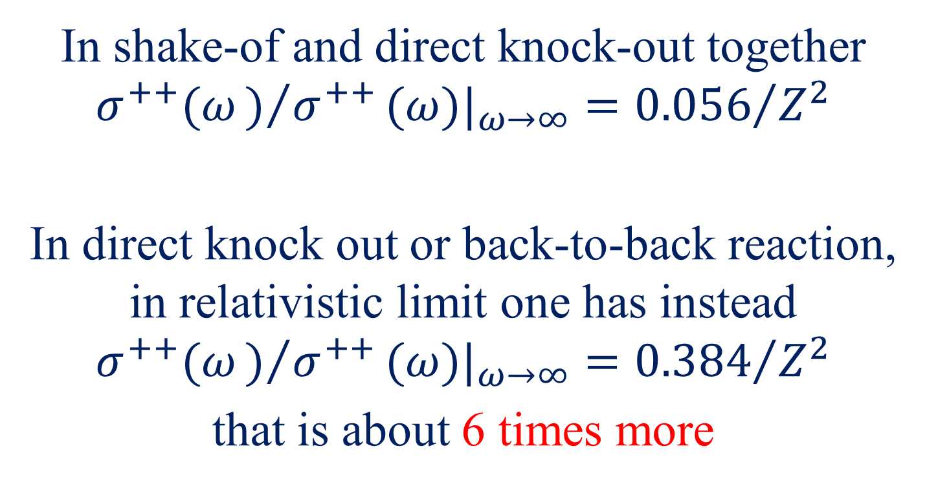
V Double-to-single ionization ratio
In shake-of and direct knock-out together $σ^{++}(ω)/{σ^{++}}(ω)|_{ω→∞}={0.056}/{Z^{2}}$
In direct knock out or back-to-back reaction, in relativistic limit one has instead
$$σ^{++}(ω)/{σ^{++}}(ω)|_{ω→∞}={0.384}/{Z^{2}}$$
that is about 6 times more

Slide 10
VI. Experimental results prior 2011
Methods:
a) Count of doubly charged ions. Photon energy up to 20 keV
b) Two-electron coincidence, the same energy
2. Results:
Non-relativistic limit as in shake-off – 1.64%
So-called U-shape of electron distribution in energy

Slide 11
VII.1 “Back-to-back” discovery
Found using recoil momentum spectroscopy.
Strange at first glance that measuring recoil momentum – heavy particle motion would be sensitive enough to detect a small contribution
Geometry was chosen that exclude dipole contribution – q orthogonal to photon polarization
Photon energy – less than 1 keV
Positive yes to non-dipole contribution

Slide 12
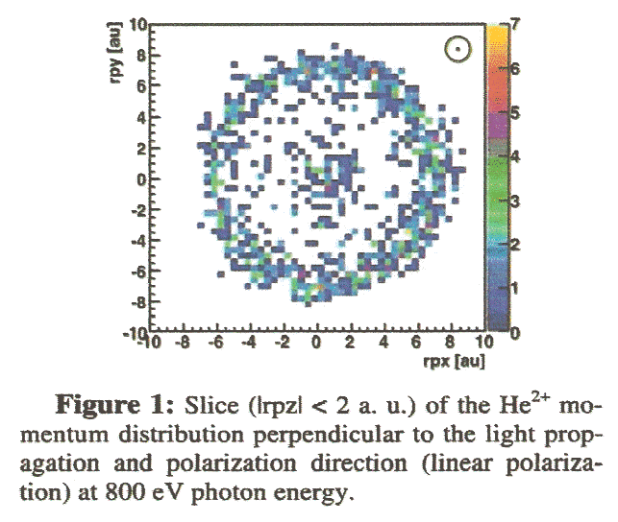
VII.2 “Back-to-back” discovery

Slide 13
VIII.1 Dependences on recoil momentum
Calculations were performed for non-dipole term at
Very accurate initial state wave function used
Outgoing electrons – Coulomb functions
Demonstrated that at the center of distribution quadrupole absolutely dominates.
Next figure gives back-to back cross-section as a function of

Slide 14
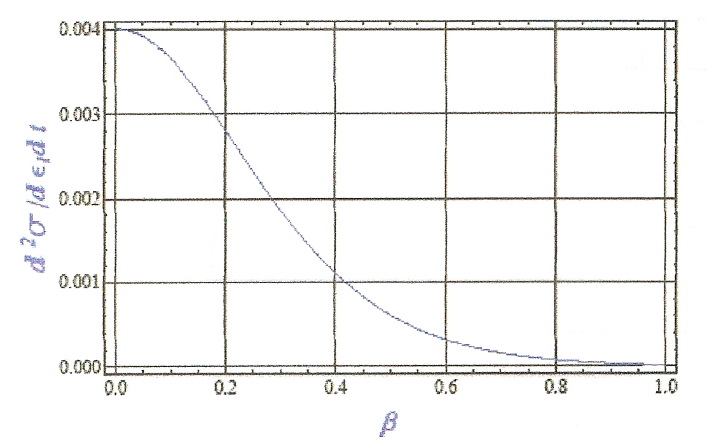
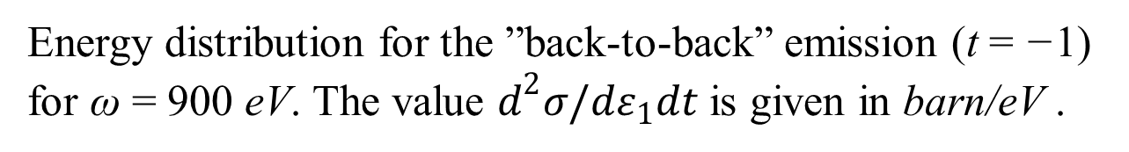
VIII.2 Dependences on recoil momentum

Slide 15
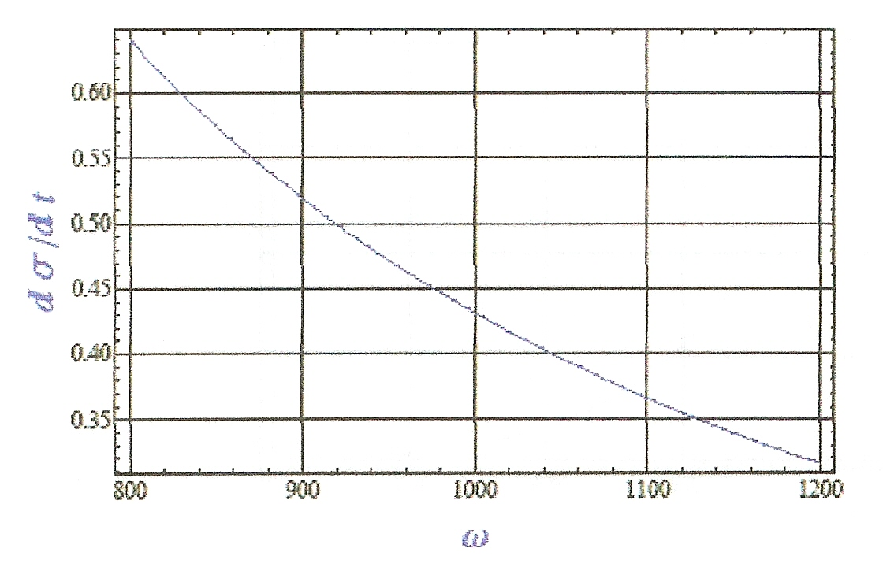
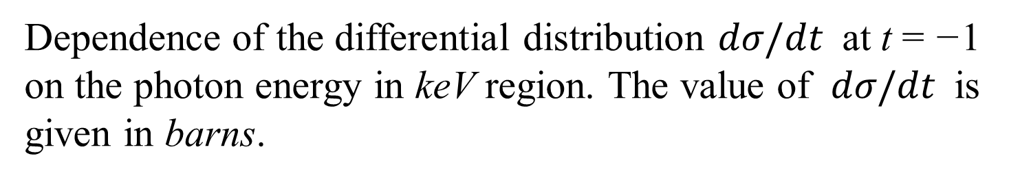
VIII.3 Dependences on recoil momentum

Slide 16
IX.1 Other ionization objects and processes
Compton ionization is a process of ionization accompanied by photon emission. Start to be comparable to photoionization at tens – hundreds KeV.
Compton scattering has strong manifestation of back-to-back ionization
Reason – angular momentum given to the target is either monopole or quadrupole, contrary to photoionizaion, that is predominantly dipole

Slide 17
IX.2 Other ionization objects and processes
Back-to-back is efficient in double-ionization of atoms by fast electrons.
Here the dominant transferred angular momentum is dipole, but the role of monopole is much bigger than in Compton and the role of quadrupole can be greatly enhanced as compared to photoionization.
Therefore the influence of quasi-free mechanism or back-to-back target electron emission could be easily amplified.

Slide 18
IX.3 Other ionization objects and processes
Two-photon ionization is a process, where incoming particles together form quadrupole or monopole.
There is no dipole action at all.
As a result the role of quasi-free mechanism or emission of back-to-back electrons is considerably enhanced.
This problem is more complex than single-electron one photon ionization, but treatable.

Slide 19
IX.4 Other ionization objects and processes
Almost non-investigated are promising objects: many-electron atoms, negative ions, molecules, metallic clusters, fullerenes and endohedrals.
In endohedrals the effect is reflection of slow outgoing electron and modification of the incoming field due to fullerenes polarization.
Back-to back is important only if both electrons has close velocities and are not too fast.

Slide 20
X. Expectations of the future
Relativistic domain, where Quasi-free mechanism absolutely dominates
This is interesting but experimentally very difficult because of increasing role of Compton and then even e+e- pair production
Study of other processes, like Compton and electron scattering
Study of other targets
Thank you very much for attention

Slide 21
References
A. Dalgarno, A. Sadeghpour, Comm. At. Mol. Phys. 30, 143 (1994) and references therein.
M. Ya. Amusia, E. G. Drukarev, V. G. Gorshkov, and M. P. Kazachkov, J.Phys. B 8, 1248 (1975).
M. Ya. Amusia, E. G. Drukarev, V.B. Mandelzweig, Phys. Scr. 72, C22 (2005)
M. S. Schoeffler et al., ICPEAC 2011, PRL 2013. (http://www.qub.ac.uk/ICPEAC2011)
Th. Weber et al., Bull. Amer. Phys. Soc. 56, n.5, 144(2011).
M. Ya. Amusia , E. G. Drukarev, and E. Z. Liverts, Phys. Rev. Lett., submitted (2011).
¹

