Slide 1
Recent Studies of Hypernuclei Formation with Electron Beams at MAMI
Patrick Achenbach
U Mainz
Sept. 2o13

Slide 2
Hypernuclear spectroscopy
Unique laboratory to investigate the YN interaction
Baryon interaction
Nuclear force
Large base of NN scattering data
Hyperon force
Limited YN/YY scattering data
Theoretical calculations
Cluster model, shell model, mean field…
Nuclear Structure
Normal / exotic nuclei
Nuclear Structure
Hypernuclei

Slide 3
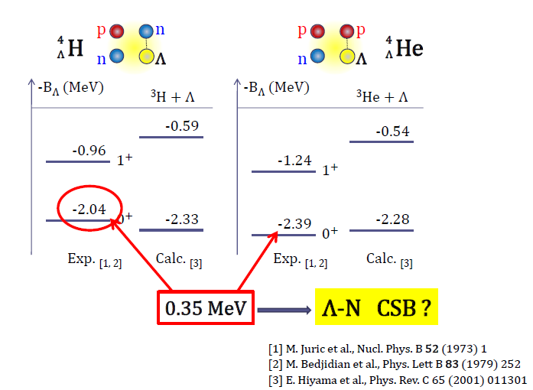
The A = 4 isospin doublet
Nucleon-hyperon interaction can be studied by strange mirror pairs
Coulomb corrections are < 50 keV for the ⁴_{Λ}H - ⁴_{Λ}He pair
Energy differences of strange mirror pair are much larger than for ³H - ³He pair
With precise spectroscopy details of NY-interaction inferred

Slide 4
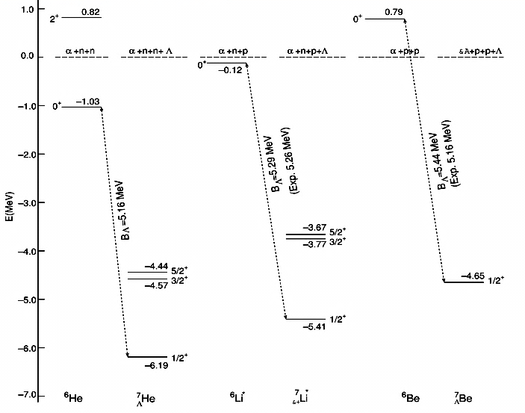
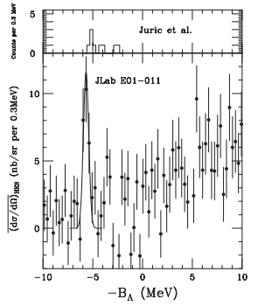

The A = 7 isospin triplet
⁷Li(e,e’K⁺)⁷_{Λ}He
[E. Hiyma, NPA 914, 130 (2013).]
[N. Nakamura et al., PRL 110, 12502 (2013).]
(with CSB)
5.36 (without CSB)
⁷He
⁷Be
Λ
Λ
⁷Li
(T=1)
Λ
Assumed CSB potential may be too naïve
Further study on A = 4 hypernuclear systems necessary

Slide 5
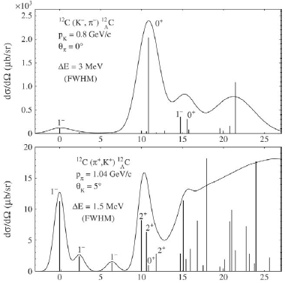
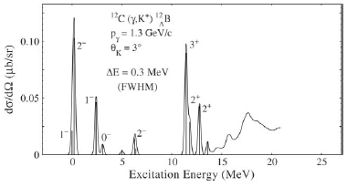
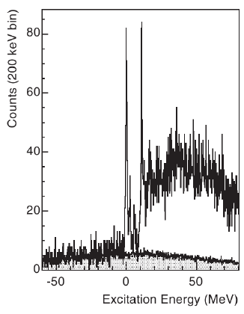
Hypernuclear production methods
[O. Hashimoto and H. Tamura, Prog. Part. Nucl. Phys. 57, 564 (2006).]
hypernucleus
quasi-free Λ
[From
J-Lab
Hall-A]
two regimes for hypernuclear and hyperfragment production:
  bound hypernuclear states
  highly excited quasi-free region

Slide 6
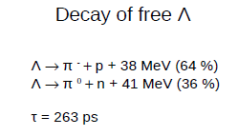
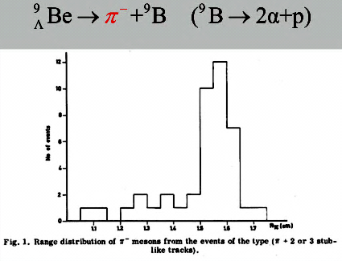
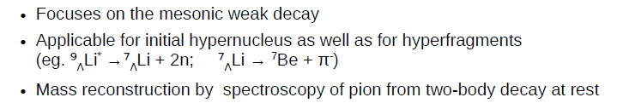
Hypernuclear decay-pion spectroscopy
e’
K⁺
⁹Be
e
p
⁹_{Λ}Li*
two-body decay ⇒
mono-energetic pions
⁷_{Λ}He
π⁻
d
fragmentation
⁷Li

Slide 7
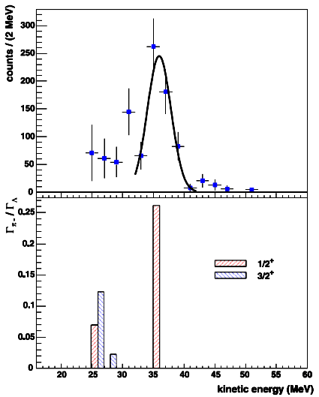
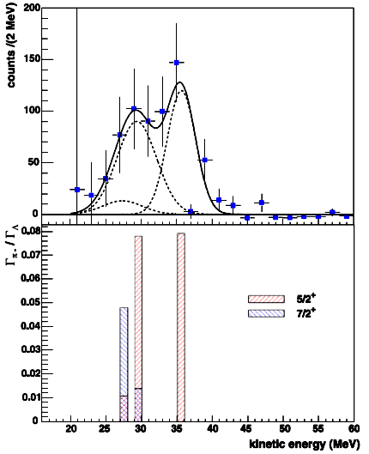
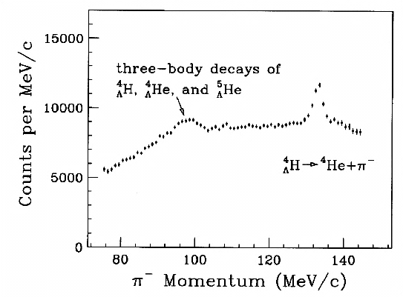
Examples of π⁻ spectroscopy
⁷_{Λ}Li
¹¹_{Λ}B
KEK-E287, E326
beam: stopped K⁻
target: thick ⁷Li
FINUDA Coll. and A. Gal, Phys Rev. B 681 (2009) 139
A. Gal, Nucl. Phys. A 828 (2009) 72
Severe limitations by statistics or momentum resolution
intense and high quality primary electron beam
(R > 10¹⁴ Hz, ∅ < 100 μm)
+
thin target (~10 mg/cm²)
decay π⁻ spectroscopy
with high resolution
and high accuracy

Slide 8

Goals of decay pion spectroscopy
Masses with high accuracy for light hypernuclei:
  ³_{Λ}H, ⁴_{Λ}H, …, ¹¹_{Λ}B, ¹²_{Λ}B
Determination of charge symmetry breaking (CSB) effects:
(⁴_{Λ}H ↔ ⁴_{Λ}He), (⁶_{Λ}He ↔ ⁶_{Λ}Li), (⁷_{Λ}He ↔ ⁷_{Λ}Li* ↔ ⁷_{Λ}Be), …
Search for hypernuclei near the neutron drip line:
  ⁶_{Λ}H, ⁷_{Λ}H, ⁸_{Λ}H …
  important information for Λ−Σ coupling [cf Hiyama]
  ⁶_{Λ}H: the “superheavy hyper-hydrogen – puzzle” [cf Fukuda and Feliciello]
pion momentum resolution ~ 100 keV/c
→ mass resolution ~100 keV/c² (FWMH)
→ accuracy of a few 10 keV/c²
Notes:
,

Slide 9
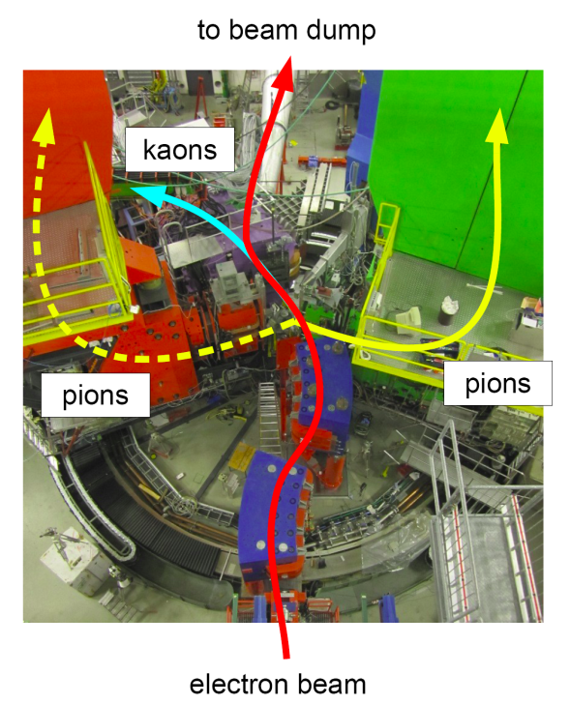
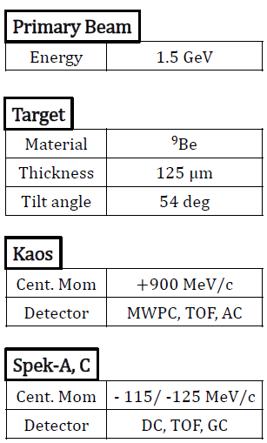
Decay-pion spectroscopy at MAMI

Slide 10
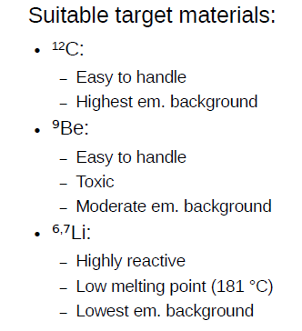
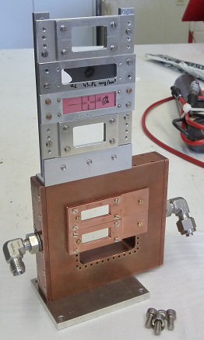
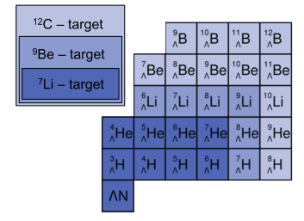
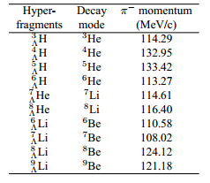
Accessible hypernuclei
missing mass sepctroscopy

Slide 11
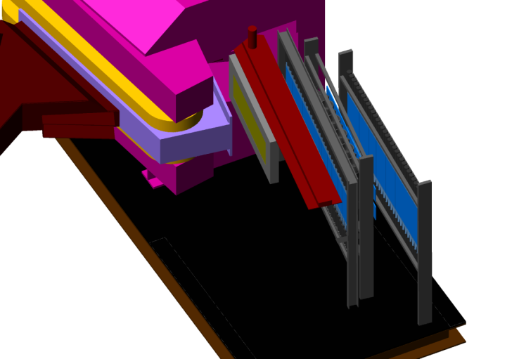
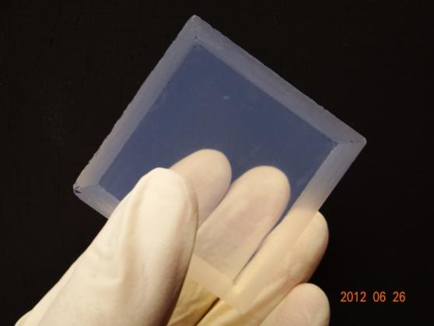
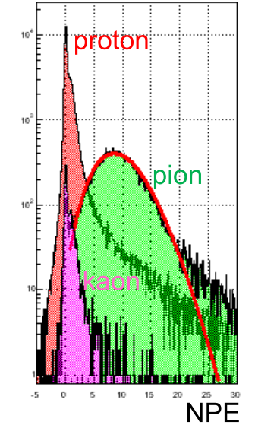
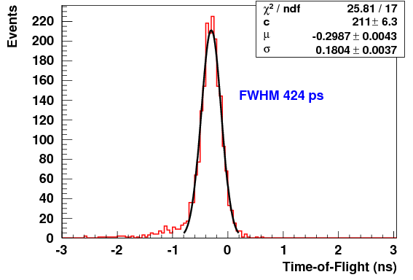
Particle detection system in KAOS
tracking system
Cherenkov system
TOF system
FWHM =
400 ps
time-of-flight reso-lution with TOF walls
pion detection ε > 95%
by aerogel Cherenkov

Slide 12
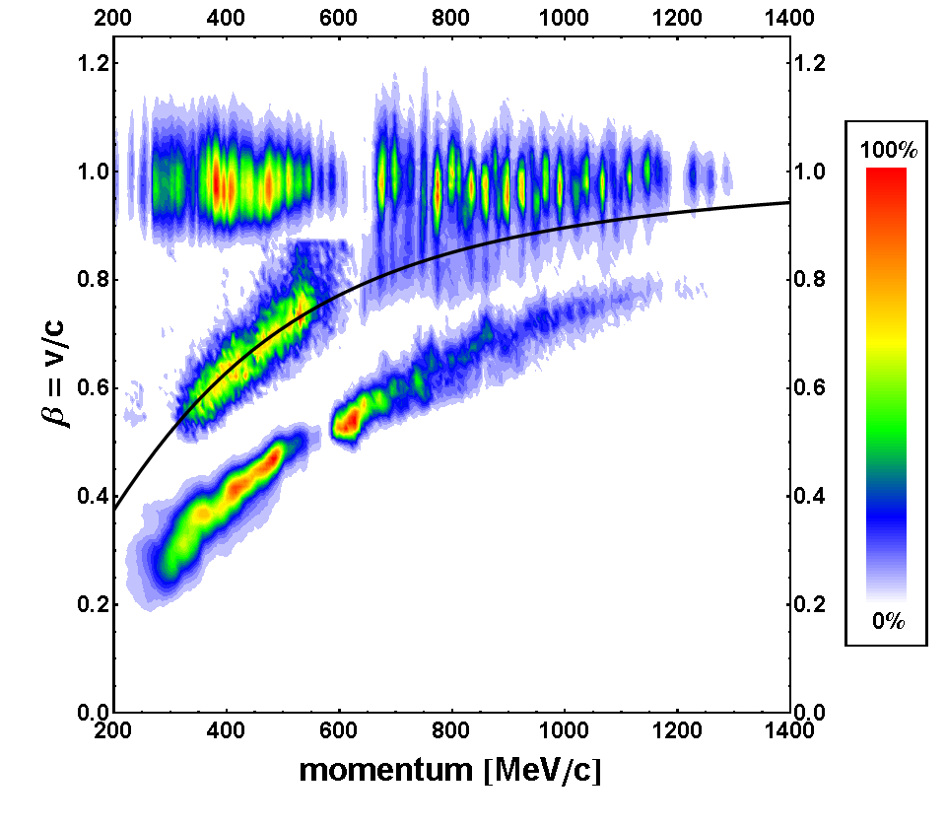
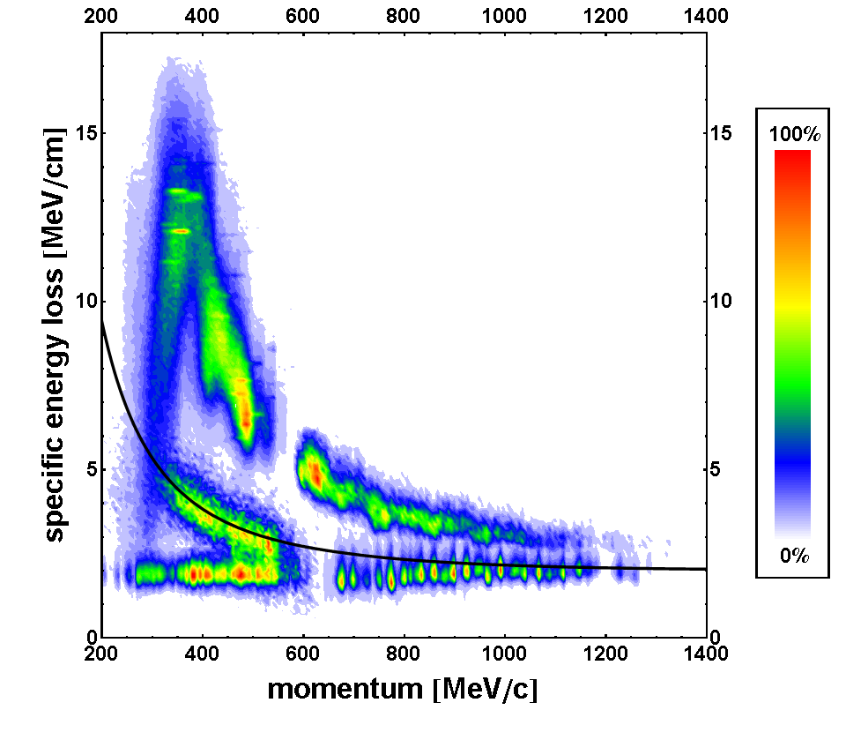
Kaon identification using TOF system
low / high momentum setting
low / high momentum setting
pions
protons
kaons
kaons
protons
pions
KAOS can cover 200–1300 MeV/c in only 2 settings
clean kaon identification by TOF at low momenta
Cherenkov information used for high momenta

Slide 13
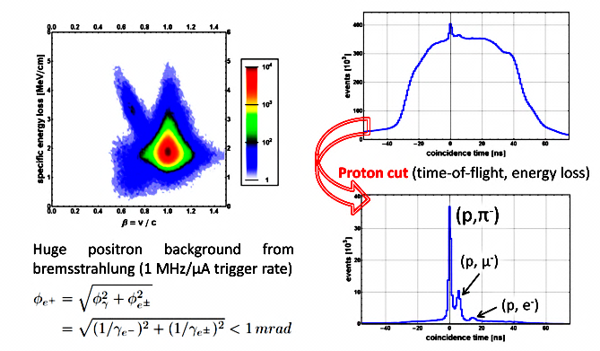
Pioneering experiment 2o11
hadrons
positrons
KAOS can be operated at zero-degree scattering angle
PID suffers from high positron background

Slide 14
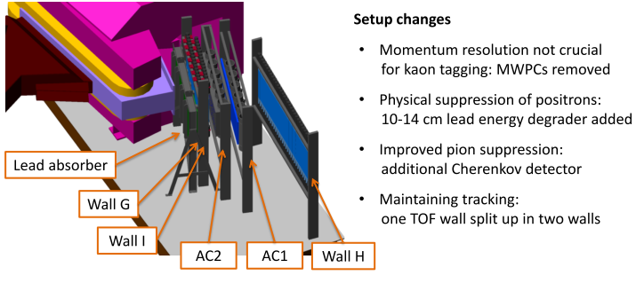
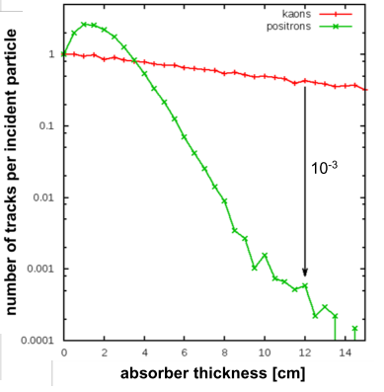
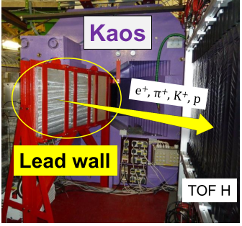
Dedicated experiment 2o12

Slide 15
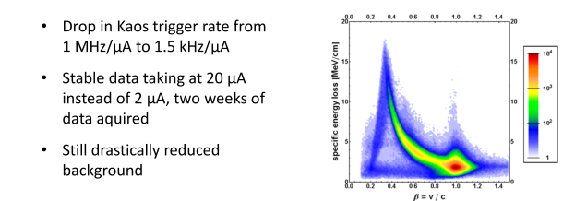
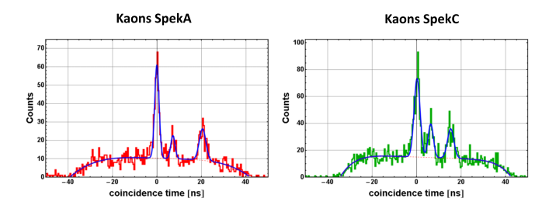
Decay pion detection
Decay pions from strange hadrons
(K,π)
(K,π)
(K,μ)
(K,μ)
(K,e)
(K,e)

Slide 16
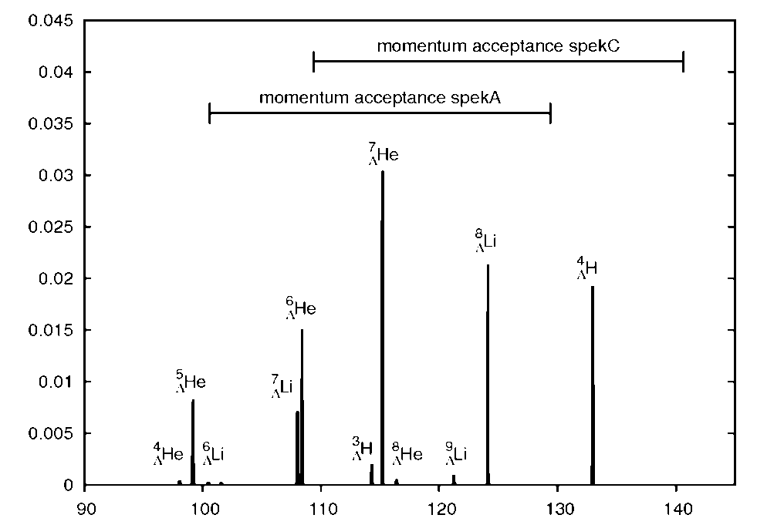
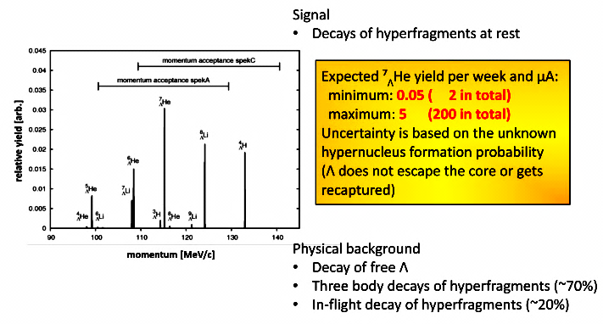
Signal interpretation

Slide 17
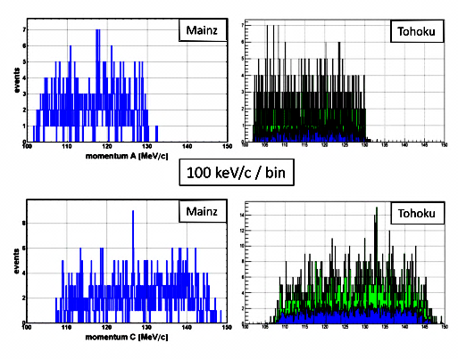
Examples of decay-pion spectra
To minimize human bias two independent analyses performed:
Final spectra to be released by end of year

Slide 18
Conclusions
Two current questions in few-body physics:
Decay pion spectroscopy gives access to ground-state masses of hypernuclei and could answer the questions!
At MAMI pioneering experiments were followed by an experiment with a dedicated setup:
  Clean tag on strangeness production at zero-degree
  Clean pion sample from weak decays of hyperons retrieved
  Current analysis limited by statistics → continuation with luminosity increase by one order of magnitude planned
How can we understand the A = 4 and A = 7 hypernuclei?
Is the superheavy hyper-hydrogen nucleus bound?

Slide 19
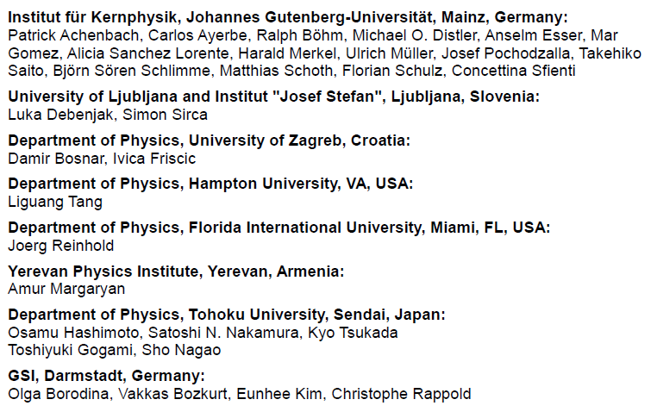
A1 Hypernuclear Collaboration

